Slide 1
Briefing on the
Interregional Connectivity Study and Advanced Guideway System Feasibility Study
Transit and Rail Advisory Committee
April 2012

Slide 2
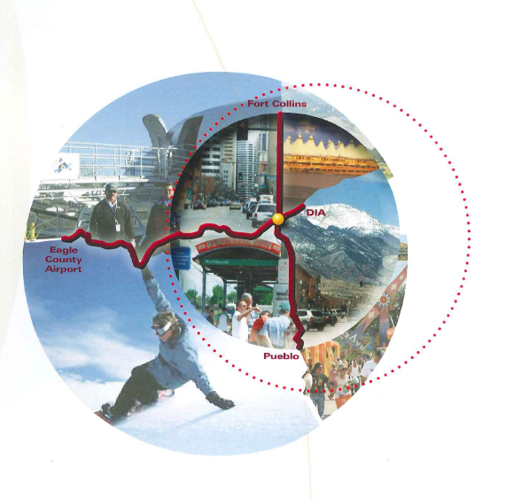
Introduction
Interregional Connectivity Study (ICS)
  Provide preliminary recommendations for
  HSIPR
  Under contract with CH2M Hill
Advanced Guideway System (AGS) Feasibility Study
  Part of the I-70 Mountain Corridor Consensus Recommendation and PEIS Preferred Alternative
  Under contract with TYPSA | Aztec and sub Jacobs
Studies done concurrently, leveraging resources

Slide 3
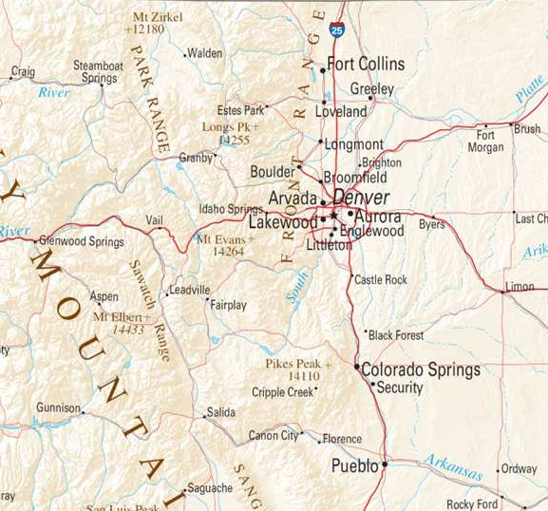
ICS Project Approach
Study Area:
  Fort Collins to Pueblo
  DIA to Jefferson County
Connect with RTD FasTracks Program
Focuses on Alignment, Technology, Funding/ Financing
Includes Travel Demand Forecasting for both the ICS and AGS study
Notes:
Fort Collins to I-25 in the NFR Region is defined by the North I-25 FEIS & ROD
DIA/E-470 to Jefferson County in the Denver Region is defined by DIA and connectivity with AGS Study

Slide 4
ICS Project Approach
Key Milestones:
  Team Charter and Visioning
  Define Corridor Vision and Evaluation Criteria for Alternative Scenarios; Develop Scenarios
  Conceptual Screening of Scenarios
  Detailed Evaluation of Scenarios
  Recommendations
18 month schedule: April 2012 – September 2013
Notes:
Fort Collins to I-25 in the NFR Region is defined by the North I-25 FEIS & ROD
DIA/E-470 to Jefferson County in the Denver Region is defined by DIA and connectivity with AGS Study

Slide 5
ICS Project Approach
Includes Stakeholder Involvement
  Context Sensitive Solutions Process
  Workshops
  Website
Other Key Tasks
  Scenario Development Process
  Demand and Revenue Estimation
  Capital and O&M Cost Estimation
  Financial Analysis
  Societal/Environmental Impact Analysis
  System Planning Recommendations
Notes:
Fort Collins to I-25 in the NFR Region is defined by the North I-25 FEIS & ROD
DIA/E-470 to Jefferson County in the Denver Region is defined by DIA and connectivity with AGS Study

Slide 6
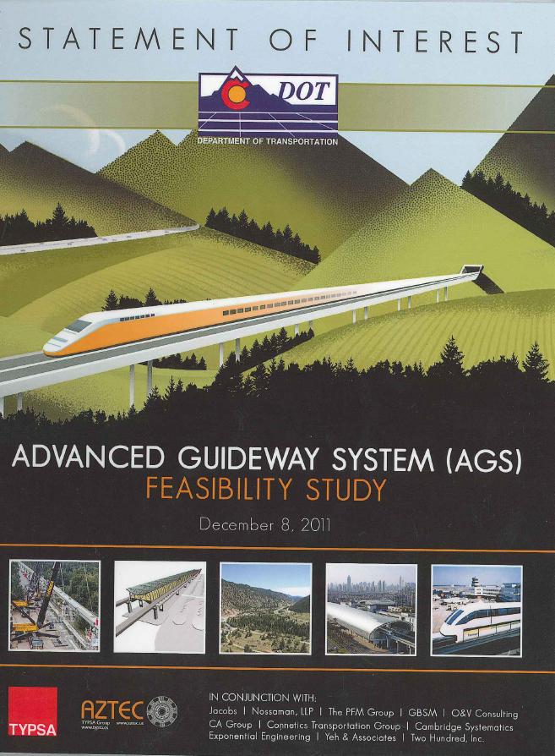
AGS Project Approach
Study Area: Jefferson County to Eagle County Regional Airport
Builds upon RMRA study and I-70 PEIS
Determine Feasibility and Financial Options of AGS on I-70
Focuses on alignment, technology, funding/financing
Follows I-70 Mountain Corridor CSS Process
Notes:
TYPSA/Aztec has over 3,000 miles of high-speed transit implemented globally
Jacobs staff include individuals who recently completed the Programmatic EIS and ROD – recent local knowledge

Slide 7
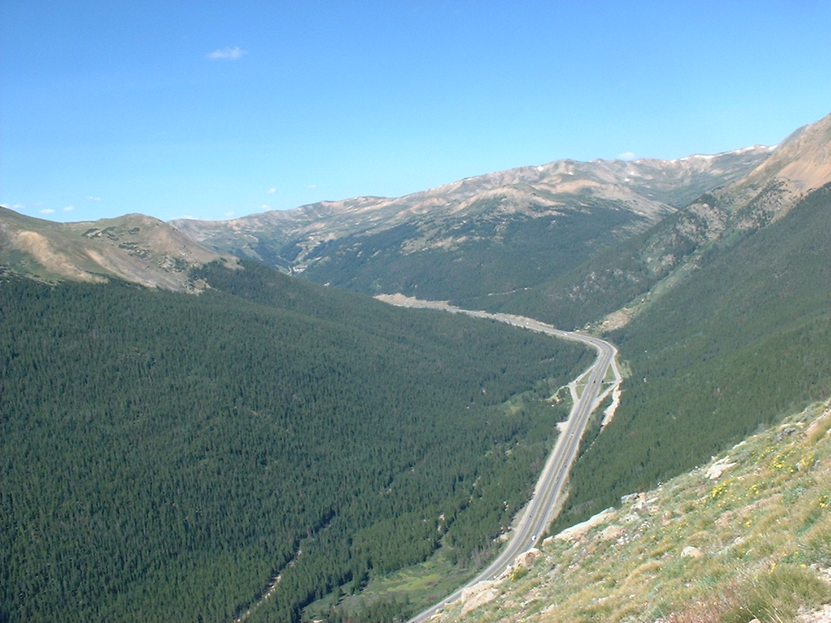
AGS Study Tasks
1 Detailed Work Plan
2. Stakeholder Involvement Plan (includes public outreach)
3 Refine and Advance Project Definition and Criteria
4. Industry Outreach & Technology Review
5. Preparation of RFQ, RFP and Proposal Solicitation
6. Evaluation of Selected Industry Elements and Feasibility of Findings
7. Financial Analysis
8. Draft AGS Study
9. Final AGS Study

Slide 8
AGS Schedule
Month 1-2: Project Initiation & Define Performance
Month 3-4: Industry Outreach
Month 5-6: RFQ Process with Industry
Month 7-13: RFP Process with 3 Industry Finalists
Month 14-18: Review Industry Proposals and Document Findings of the Study
18 month schedule: April 2012 – September 2013
Notes:
Month 3-4 is the time to create a “buzz” of interest in the project and to begin dialogue to generate a successful RFQ and RFP process

Slide 9

ICS & AGS Coordination
Stakeholder Outreach
Project Team Interface
Scenario Evaluation Process
Travel Demand Forecasting
Capital Cost Estimation
O&M Cost Estimation
Revenue Estimation
Funding and Financing Strategies

Slide 10
ICS, AGS & Co-Development Project

Slide 11
Relationship to Planning
State Freight & Passenger Rail Plan
Freight
Advanced Guideway System (AGS)
Passenger
Interregional Connectivity Study (ICS)
Statewide Transit Plan
MPO & TPR Approvals
Statewide Transportation Plan

Slide 12
Questions & Discussion

