Slide 1
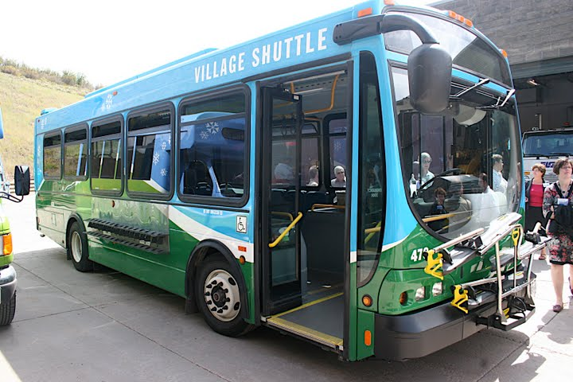
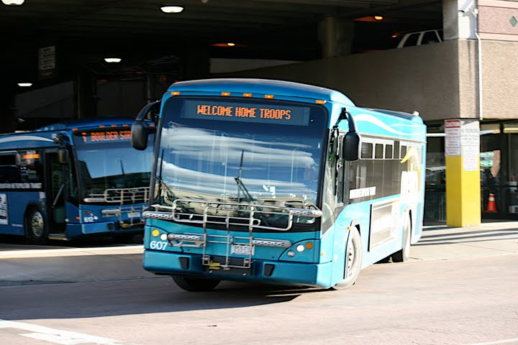
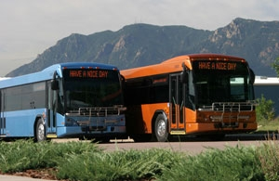
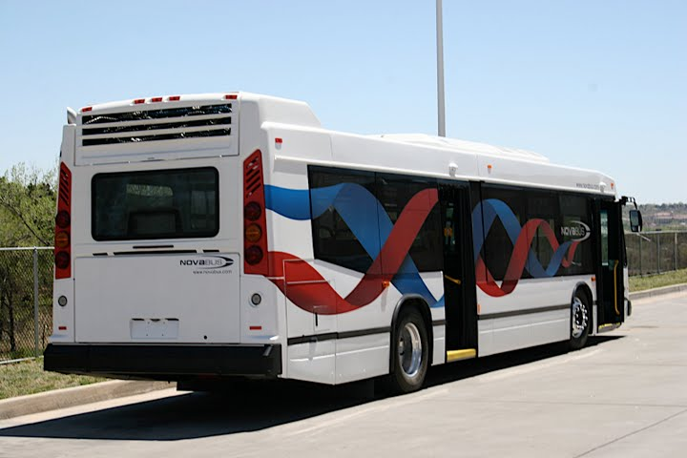
Policy Considerations for Interregional Commuter Bus Service
TRAC Meeting
May 11, 2012

Slide 2
General Concepts
Increase mobility and connectivity between regions
Increase interregional access to employment
Provide energy-conserving options to long-distance SOV commuting
Fill in the gaps between transit systems

Slide 3
Service/Mobility Concepts
Service between transit systems
Provides connectivity to local services
Not intended to replace service within existing RTA/Agency service areas (e.g., Boulder-Denver, Glenwood-Aspen, Fruita-Grand Junction)
Start small with options for expansion
Initially provide am/pm peak-period service
Expand based on demand and finances
Manage by performance
Develop criteria to determine eligibility for operating assistance
Use performance measures to adjust service over time

Slide 4
FASTER Funding Concepts
CDOT owns buses (FASTER capital funds)
CDOT contracts for service
IGAs with public providers
Direct contracts with private providers
FASTER state transit funds used for O&M

Slide 5
Funding Scenarios
Allocate $2M (approximately 22%) of FASTER funds for interregional bus operations
At what level does CDOT fund service routes?
20% to 50%? More? Less?
Requires revision to TC Resolution and FASTER Guidance
Match
Local/Regional – 20% to 40%
In-kind, fare box, other
Federal – 20% to 40%
Possible match requirements are adjusted
Start-up vs. on-going

Slide 6
Potential Routes
Colorado Springs – Denver – Fort Collins
Possible extensions to Pueblo and/or Greeley
Grand Junction – Glenwood Springs
Possible extension to Dotsero
Conceptual criteria for other routes:
High congestion corridors
High ridership corridors
Future rail corridors
Network connectivity (connections to activity centers, metro areas, other routes, gaps in service, etc)

Slide 7






Develop Partnerships
Potential Partners:
MPOs and TPRs
Local Jurisdictions
Local Transit Providers
RTAs
Others
Develop IGAs
Operations
Maintenance
Others

Slide 8
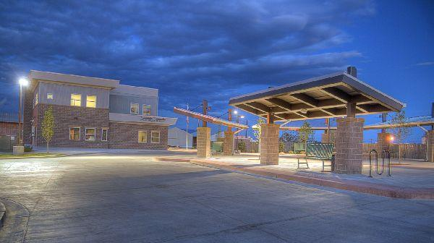
Other Service Issues
Number of Buses
Hours of Operation
Frequency of Service
Number of Trips
Number and Location of Stops
Fare structure
Bus Maintenance and Storage
Marketing

