Slide 1

Tutorial for Completing CDOT Form 473/474 Using Adobe Sign
Introduction and General Instructions

Slide 2
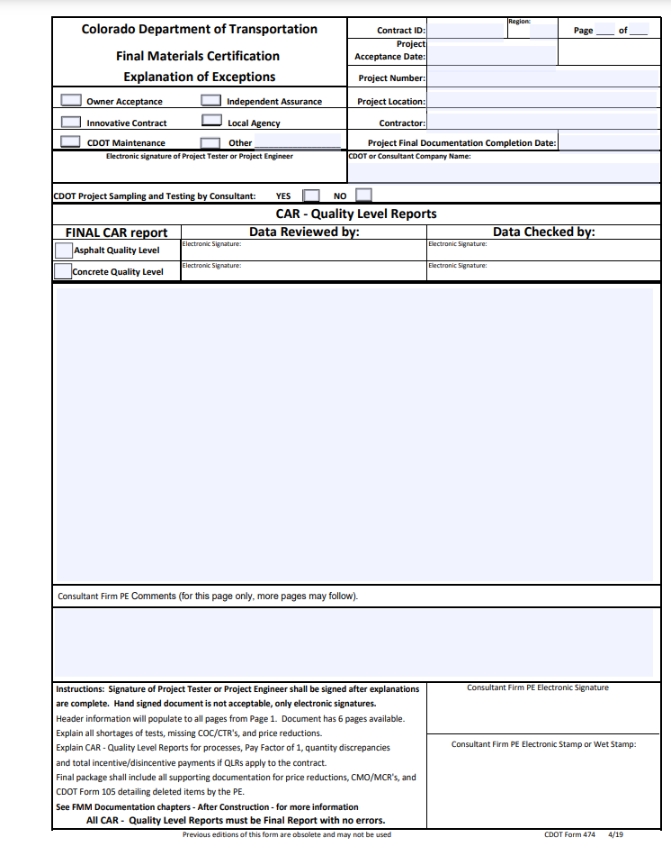
This form and process:
- Will be implemented July 1st, 2021
- Allow users to document that
sampling and testing for a project
conforms with plans and
specifications
- Have been created to maintain an
efficient and creditable method of
managing and collecting CDOT
project documentation

Slide 3
- Craig Wieden
- Todd Mayhew
- Darren Phipps
- Jennifer Kelly
- Lisa Wisner
- Patrick [RS] Murphy
- Paul Davila
- Melody Perkins
- Edward Trujillo
- Hailey Goodale
- Brian M. Kelly
- Charles Z. Smith
- Cheryle Clark
Only those designated as Region Group Members may initiate forms. Those designees are listed below:
If you require form initiation capabilities, please contact OIT.

Slide 4
This training will cover using Adobe Sign to complete Form 473/474 for the following roles:
- Form Initiator
- Independent Assurance Tester
- Region Materials Engineer
- Project Tester
- Consultant Engineer
- Project Engineer
- Resident Engineer
- Finals Material Documentation Administrator or Finals Coordinator

Slide 5
Things to Note:
The form will move through the workflow outlined on the previous slide.
The form will not move onto the next recipient until it is completed by the previous recipient in the workflow.
Once attachments are put into the form, they will be amended to the bottom of the document for viewing by proceeding recipients.

Slide 6
Things to Note:
This form can be completed on a mobile device as well as a PC. Written instructions for completion on both a PC and a mobile device are contained in the 2022 Field Materials Manual.
If you wish to exit the form in the middle of filling it out, you may, and your progress will be saved. To return to the form, open the email containing the “Review and Sign” link and follow the instructions to complete and sign the form.

Slide 7
In this introduction video, I will walk you through the general steps of completing this form using Adobe Sign.
However, completing the form looks slightly different for every role. After watching this video, please watch the training video created for your specific role.
Notes:
Once the form has been initiated, the first recipient will receive the form via email.
To begin filling out your portion of the form, open the email and click “Review and Sign”.
This will open up Adobe Sign and allow you to fill out the required fields for your role’s section of the document.
Red asterisks indicate fields that are required.
To begin, click the yellow “Start” tab on the left-hand side of the screen.
This will bring you to your first field. Enter the information requested and click the next yellow input box or the “Next” tab on the left to move to the next field.
Notice the gray dialog boxes that appear when you click on each field. This box will provide more information on what exactly is required for each field to include attachments, formatting considerations, and more.
Complete all fields required for your section. Once all fields have been completed, scroll to the bottom of the screen and click “Click to Sign”.
You will receive a notification that your portion of the form has been completed and the form will be sent to the next recipient in the workflow.

Slide 8
In this introduction video, I will walk you through the general steps of completing this form using Adobe Sign.
However, completing the form looks slightly different for every role. After watching this video, please watch the training video created for your specific role.
Notes:
First you will get an email from the form initiator requesting you fill out the form.
Go ahead and open up the email and click the “Review and Sign” button.
This will take you to your section of the form.
“Start” and “Next” arrows will move users through the form.
Click on “Start” and fill out the blocks highlighted in yellow.
The blue dialog that pops up when you hover over a field will display more information on what exactly the field requires.
Red asterisks indicate mandatory entries. You cannot submit the form without completing each section containing an asterisk.
If you have documents to attach, click the “Click to Attach” field. A file explorer will pop up allowing you to find and select the appropriate attachment.
When you are ready to sign, click the “Click to Sign” field. A box will pop up allowing you to type, draw, upload an image, or use your mobile device to sign your name. Once your signature is complete, click “Apply”.
Once all fields are complete and your signature is attached, click the “Click to Sign” button at the bottom of the screen.
You will receive a message notifying you that your portion is complete and letting you know who the form will be sent to next. The document can now be viewed and/or downloaded to include the information in the forms as well as any attachments. Each party will also get an email when the form is fully completed with a link to download the filled-out form and all attachments.

Slide 9
Thanks for watching!
If you need assistance with this form, please contact Ed Trujillo at edward.trujillo@state.co.us

