Slide 1
Buy America Requirements and Documentation

Slide 2
Presentation Outline
Introduction
Requirements
Non-exempt Products
Waivers
Exempt Products
Foreign Steel
Documentation
  Requirements
  Submittal and Access
  Examples
Checklist

Slide 3



Introduction
There have been no changes to CDOT’s Buy America (BA) requirements which are outlined in the Field Materials Manual under Special Notice to Contractors, under Section 4.
These Requirements may also be found in Subsection 106.11 of the Standard Specifications as referenced in 23 CFR Part 635.410.

Slide 4
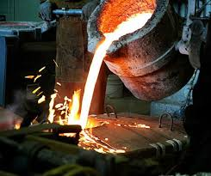
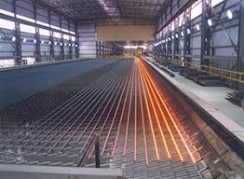
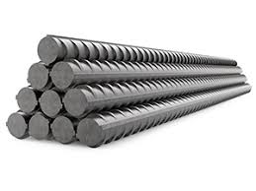

Requirements
Buy America requires the use of domestic steel and iron in Federally funded construction projects.

Slide 5
Requirements
All manufacturing processes, including the application of a coating, for all steel and iron products permanently incorporated in the work shall have occurred in the United States of America.
All manufacturing processes are defined as “processes required to change the raw ore or scrap metal into the finished, in-place steel or iron product”.

Slide 6
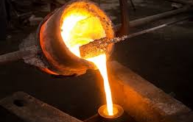
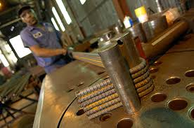
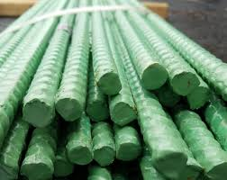
Requirements
Processes include but are not limited to:
    Initial melting and mixing
    Fabrications
    Alterations to the size or shape
    Chemical modifications
    Coatings (galvanized or epoxy)
    Any other processes prior to arriving at a project.

Slide 7
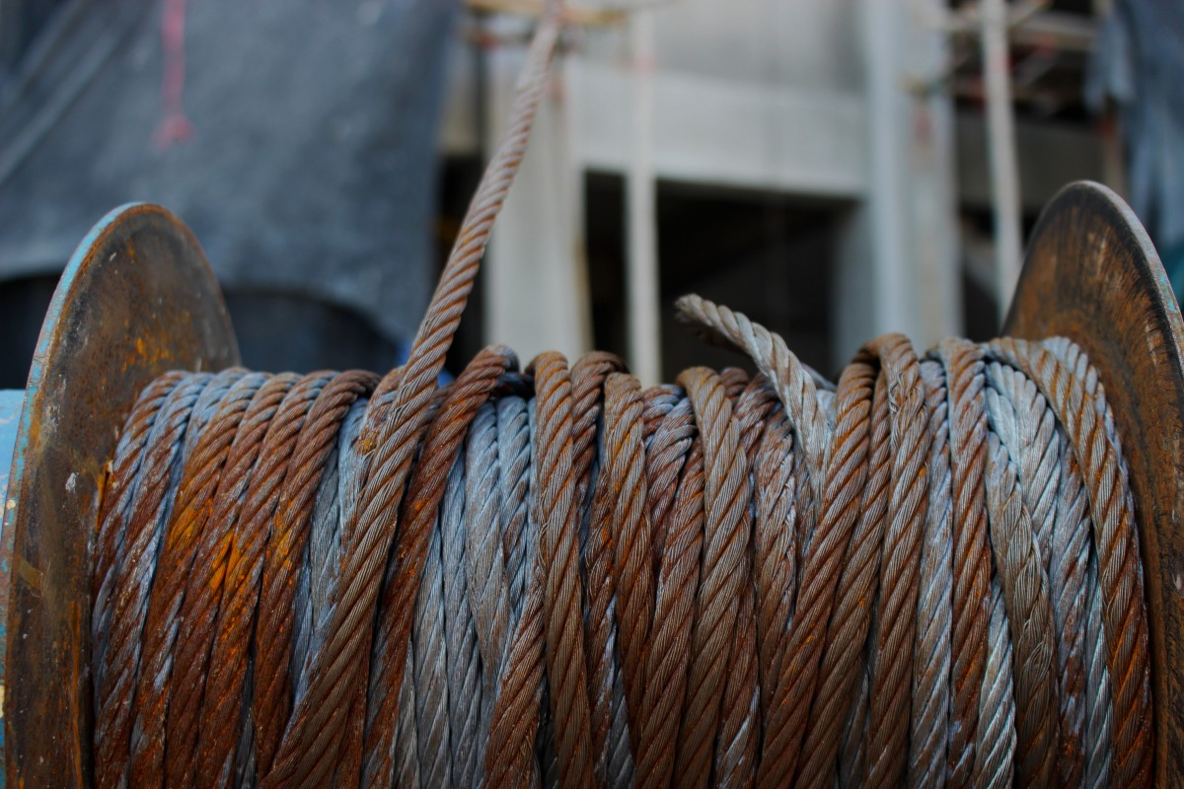
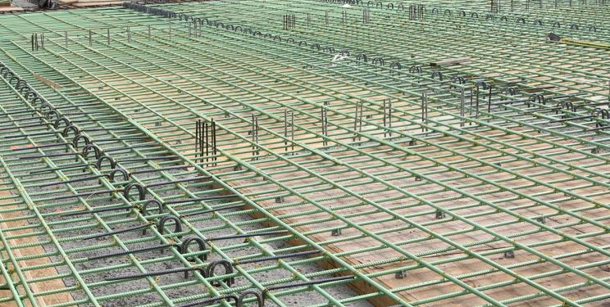
Requirements
All processes must occur in the United States. At no time may an item cross the US border for any reason.
Scenario: A reinforcing bar in melted, sized and shaped in Michigan. The bar then is sent to Canada for epoxy coating and sent back to the US. This steel no longer meets the Buy America requirement and may not be permanently incorporated into a Federally funded project.

Slide 8
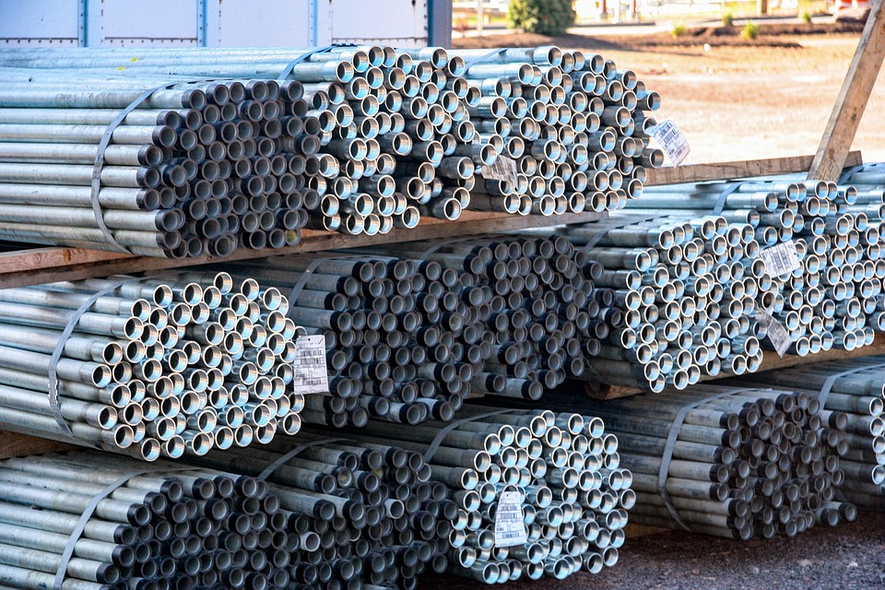
Requirements
Note:
Buy America strictly limits, but does not eliminate, the amount of foreign steel used on Federally funded construction projects. Foreign steel will be discussed later in this presentation.
The following slides contain examples of products subject to Buy America requirements.

Slide 9
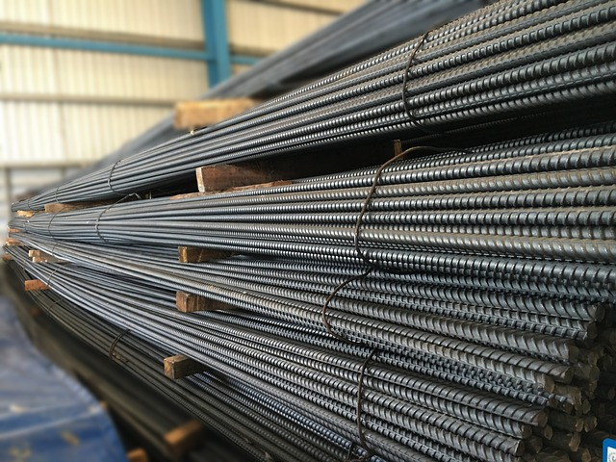
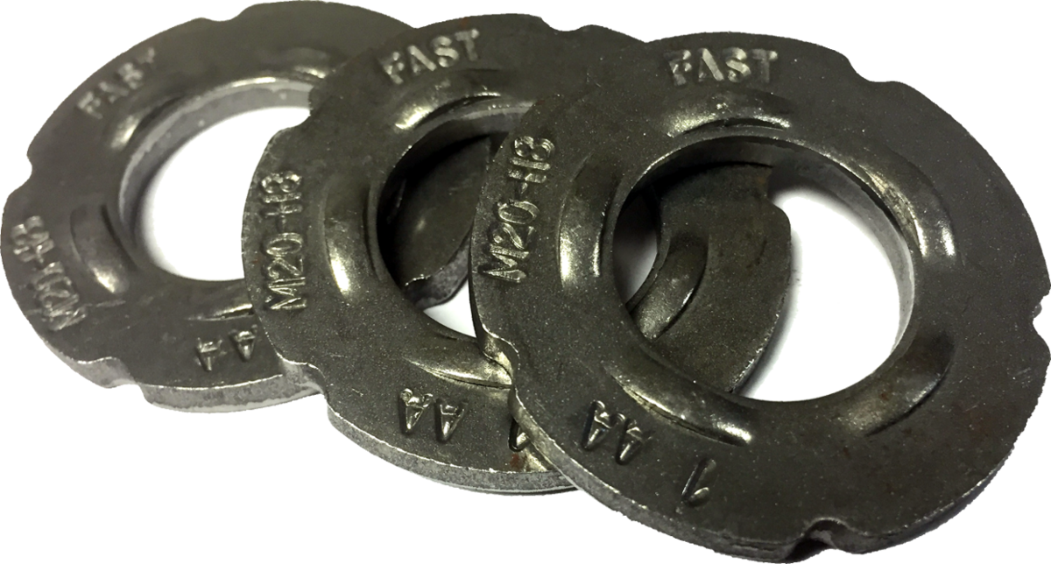
Non-Exempt Products
Examples of products subject to Buy America requirements include, but are not limited to the following:
steel or iron products used in pavements, bridges, tunnels or other structures, which include, but are not limited to, the following: fabricated structural steel, reinforcing steel, piling, high strength bolts, anchor bolts, dowel bars, permanently incorporated sheet piling, bridge bearings, cable wire/strand, pre-stressing / post-tensioning wire, motor/machinery brakes and other equipment for moveable structures;

Slide 10
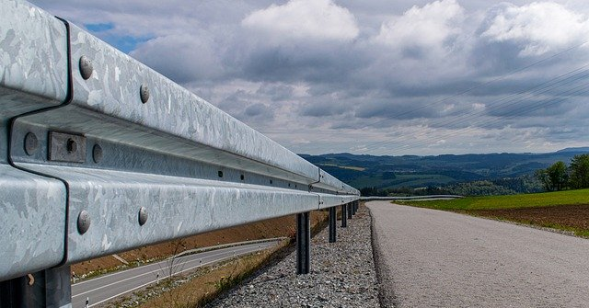
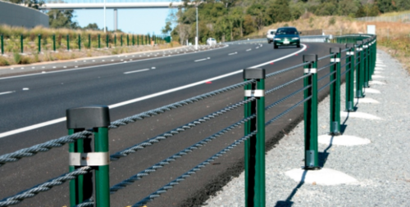
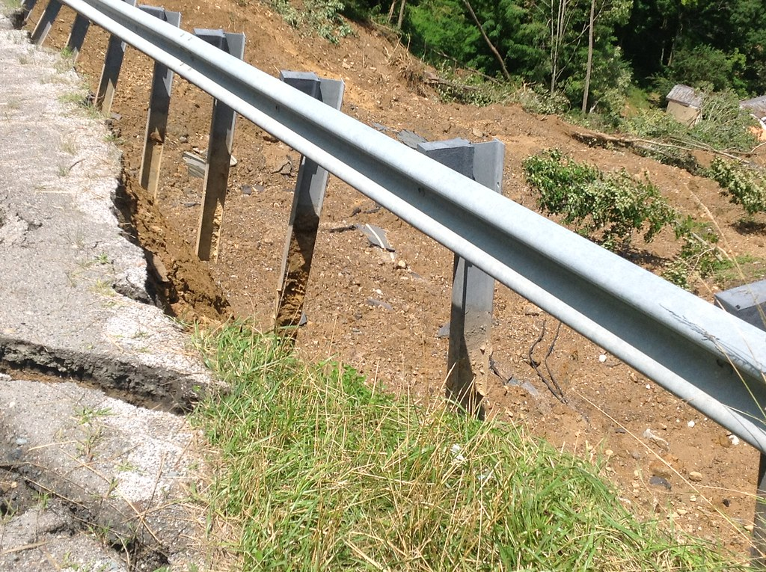
Non-Exempt Products
Examples of products subject to Buy America requirements include, but are not limited to the following:
guardrail, guardrail posts, end sections, terminals, cable guardrail;

Slide 11
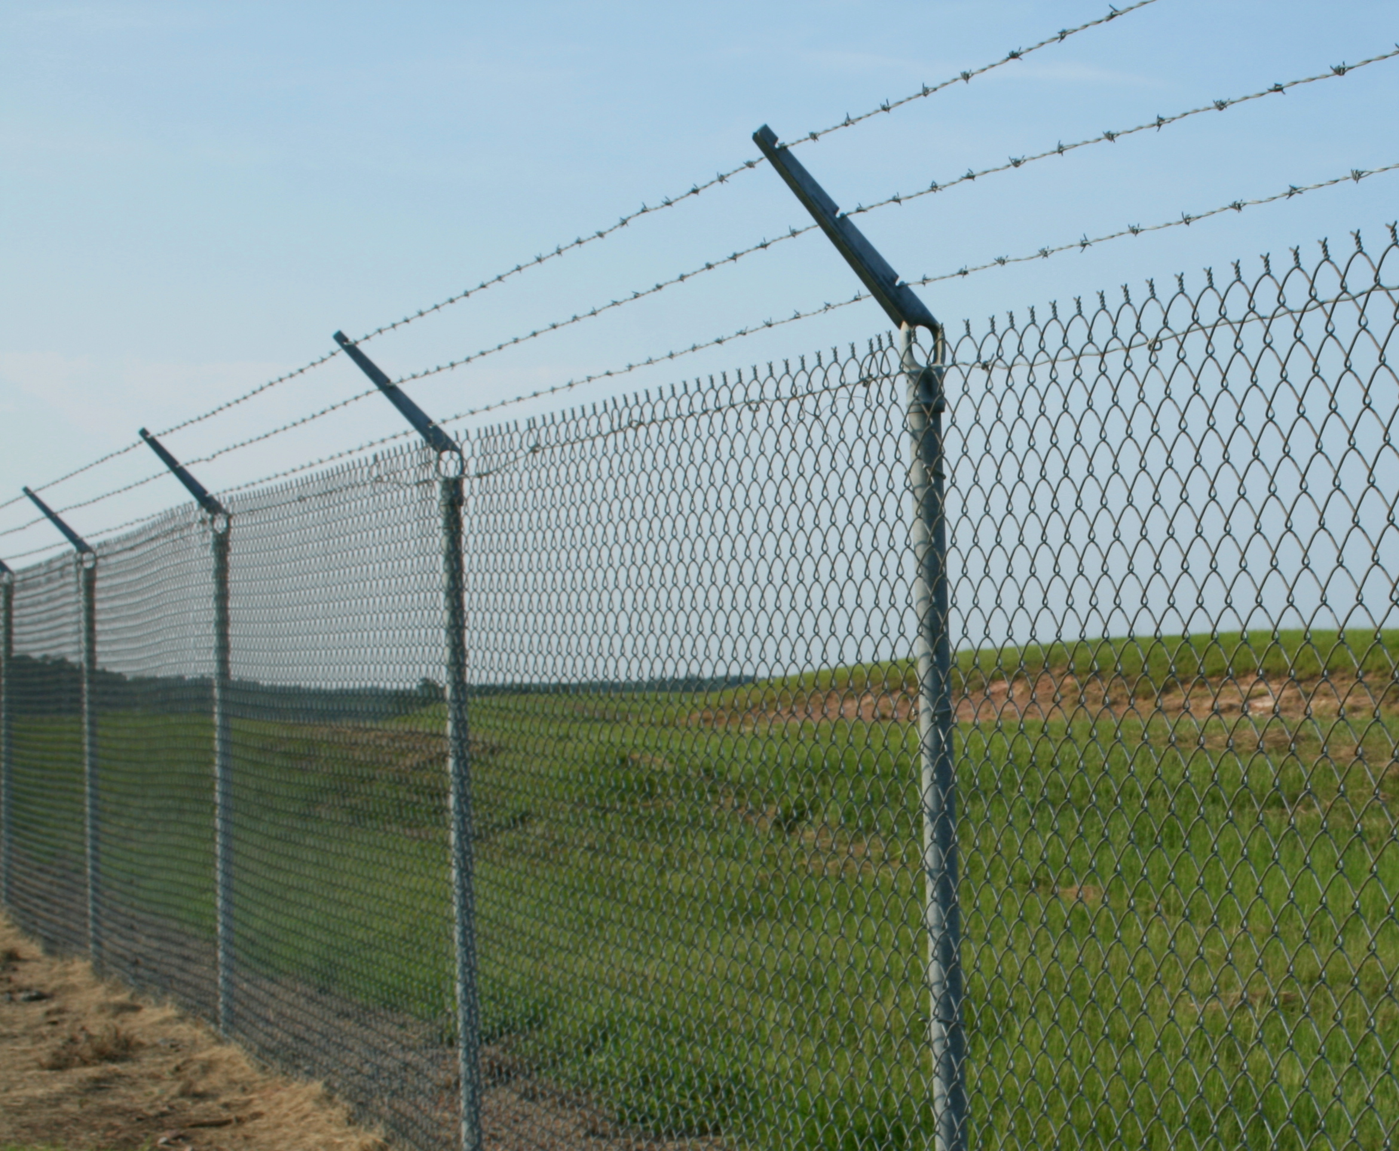
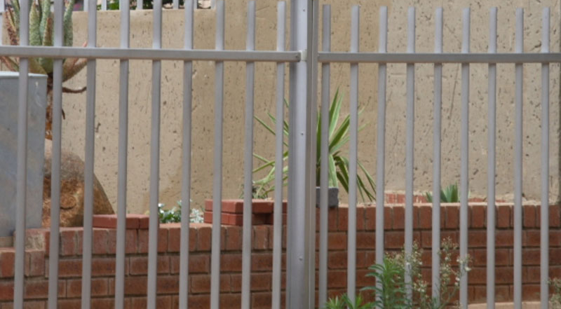
Non-Exempt Products
Examples of products subject to Buy America requirements include, but are not limited to the following:
steel fencing material, fence posts;

Slide 12
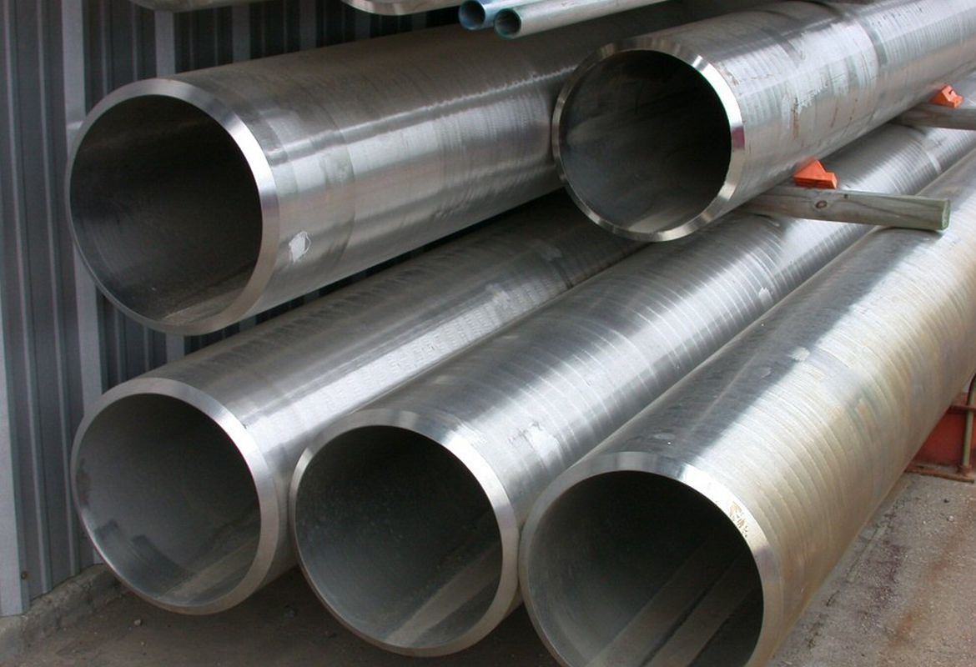
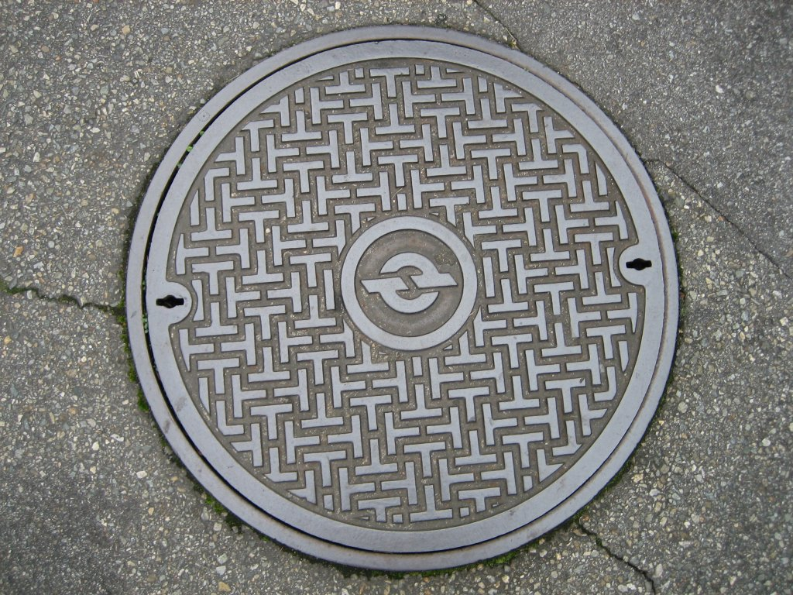
Non-Exempt Products
Examples of products subject to Buy America requirements include, but are not limited to the following:
steel or iron pipe, conduit, grates, manhole covers, risers;

Slide 13
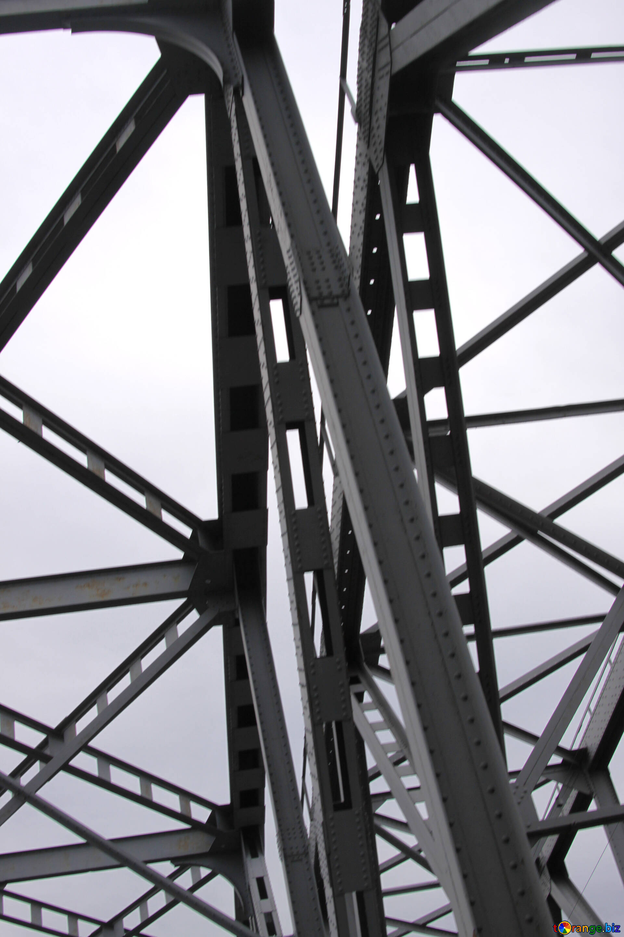
Non-Exempt Products
Examples of products subject to Buy America requirements include, but are not limited to the following:
mast arms, poles, standards, trusses, or supporting structural members for signs, luminaires, or traffic control systems; and

Slide 14
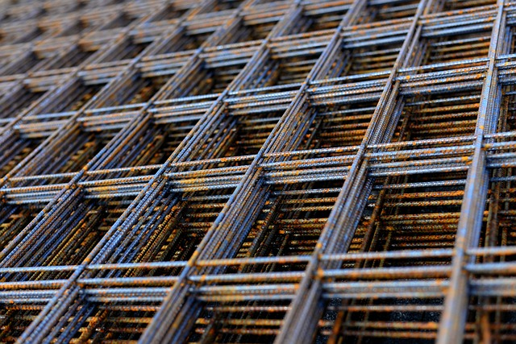
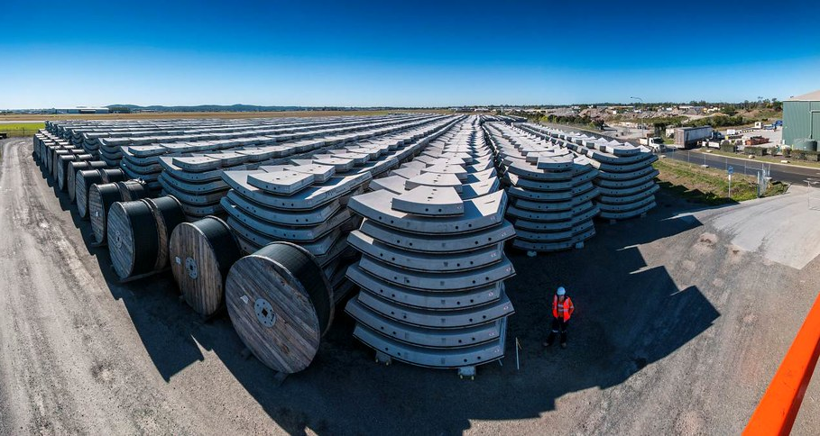
Non-Exempt Products
Examples of products subject to Buy America requirements include, but are not limited to the following:
steel or iron components of precast concrete products, such as reinforcing steel, wire mesh, and prestressing or post-tensioning strands or cables.

Slide 15
Waivers
CDOT may provide waivers for manufactured products containing less than 80% steel or iron. The following slides contain examples of these products.
  A request for waiver, accompanied by supporting information, must be submitted in writing to the Regional Federal Highway Administrator (RFHWA) through the FHWA Division Administrator. A request must be submitted sufficiently in advance of the need for the waiver in order to allow time for proper review and action on the request. The RFHWA will have approval authority on the request.
When domestic steel products are available, meeting the contractor’s schedule should not be the basis for requesting a Buy America waiver.

Slide 16
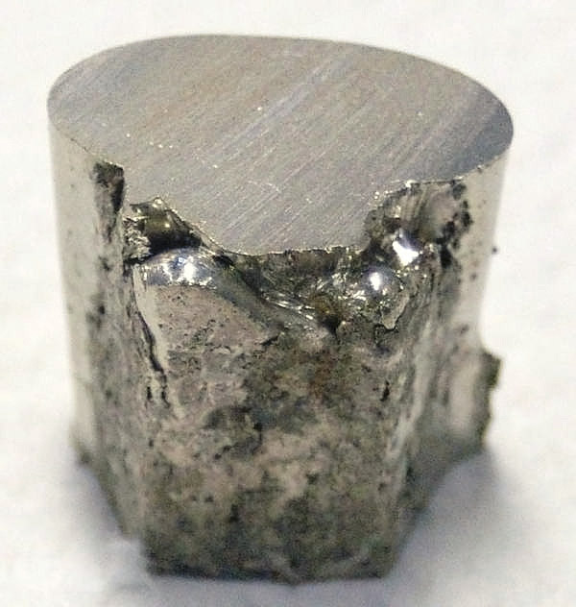
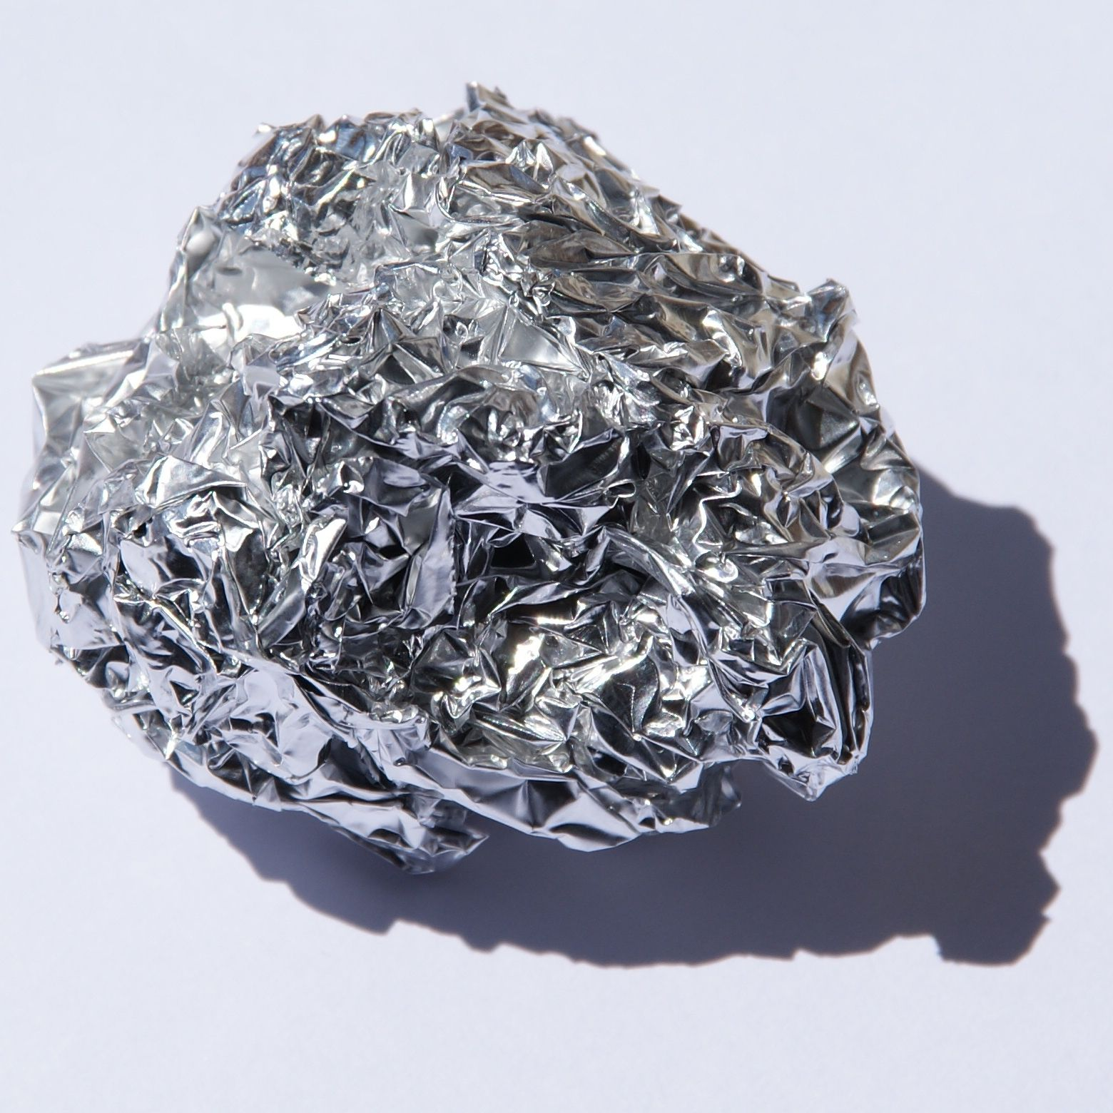
Exempt Products
Examples of products subject to Buy America requirements include, but are not limited to the following:
Products made of material other than steel or iron aluminum, copper, brass, nickel, etc.);
Cabinets, covers shelves;

Slide 17
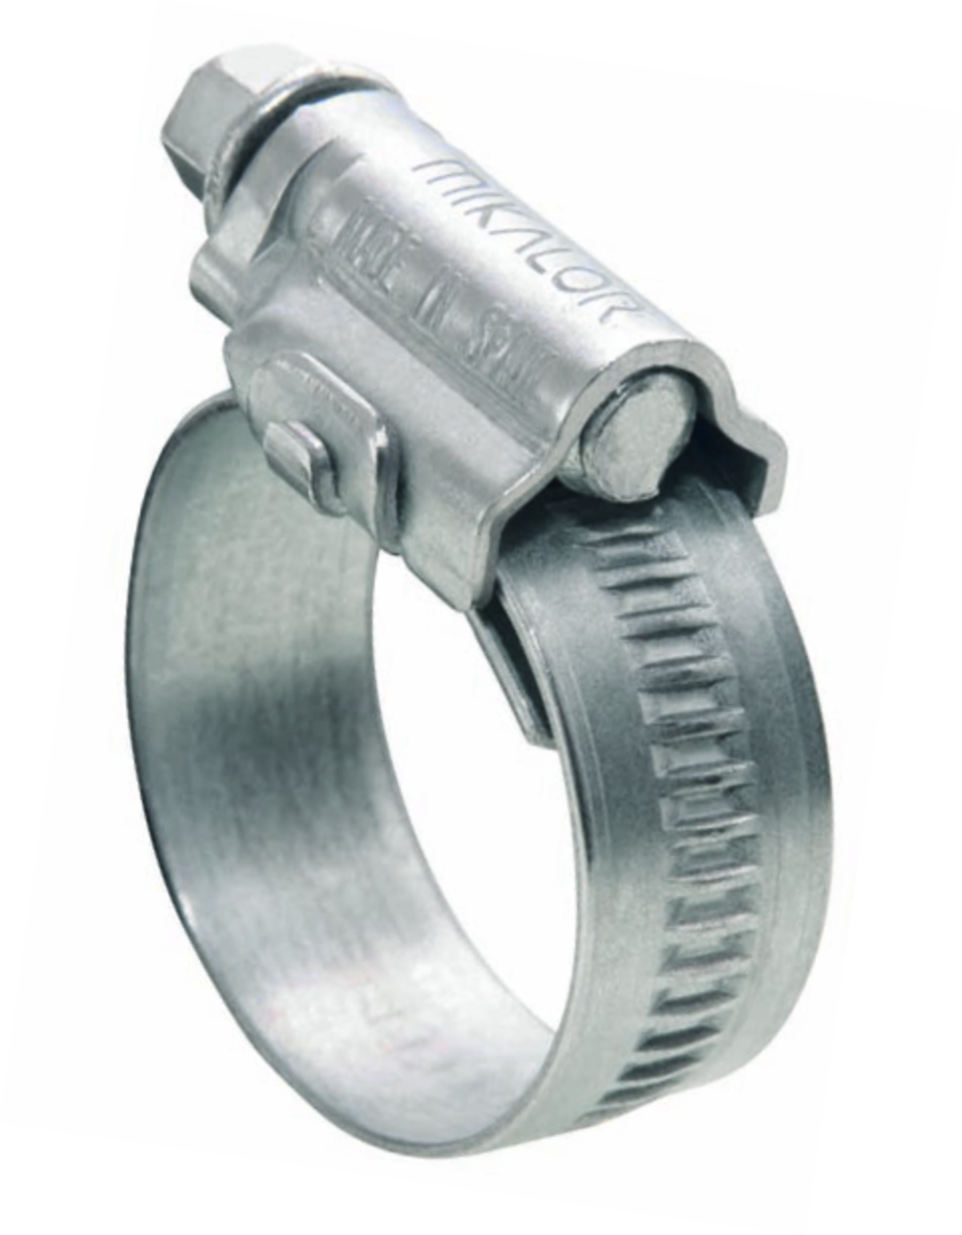
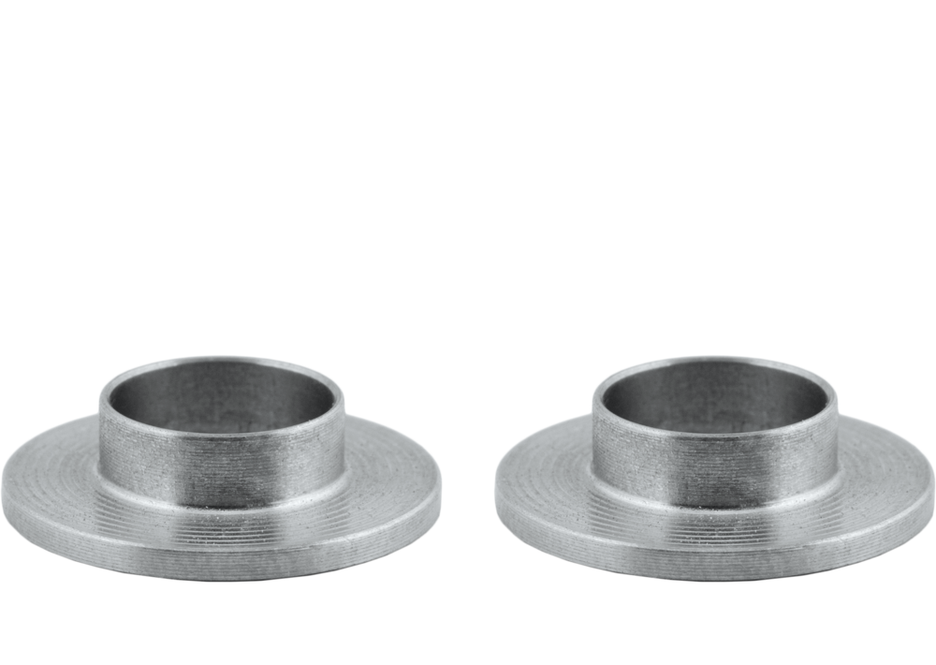
Exempt Products
Examples of products subject to Buy America requirements include, but are not limited to the following:
Clamps, fittings, sleeves;

Slide 18
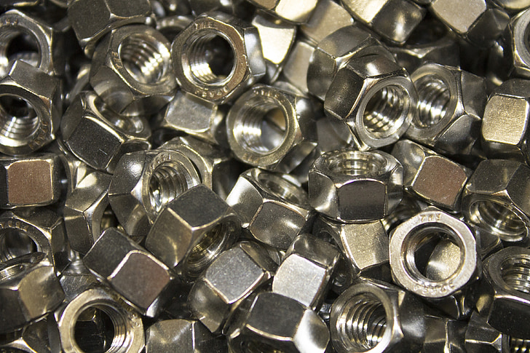
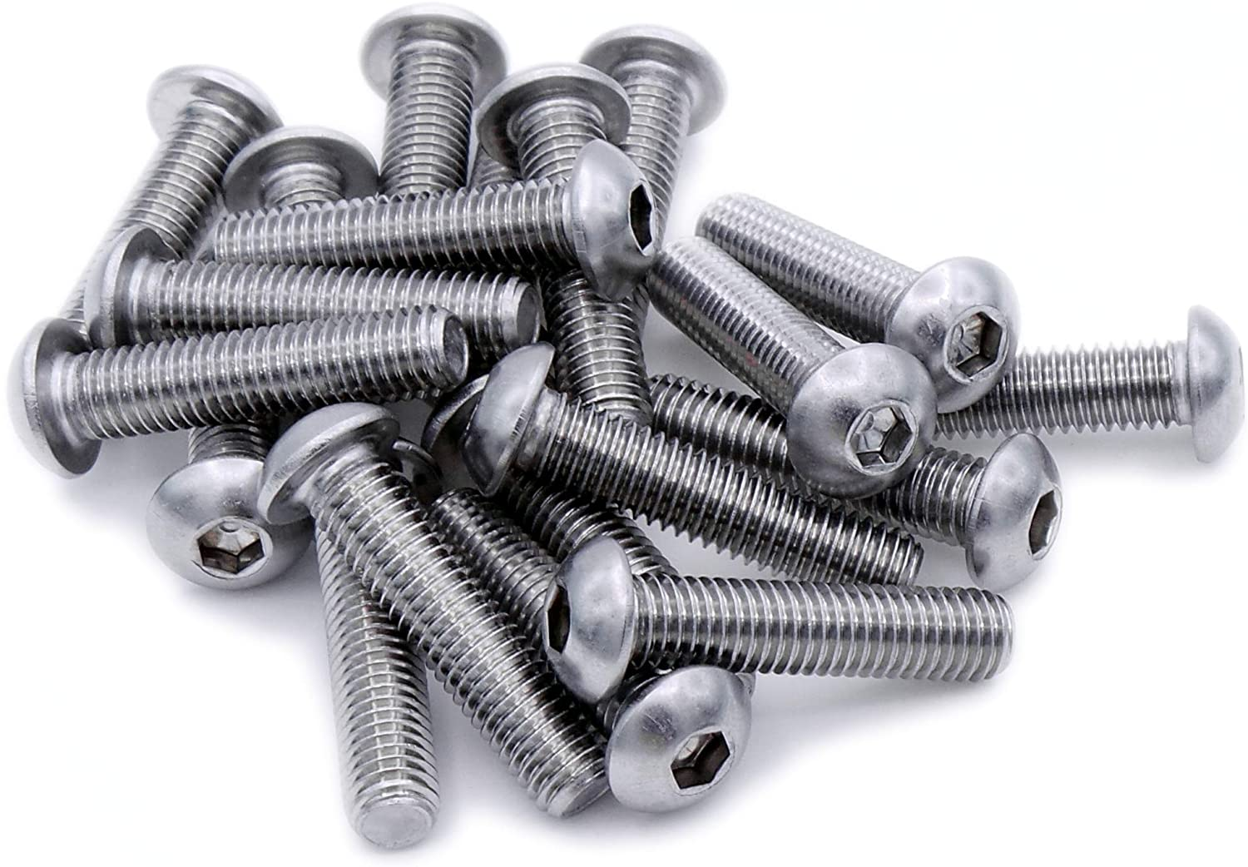
Exempt Products
Examples of products subject to Buy America requirements include, but are not limited to the following:
Washers, bolts, nuts, screws;

Slide 19
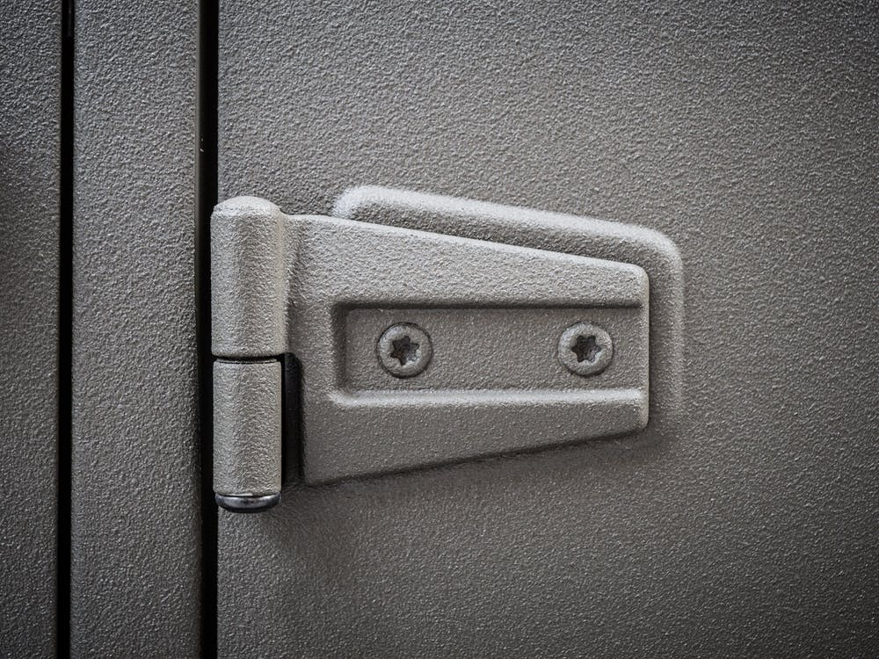
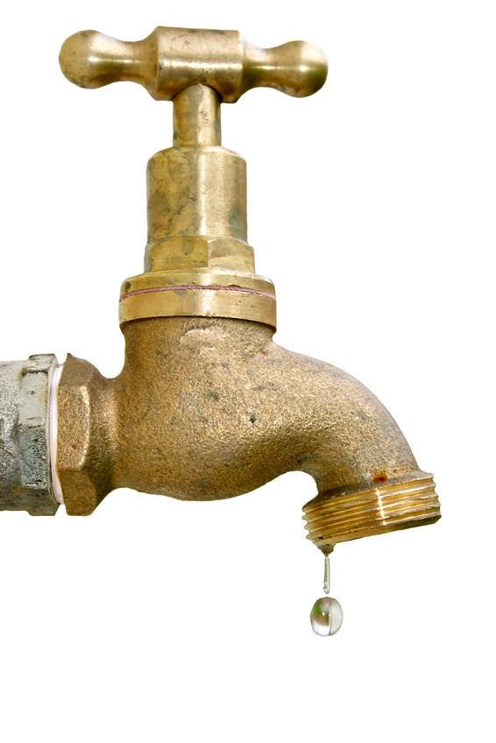
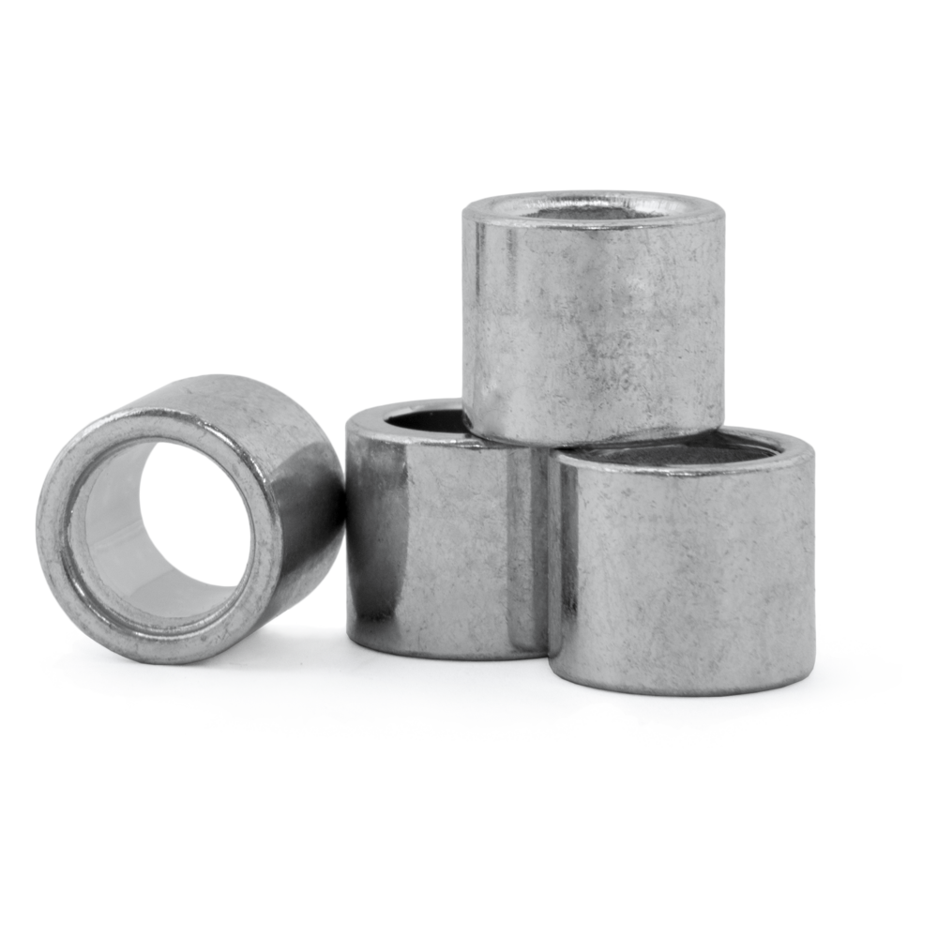
Exempt Products
Examples of products subject to Buy America requirements include, but are not limited to the following:
Tie wire, spacers, chairs;
Lifting hooks;
Faucets; and
Door hinges.

Slide 20
Foreign Steel
The use of foreign steel on a Federally funded construction project shall not exceed one-tenth of one percent (0.1%) of the total contract cost* or $2,500, whichever is greater.
* The total contract cost includes the total project delivery cost of all steel and iron products as well as the cost of delivering the steel and iron products to the project.
If there is any foreign steel or iron permanently incorporated into the project the Contractor shall provide documentation of the project delivered cost of that foreign steel or iron.

Slide 21
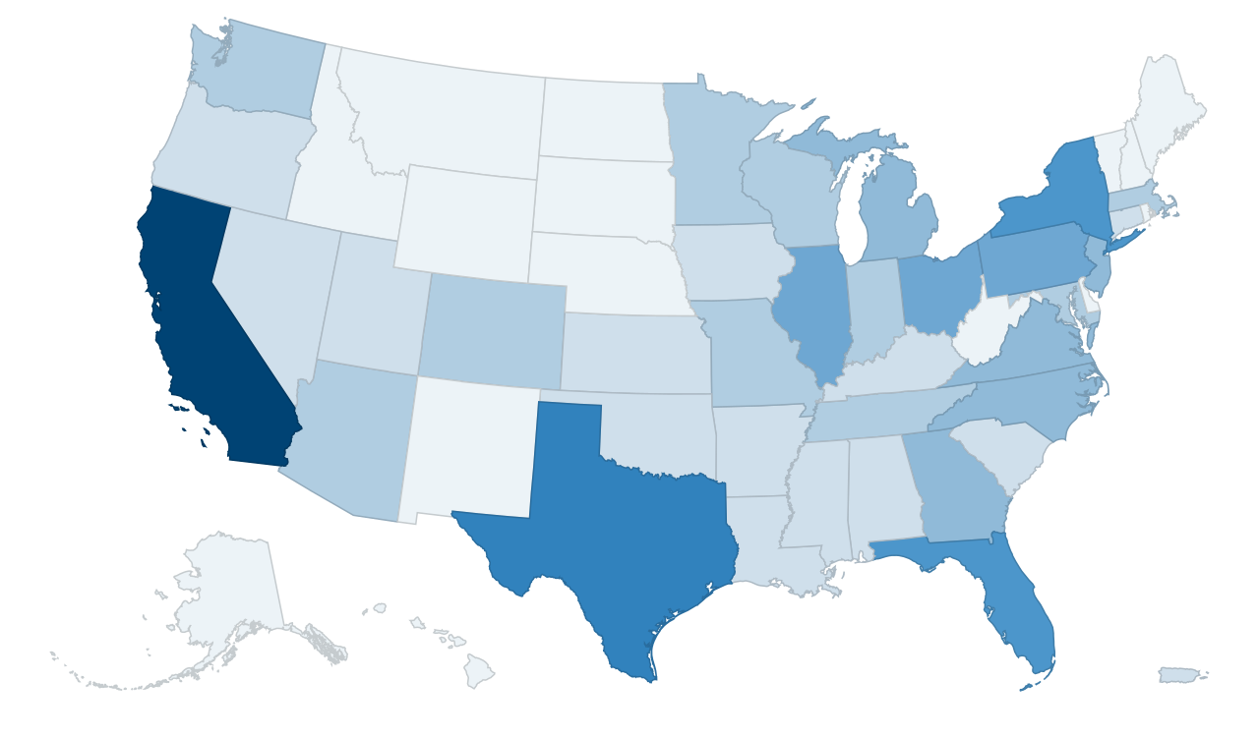
Documentation - Requirements
The Contractor shall maintain on file Buy America certifications that every process to either the original smelting or melting operation, including the application of a coating, performed on steel or iron products either has or has not been carried out in the United States of America.

Slide 22
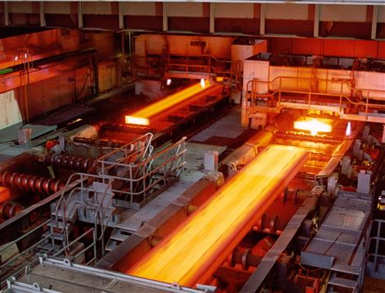
Documentation - Requirements
These certifications apply to every steel and iron product that requires pre-inspection, pretesting, certified test results, or a certificate of compliance.
Shipping invoices, bar lists and mill test reports shall accompany the Buy America Certifications.

Slide 23
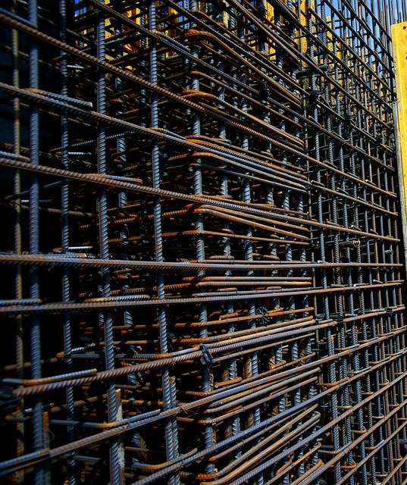
Documentation - Requirements
The Contractor shall obtain a certification from each supplier, distributor, fabricator, and manufacturer that has handled each steel or iron product.
These certifications shall create a chain of custody trail for every supplier, distributor, fabricator, and manufacturer that handles the steel or iron product and shall include certified mill test reports with heat numbers to either the original smelting or melting operation.

Slide 24

Documentation - Requirements
Prior to permanent incorporation into the project of any steel or iron products (domestic or foreign) the Contractor shall certify in writing to the Project Engineer on a monthly basis that the delivered quantity of each material:
  Meets the Buy America requirements.
  A copy of the Buy America certification from the Supplier is on file in the Contractor’s project office.
  Steel or iron product are in compliance with project plans and specifications for the project.
  When requested, the required documentation has been submitted to CDOT.

Slide 25
Documentation - Requirements
The Contractor shall maintain an assurance document that summarizes the date and quantity of all steel and iron material delivered to the project and include the following:
  Pay item
  Quantity of material delivered to the project
  Mill test reports with heat numbers
  Quantity of material installed by the monthly progress payment cutoff date.
The assurance document shall reconcile the pay item quantities and certified mill test reports with heat numbers, of the material delivered to the project to the Buy America certifications.
The assurance documentation shall include the project delivered cost of all foreign steel or iron permanently incorporated into the project.

Slide 26
Documentation – Submittal and Access
The Contractor shall submit a monthly summary to the Project Engineer per Section 106.11 of the Standard Specifications for Road and Bridge Construction.
  A monthly summary shall be submitted even in months in which no steel or iron products are incorporated into or delivered to the project.
The Contractor shall submit the assurance documentation to the Engineer within five (5) days of the cutoff for the monthly progress payment.
The assurance documentation does not relieve the Contractor of providing the necessary Buy America certifications for steel or iron products.

Slide 27
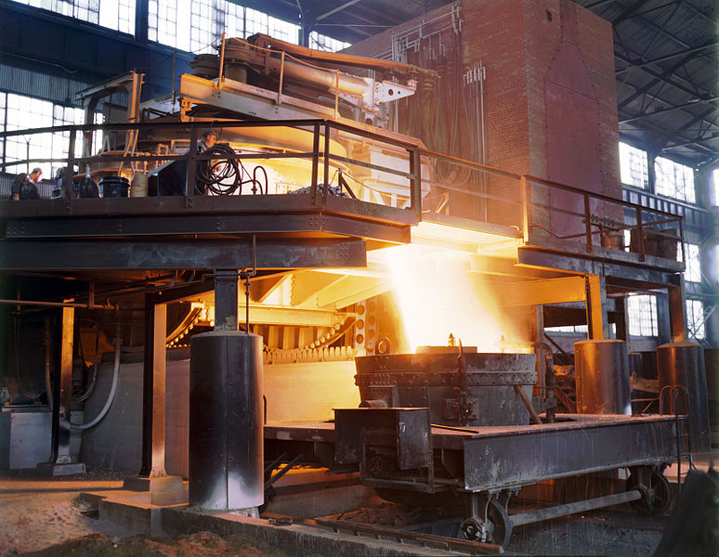
Documentation – Submittal and Access
Upon request, the Contractor shall allow the State, FHWA, and their representatives’ access to the Buy America certifications.
When the Contractor does not provide the Buy America certifications at the Engineer’s request, the Engineer will reject the steel or iron product.

Slide 28
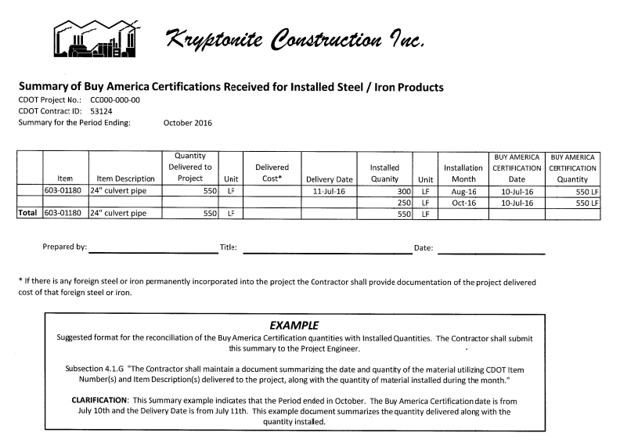
Documentation - Examples
Contractor Monthly Summary
Note: This document is available in the Field Materials Manual in “Special Notice to Contractors”.

Slide 29
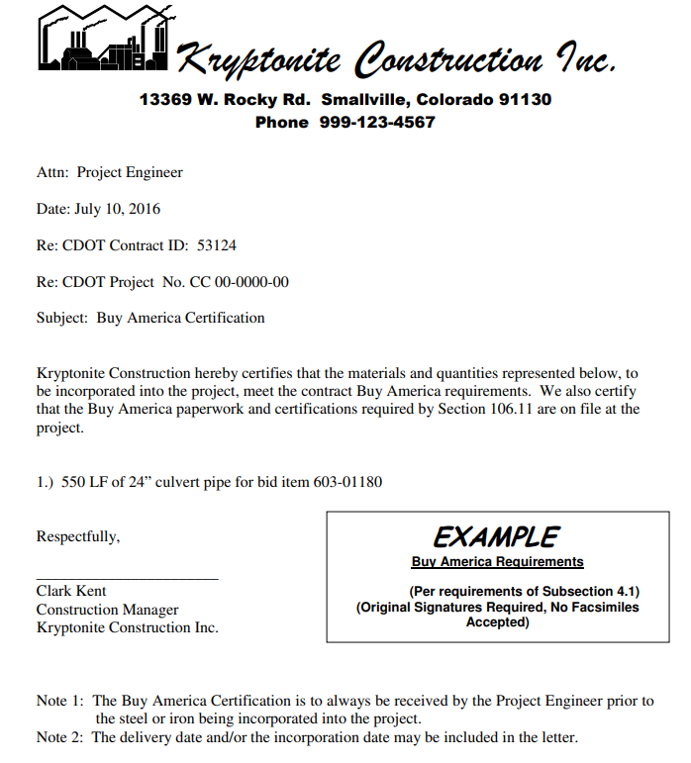
Documentation - Examples
Certificate of Compliance
Note: This document is available in the Field Materials Manual in “Special Notice to Contractors”.

Slide 30
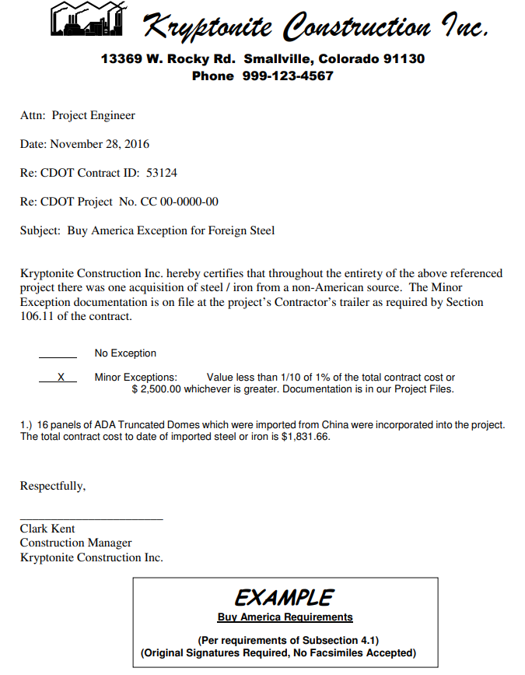
Documentation - Examples
Foreign Steel Exemption
Note: This document is available in the Field Materials Manual in “Special Notice to Contractors”.

Slide 31
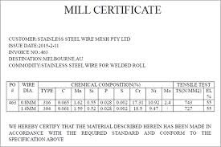
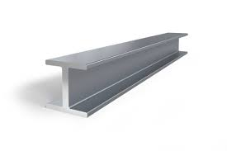
Documentation - Examples
Scenario
CDOT needs the mill certificate/heat number from plant of origin, which should follow the product to the epoxy coater, who then certifies the product was coated in the United States, thus meeting Buy America. This certification along with the heat number/mill cert should be delivered to the Contractor who can then provide that info to CDOT upon request or end of the project.

Slide 32
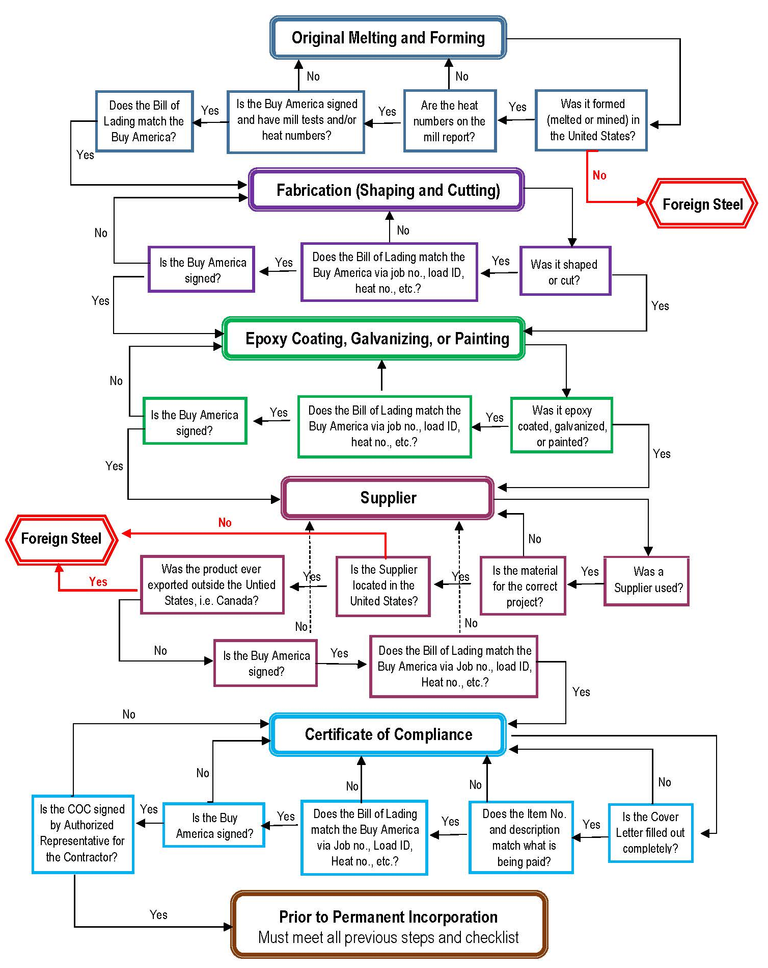
Documentation – Example Process

Slide 33
Checklist
Section 1: Original Melting and Forming
  Where was the steel or iron melted and formed (milled)?
  Is the heat number/numbers listed on the test mill report?
  Does the material meet project specification requirements?
  Is the Buy America statement on the mill test report?
  If not, does the Buy America Certification statement list the heat number/numbers?
  Is the Buy America Certification signed?
  Is there a Bill of lading or proof of transfer or sale from the manufacturer to the Contractor, Project, or Fabricator (new process)?
  Is the material listed on the Bill of Lading or proof of transfer or sale tied to the Buy America Certification via a job number, load ID number, or some other descriptor?
  Do the weights/quantity indicated on the Bill of Lading or proof of transfer or sale match the weights/quantity indicated on the Buy America Certification?
  Is the weight/quantity indicated on the Bill of Lading or proof of transfer or sale enough to cover the weight/quantity of the material being supplied?

Slide 34
Checklist
Section 2: Fabrication – Shaping or Cutting
  Was the steel or iron item shaped or cut?
    If no, go to Section 3.
    If yes, continue.
  How is this fabrication process tied to the Section 1 or the provided heat numbers?
  Is there a Buy America Certification statement for this process?
    Is it signed?
  Was is shaped or cut in the same location as Section 1?
    If yes, go to Section 3.
    If no, continue.
  Is there a Bill of Lading or proof of transfer or sale from fabricator to the Contractor, Project, or other Fabricator?
  Is the material listed on the Bill of Lading or proof of transfer or sale tied to the Buy America Certification via a job number, load ID number, or some other descriptor?
  Do the weights indicated on the Bill of Lading or proof of transfer or sale match the weights indicated on the Buy America Certification?
  Is the weight/quantity indicated on the Bill of Lading or proof of transfer or sale enough to cover the weight/quantity of the material being supplied?
  Are the dates on the paper work for this process after the dates on the paperwork for Section 1?

Slide 35
Checklist
Section 3: Epoxy Coating, Galvanizing, or Painting
  Was the steel or iron coated, i.e. epoxy, galvanized, painted, etc.?
    If no, go to Section 4.
    If yes, continue.
  How is this fabrication process tied to the Section 2 or the provided heat numbers?
  Is there a Buy America Certification statement for this process?
    Is it signed?
  Was is coated or painted in the same location as Section 2?
    If yes, go to Section 4.
    If no, continue.
  Is there a Bill of Lading or proof of transfer or sale from fabricator to the Contractor, Project, or other Fabricator?
  Is the material listed on the Bill of Lading or proof of transfer or sale tied to the Buy America Certification via a job number, load ID number, or some other descriptor?
  Do the weights indicated on the Bill of Lading or proof of transfer or sale match the weights indicated on the Buy America Certification?
  Is the weight/quantity indicated on the Bill of Lading or proof of transfer or sale enough to cover the weight/quantity of the material being supplied?
  Are the dates on the paper work for this process after the date on the paperwork for Section 1 or 2?

Slide 36
Checklist
Section 4: Supplier
  Does the documentation indicate the material was for the correct product?
  Was the supplier utilized at any time during the procurement process?
    If no, go to Section 5.
    If yes, continue.
  Is the supplier located in the United States?
  Does the documentation indicate that the product was ever exported and then returned to the United States?
  Is the weight/quantity indicated on the Bill of Lading or proof of transfer or sale enough to cover the weight of the material being supplied?

Slide 37
Checklist
Section 5: Certification of Compliance
  Is the cover letter filled out completely?
  Do the item number and description match what is being paid?
  Does the weight indicated match the weights on the Bills of Lading and the Buy America Certifications?
  Are all the heat numbers, lot numbers, or batch numbers listed and do they match the Buy America certifications?
  Is the manufacturer listed?
  Is the COC signed by an Authorized Representative for the Contractor?

Slide 38
Checklist
Section 6: Prior to Permanent Incorporation
  Contractor has certified in writing to the Project Engineer on a monthly basis that the delivered quantity of each material meets the contract Buy America requirements.
  Were the above documents submitted to the Project Engineer within 5 days of the cutoff date for the monthly progress payment?
  Does the document show the pay item, quantity of material delivered to the project, and the quantity of material installed by the cutoff date for the monthly progress payment?
  Does the summary also reconcile the pay item quantities to the submitted Buy America Certifications?
  Is the original Buy America Certification from the Supplier on file in the Contractor’s project office?
  Are the steel or iron products in compliance with the plans and specifications of the project?
  Has the Contractor maintained a document summarizing the date and quantity of the material utilizing CDOT’s Item Number(s) and Item Description(s) delivered to the project?
  Has the Contractor maintained a document summarizing the quantity of material installed during the month?
  Has the Contractor maintained documentation of project delivered cost of all foreign steel or iron permanently incorporated into the project on a monthly basis?
  Has a monthly summary been provided even if no steel or iron products are incorporated into the project during the month?
  The Contractor has certified in writing that the documentation of file and the steel or iron products are in compliance with Buy America?

Slide 39
Thank you!
For questions or comments please contact:
  Melody Perkins, P.E.
  Pavement Design and Documentation Manager
  melody.perkins@state.co.us | 303.398.6561

