Slide 1
TSM&O Evaluation
Project Manager Training
Notes:
Welcome to TSM&O Evaluation training. I’m San Lee with TSM&O
We plan to spend about an hour providing you with information you will need as a project manager to effectively execute this process.
This is a recorded session so please submit your questions via Zoom and we will answer them at the end of the session. The following people are here to provide information and support the training:
Charles Meyers
Olivia Brey
Nate Algoe and
Kevin Mindenhall

Slide 2
Topics
TSM&O Evaluation Background & Timeline
Why TSM&O Evaluation Process?
What is the TSM&O Evaluation?
Project Managers’ Roles and Responsibilities
Resources for the PM
Please submit questions via Zoom to be addressed at the end of the session
Notes:
The TSM&O Evaluation process is at its core about CDOT of the future and being the best DOT and providing the best service possible to our travelling customers. We have been working on it for some time and have engaged many CDOT leaders and subject matter experts in the effort.
This evaluation process is history in the making to change our culture now and long into the future to ensure comprehensive and best service to our citizens.
Today we would like to share with you what this evaluation is all about. Where did it come from, why are we doing it, what is it, what is your role and what resources are available to support you.
So with that, let’s get started!

Slide 3
TSM&O Evaluation Background & Timeline
We are here now
2014-June 2015
June 2015
Sept 29-Oct 1
Oct-Dec
January 2016+
Operations Clearance Pilot Program
Lean Rapid Improvement Event
All Region Implementation Planning Workshop
TSM&O Implementation
Preparation
TSM&O Evaluation for All Projects
Sponsor Coalition formed
Operations Clearance process piloted
Initiated process refinement
TSMO Evaluation not Clearance
Process aligned with CDOT project planning process
Region Traffic Representative identified as point person for TSMO Evaluation
SAP Milestone for TSMO Evaluation
Align regions on TSMO Evaluation process
Define clear roles and accountability
Develop Implementation and Communications Plans
Identify and refine:
TSMO Evaluation process details
Checklists/ questionnaires
Documentation requirements
TSMO Evaluation required for all projects in Design Scoping after Feb 1, 2015
Training provided for PMs and RTRs
Process metrics initiated
Ongoing refinement
Executive Sponsors:
Ryan Rice
Josh Laipply
Contributors:
  Region Traffic Engineers
  Program Engineers
  Resident Engineers
  Project Development
  HQ Safety, Operations, and ITS
Notes:
As we mentioned, the TSM&O Evaluation process has been developed and refined over the past year or so. It was initially piloted over the past year and a half under the sponsorship of CDOT leadership and refined in a Lean Rapid Improvement Event held in June. A broader stakeholder group was engaged in late sept to further refine the process and develop an implementation plan. We have been working on that plan over the past several months and are now ready to move forward with implementation.

Slide 4
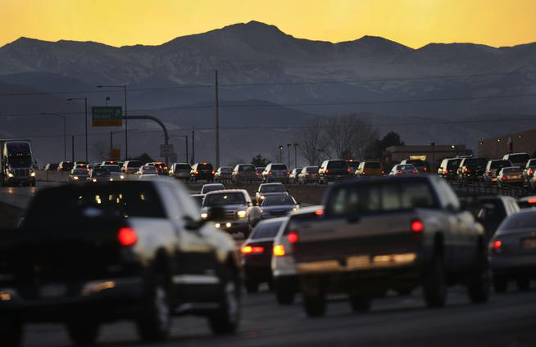
Why TSM&O Evaluation?
CDOT leaders have recognized that we cannot build our way out of future congestion and must employ new innovations, recognized improvement strategies and technology to safely move increased traffic volumes
The purpose of the TSM&O Evaluation is to evaluate the project area and make recommendations to the project team that improves reliability, safety, quality of life, and traveler information
Mobility and safety improvement and innovation is a national trend and CDOT is at the forefront of this movement
Colorado’s front range population is projected to increase 50% by 2050 while freeways and older streets have little room for expansion.
-Sunday Denver Post, Dec. 20, 2015
TSM&O Video
Let’s hear the perspective of CDOT executive sponsors Ryan Rice and Josh Laipply on this important initiative.
Notes:
Why TSM&O Evaluation? The answer to this question was nicely reported in a front page article in the Dec 20 Sunday Denver Post about population growth in CO and increasing congestion. The bottom line is a real need to improve safety and mobility through innovation, operations improvement strategies, as well as technology. But let’s hear from CDOT leaders to gain their perspective on the TSM&O Evaluation…

Slide 5
Video From CDOT Leaders

Slide 6
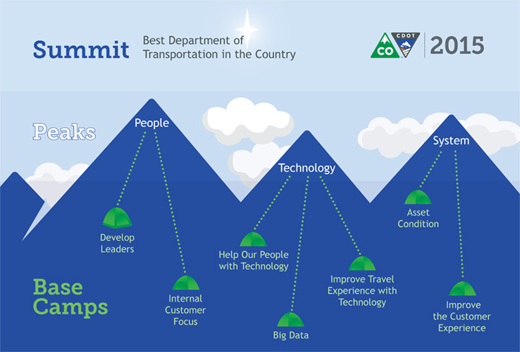
CDOT’s 3 Peaks
Notes:
We have all been hearing about CDOT’s 3 Peaks. The TSM&O Evaluation spans across many initiatives and here is how they relate
Under the People Peak, improving upon our internal customer focus will expand the skills of our people by providing an understanding each others roles and responsibilities.
Under the Technology peak, recommendations will move us towards improving the travel experience using technology
Finally, under the System peak, the Evaluations will help improve the customer experience. Examples include better real-time travel information, improved reliability, and moving toward zero deaths
By considering safety, ITS, and operations early and throughout the design process, CDOT will optimize its limited resources to make the right decisions for transportation improvements and deliver the best projects possible for the public.

Slide 7
What is a TSM&O Evaluation and when does it start?
Safety
Operations
ITS
The Transportation Safety Management &Operations (TSM&O) Evaluation consists of three parts; Safety, Operations, and ITS analyses
The TSM&O Evaluation Process is aligned with the CDOT Project Development Process and will be included in the manual
The TSM&O Evaluation will evaluate the project area and make recommendations to the project team for improvements related to Safety, Operations, and ITS
Beginning January 1, 2016 all projects with a Design Scoping Review on or after February 1, 2016 will require a TSM&O Evaluation.
TSM&O Evaluation
Recommendations
Improvements Incorporated in Project
Notes:
Let’s talk about what the Evaluation is and when it starts.
The TSM&O Evaluation consists of 3 main parts: a Safety analysis, Operations analysis and ITS analysis…
and is now aligned with the Project Development process. The Evaluation results in recommendations for improvements that may be incorporated in the project.
All projects with a Design scoping date after Feb 1 2016 will require a TSM&O Evaluation. Let’s talk about how the process works…

Slide 8
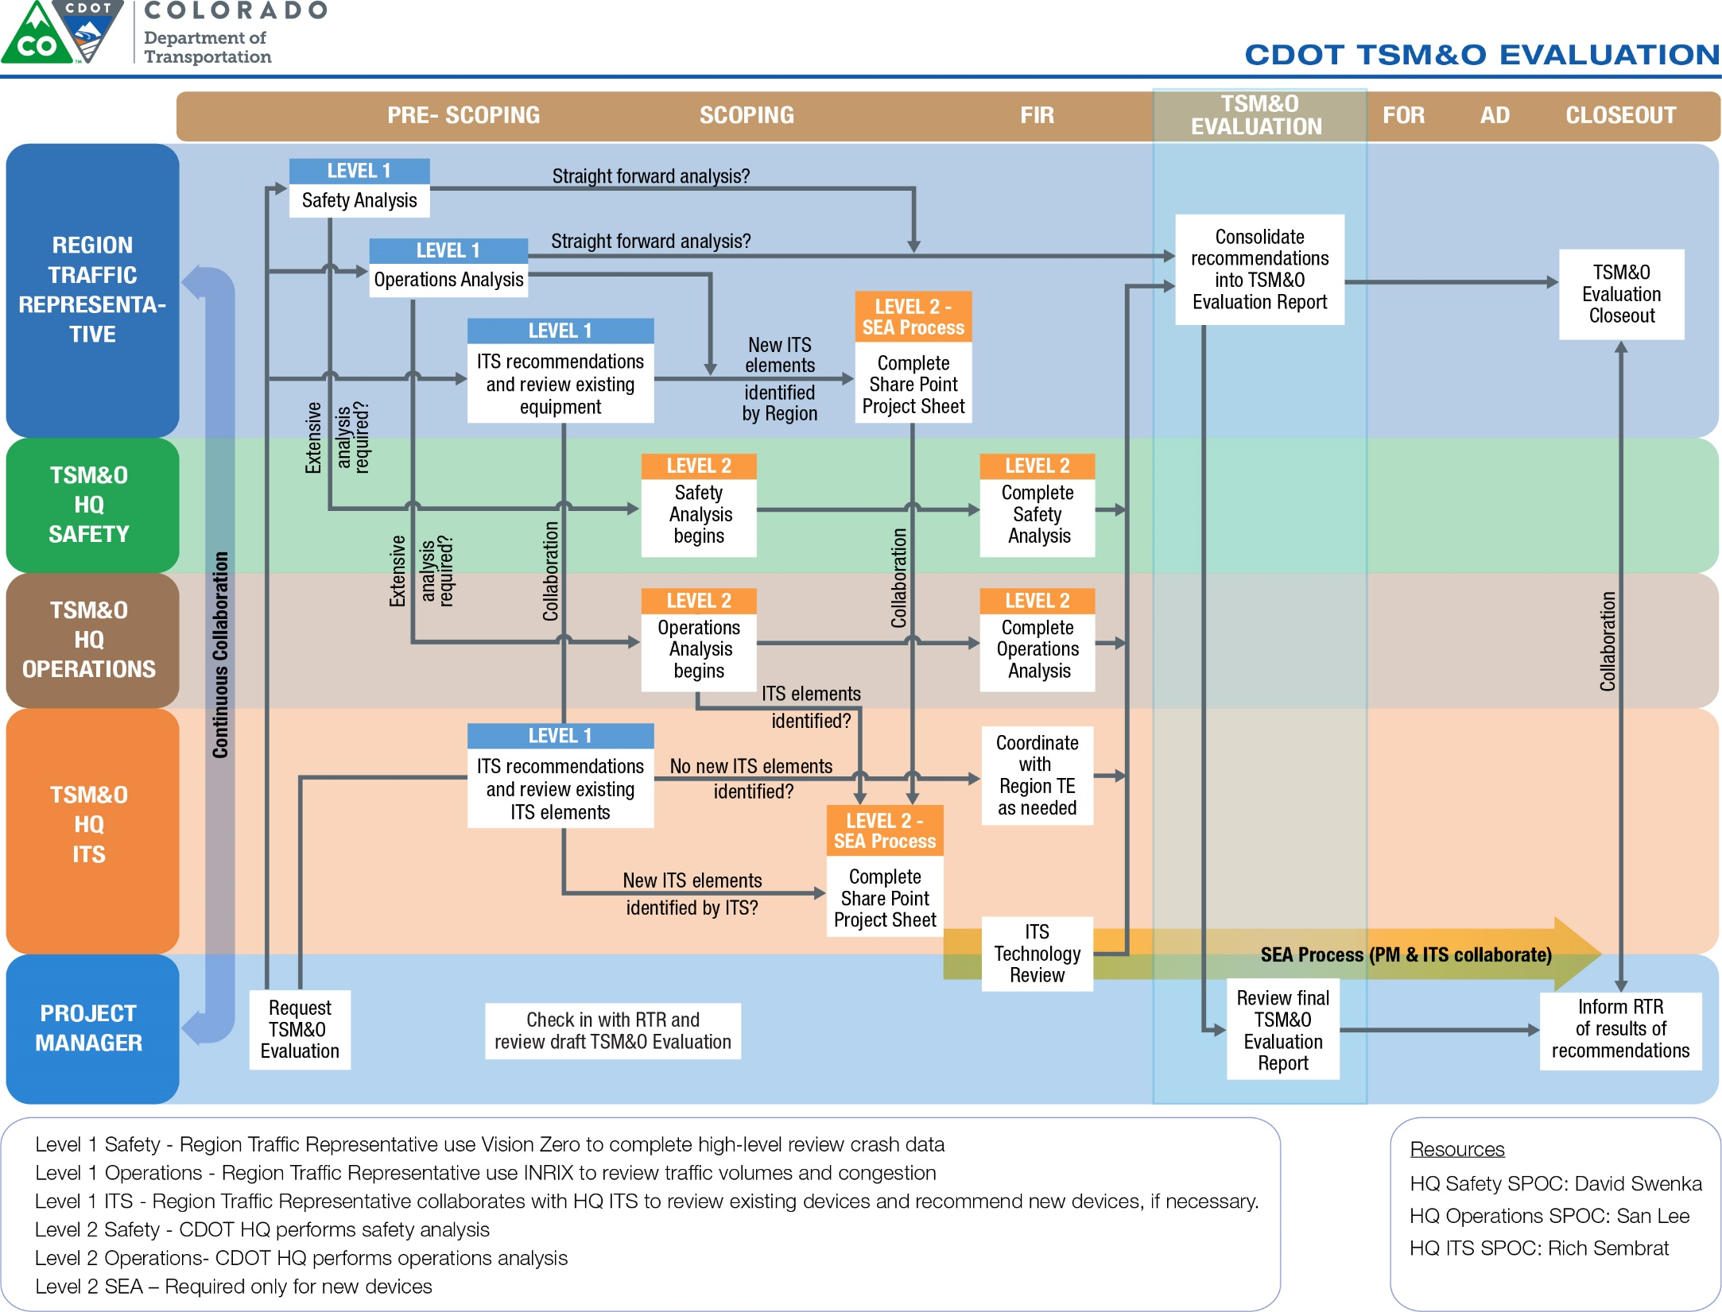
Notes:
As a reminder, it is important to have a printout of this process for reference. Let’s go over it as a high level. The process map shown on this slide provides an overview of the process by area of responsibility. Each CDOT project will have an assigned Region Traffic Representative (or RTR) who will be the point of contact for the PM and responsible for coordinating the Evaluation GRAPHIC.
FOLLOWING THE BOTTOM ROW OF THE GRAPHIC. The process is initiated when the PM prepares a TSM&O Evaluation Request. This step is similar to the current Safety analysis request. Once requested the RTR will complete a Level 1 analysis of the project in each of the areas. If necessary, the RTR will request a Level 2 analysis in one or more areas. The Level 2 analysis will be supported by HQ TSM&O and your Point of contact still is the RTR.
Recommendations will be summarized and provided to the PM who will actively seek to implement them in the project design. Details of the process are described on the following slides.

Slide 9
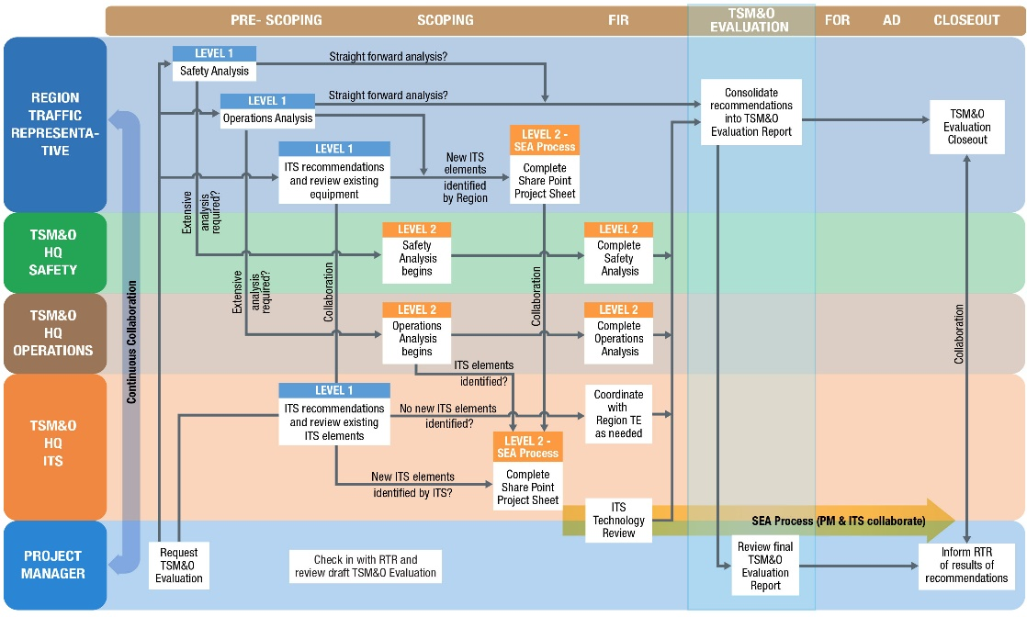
Who performs a TSM&O Evaluation?
The Region Traffic Representative (RTR) for a particular project will complete a Level 1 TSM&O Evaluation
Based upon the Level 1 review, the RTR may initiate a Level 2 analysis from HQ Support Groups
If new ITS devices are identified, a Level 2 ITS Analysis will be required and may include a Systems Engineering Analysis (SEA), in accordance with FHWA requirements
Notes:
As mentioned earlier, the RTR is the point person for ensuring the TSM&O Evaluation is completed. The RTR will keep the PM informed as the TSMO Evaluation develops and will provide the consolidated recommendations to the PM. If new or existing ITS devices will be incorporated in the project a Level 2 ITS analysis will be required. A Level 2 ITS analysis may include a Systems Engineering Analysis.

Slide 10
Project Manager Responsibilities
  Establish the TSM&O milestone in SAP
Request TSM&O Evaluation
Collaborate with RTR and review the final TSM&O Evaluation Report
Coordinate with RTR to complete TSM&O closeout
Note: See TSM&O Design Bulletin for details on how to establish the SAP milestone.
Notes:
Here are the 4 key PM responsibilities.
Establish the Milestone in SAP – Follow the Project Design Bulletin, as this is a evolving process and may change
Request the TSMO Evaluation - This should be done as early as possible to allow the RTR’s to complete the Evaluation
Collaborate with the RTR throughout the process to incorporate the recommendations that you can within the scope of your project
Throughout the project cycle, coordinate with the RTR on what recommendations were incorporated. Recommendations that don’t get completed will provide justification for future projects and funding.

Slide 11
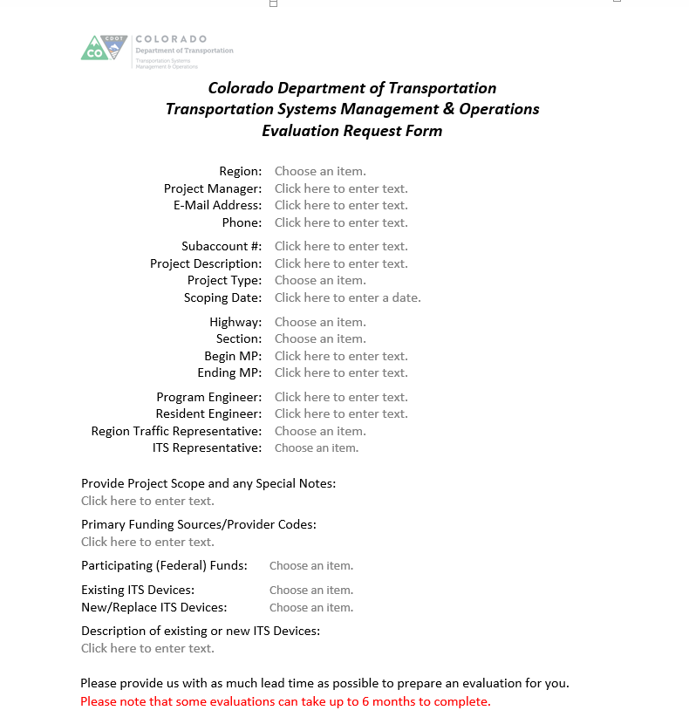

Request TSM&O Evaluation
Click on link to access TSM&O Evaluation Request:
http://cdot.dot.state.co.us/business/tsm-o/tsmo-evaluation/request
  Complete TSM&O Evaluation Request Form to initiate the analysis and distribute to the RTR and ITS representatives indicated on the form (This step is similar to requesting a safety analysis currently)
  Create a TSM&O folder in the ProjectWise Traffic folder and file the TSM&O documentation
Notes:
This is Olivia. Let’s further go over the steps in detail.
Requesting a TSM&O Evaluation is simple and is just like the current Safety Analysis request. The form can be accessed by clicking on the link above and once opened, the PM will add in the project information. Once complete, email the request to the indicated Region Traffic and ITS contacts.
Next, you’ll need to create a TSM&O folder in the ProjectWise Traffic folder in order to file the TSM&O documentation. And that’s it!

Slide 12
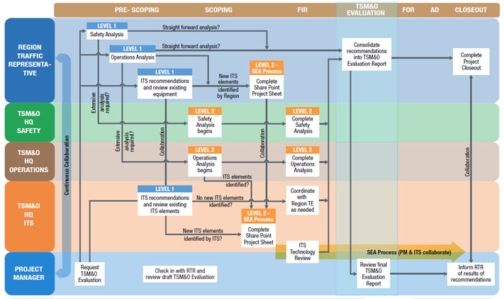
Review the TSM&O Recommendations and Identify Potential Funding Sources
  The PM and RTR will collaborate as the TSM&O Evaluation proceeds
    RTR will complete the TSM&O Evaluation Report and provide it to PM
    HQ Safety, Operations and ITS will support the Regions
  The PM will incorporate recommendations in the project and actively seek funding to include recommendations in project
Notes:
As recommendations are made they need to evaluated for inclusion in the project design. There are many funding sources that are utilized for projects, so it is important we consider all our options as early in the project development process as possible. The PM should coordinate with their Resident Engineer to actively seek funding or make arrangements to include as many of the recommendations as possible. The Regions and TSM&O will also actively work to fund critical needs. It’s important to note that all recommendations may not get funded, but will logged for consideration for and on future projects.

Slide 13
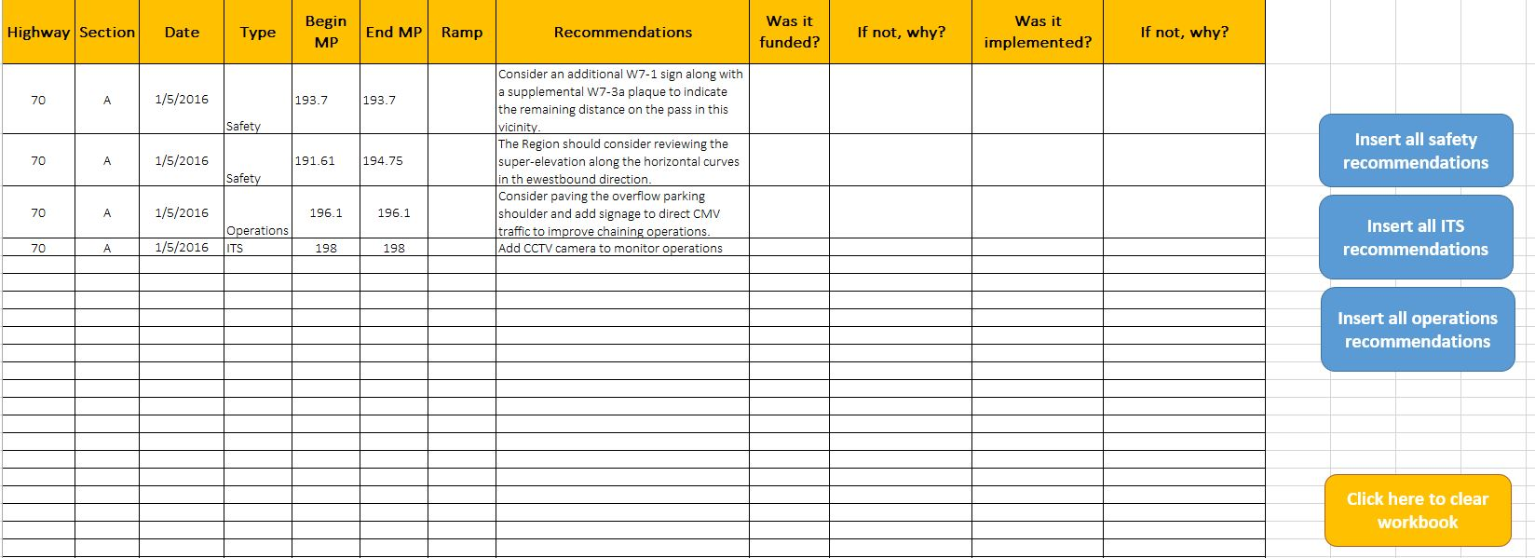
Sample TSM&O Recommendations Report
Sample for illustrative purposes only
Notes:
Here is a sample report that you, as the PM, will receive from the RTR. It is organized by Highway, MP, and Type of Recommendation. It consolidates the recommendations for Safety, Operations, and ITS. Example recommendations could include Signs for Safety, Geometric Improvements, Striping, and Cameras.

Slide 14
TSM&O Evaluation Closeout
  Prior to project closeout, the PM will notify the RTR of which TSM&O recommendations were incorporated in the project
  The PM will notify ITS to complete the acceptance testing of any ITS devices in the project
  The RTR will complete the TSM&O Evaluation and file it for future use
Notes:
Here is the FINAL STEP!!
During TSMO Evaluation Closeout, the PM should notify the RTR of which recommendations were implemented.
As a critical piece of all projects, it’s important to notify ITS of any devices installed on the project for acceptance testing, and when you are working near ITS infrastructure. Although there is an RTR designated to your project, the PM will need to collaborate directly with TSMO ITS throughout the project.
The RTR will then closeout the evaluation. those recommendations implemented will be recorded in the recommendations report.

Slide 15
Resources to Support the PM
The primary support for TSM&O Evaluation for the PM is the designated RTR
Region Traffic Engineers
R1 - Clark Roberts
R2 - Sasan Delshad
R3 - Zane Znamenacek
R4 - Mike Crow
R5 - Mike McVaugh
Region Traffic Representative POC’s
R1 - Alazar Tesfaye, Leela Rajasekar
R2 – Matt Jagow, Terry Shippy
R3 - Sean Yeates
R4 - Long Nguyen
R5 - Rick Routh
Other Support
Safety- David Swenka
Operations- San Lee
ITS- Rich Sembrat
Project Development- Neil Lacey,
Ryan Sorensen
Notes:
This slide shows the resources to support you the PM
The center column shows your initial points of contact who will receive the initial TSMO Evaluation Request from you, the PM.
They will then act as your RTR or assign another person as your RTR.
Other support includes:
Ofcourse the TE’s will always be there to help you with your projects

Slide 16
Next Steps
  Training acknowledgement
  Survey
  Next Steps
    Consult the January 2016 TSM&O Evaluation Design Bulletin for detailed information
    Initiate TSM&O Evaluation Request for your projects in design scoping after Feb 1
Note: This training is required for all CDOT Project Managers. We will record the names of participants to add to the CDOT training records following the session. Please make sure that we have your name as a participant.
Notes:
Here are the next steps we are asking of you….
To take credit for this webinar, please take the survey that will be emailed out soon. We are also working to incorporate this in CDOT’s SAP learning portal.
As your next steps, please print out the workflow for reference, ……
Charles, any final words before me proceed?

Slide 17
Thank you
Notes:
Thank for your attention and participation in this training on the TSMO Evaluation. And mostly, we thank you for your commitment to making this TSMO Evaluation Process a success at CDOT. This process will ensure that every project is incorporating the latest strategies, best practices, innovations, and technologies in operations and safety on all of our projects … for the benefit of our customers. You are a part of history in making CDOT the best DOT in the country.

Slide 18
Q&A

