Slide 1

Clean Transit Enterprise Board
10 Year Plan Working Session

Slide 2
Clean Transit Enterprise 10-Year Plan
Requirements
(10)(a) TO ENSURE TRANSPARENCY AND ACCOUNTABILITY, THE ENTERPRISE SHALL:
(I) NO LATER THAN JUNE 1, 2022, PUBLISH AND POST ON ITS WEBSITE A TEN-YEAR PLAN THAT DETAILS HOW THE ENTERPRISE WILL EXECUTE ITS BUSINESS PURPOSE DURING STATE FISCAL YEARS 2022-23 THROUGH 2031-32 AND ESTIMATES THE AMOUNT OF FUNDING NEEDED TO IMPLEMENT THE PLAN. NO LATER THAN JANUARY 1, 2032, THE ENTERPRISE SHALL PUBLISH AND POST ON ITS WEBSITE A NEW TEN-YEAR PLAN FOR STATE FISCAL YEARS 2032-33 THROUGH 2041-42;
(II) CREATE, MAINTAIN, AND REGULARLY UPDATE ON ITS WEBSITE A PUBLIC ACCOUNTABILITY DASHBOARD THAT PROVIDES, AT A MINIMUM, ACCESSIBLE AND TRANSPARENT SUMMARY INFORMATION REGARDING THE IMPLEMENTATION OF ITS TEN-YEAR PLAN, THE FUNDING STATUS AND PROGRESS TOWARD COMPLETION OF EACH PROJECT THAT IT WHOLLY OR PARTLY FUNDS, AND ITS PER PROJECT AND TOTAL FUNDING AND EXPENDITURES;
(III) ENGAGE REGULARLY REGARDING ITS PROJECTS AND ACTIVITIES WITH THE PUBLIC, SPECIFICALLY REACHING OUT TO AND SEEKING INPUT FROM COMMUNITIES, INCLUDING BUT NOT LIMITED TO DISPROPORTIONATELY IMPACTED COMMUNITIES, AND INTEREST GROUPS THAT ARE LIKELY TO BE INTERESTED IN THE PROJECTS AND ACTIVITIES; AND
(IV) PREPARE AN ANNUAL REPORT REGARDING ITS ACTIVITIES AND FUNDING AND PRESENT THE REPORT TO THE TRANSPORTATION COMMISSION CREATED IN SECTION 42-1-106 (1) AND TO THE TRANSPORTATION AND LOCAL GOVERNMENT AND ENERGY AND ENVIRONMENT COMMITTEES OF THE HOUSE OF REPRESENTATIVES AND THE TRANSPORTATION AND ENERGY COMMITTEE OF THE SENATE, OR ANY SUCCESSOR COMMITTEES. THE ENTERPRISE SHALL ALSO POST THE ANNUAL REPORT ON ITS WEBSITE. NOTWITHSTANDING THE REQUIREMENT IN SECTION 24-1-136 (11)(a)(I), THE REQUIREMENT TO SUBMIT THE REPORT REQUIRED IN THIS SUBSECTION (10)(a)(IV) TO THE SPECIFIED LEGISLATIVE COMMITTEES CONTINUES INDEFINITELY.

Slide 3
Business Purpose
The Clean Transit Enterprise is created to serve the primary business purpose of reducing and mitigating the adverse environmental and health impacts of air pollution and greenhouse gas emissions produced by retail deliveries by:
Supporting the replacement of existing gasoline and diesel public transit vehicles with electric motor vehicles,
Providing the associated recharging infrastructure for electric transit fleet motor vehicles,
Supporting facility modifications that allow for the safe operation and maintenance of electric transit motor vehicles,
Funding planning studies that enable transit agencies to plan for transit vehicle electrification

Slide 4
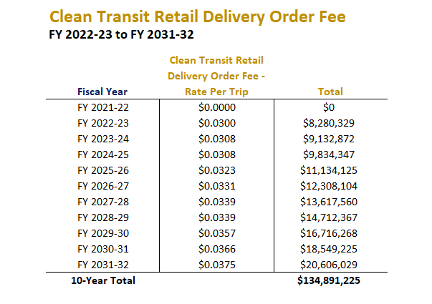
Expected Revenues
Department of Revenue begins collecting fees on July 1, 2022
Clean Transit Retail Delivery Fee is an ongoing revenue stream for Clean Transit Enterprise activities
Expected revenues reflect first 10 years of revenue projections

Slide 5
Clean Transit Enterprise 10-Year Plan
Draft Outline
Introduction
  SB21-260 Language
  State of Colorado ZEV Goals
Anticipated Fee Revenues for FY23-FY32
  Fee Levels
  Anticipated Revenues by Year
  Potential Matching Funds
Transit Electrification Barriers & Opportunities
  Current State Transit Fleet Inventory
  Technology Availability
  Barriers to Implementation
  Anticipated Costs & Timelines
  Supporting Policies & Actions
Clean Transit Enterprise Funding Strategy
  Funding Mechanisms
  Funding Category Prioritization
  Project Prioritization
  Match Levels
  Scrapping Requirements
  Replacement Ratios
  Other Policy Decisions
Implementation & Tracking
Conclusions
Legislation and 2020 Colorado EV Plan
CDOT Division of Accounting & Finance (CDOT DAF) and Colorado Department of Revenue (DOR)
Colorado Transit Zero Emission Vehicle Roadmap
Focus of Clean Transit Enterprise Board & Stakeholder Conversations

Slide 6
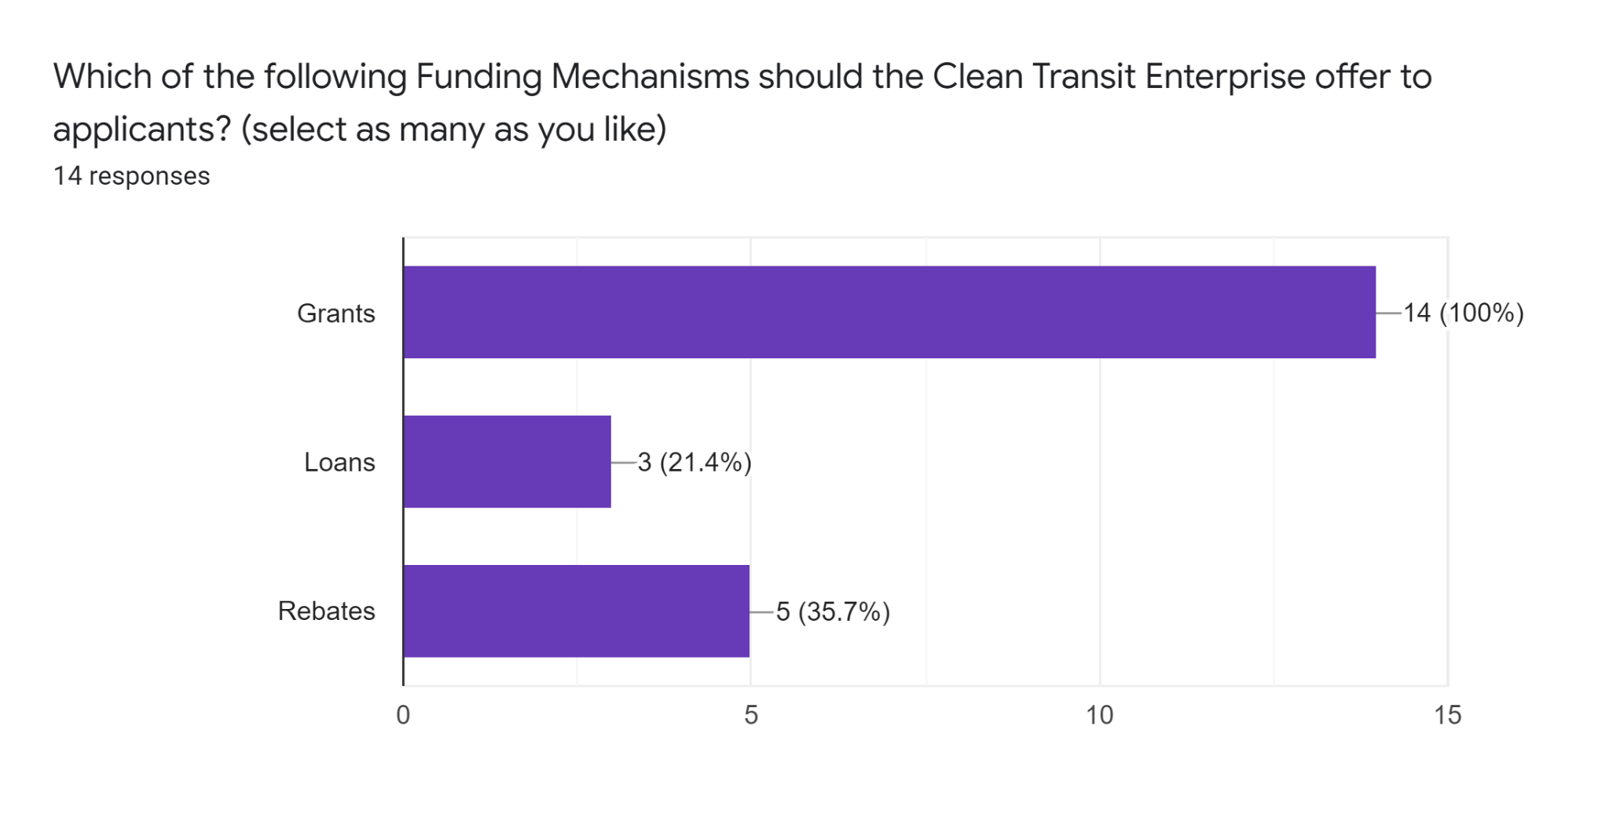
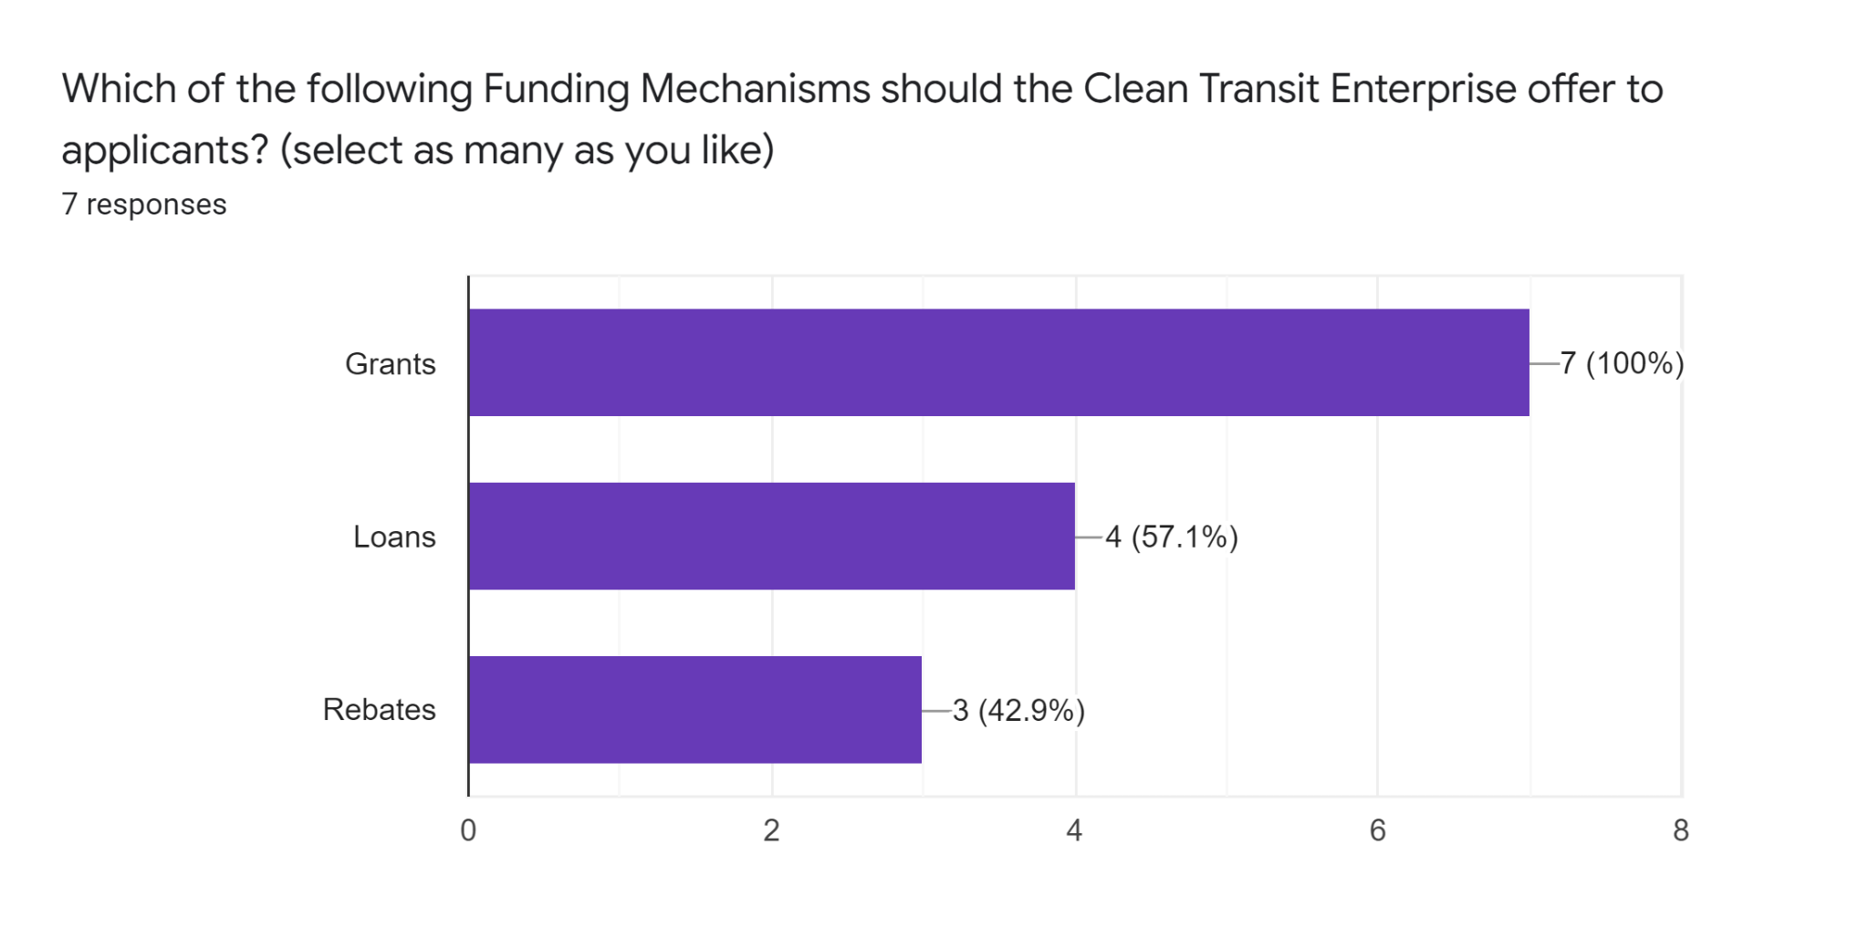
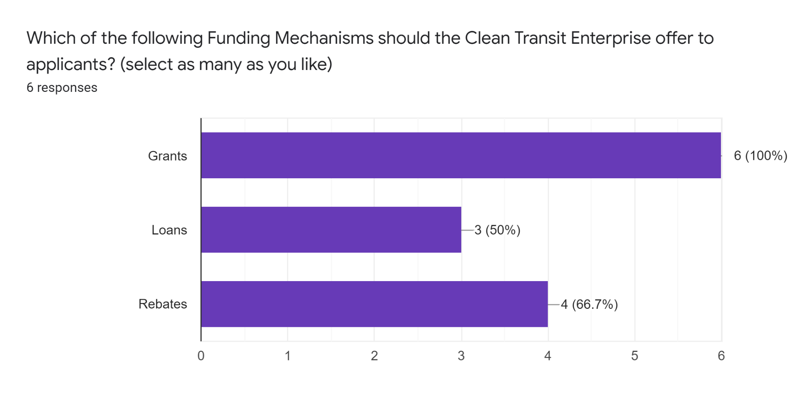
Funding Mechanisms
The Enterprise is authorized to make “grants, loans, and rebates” in support of its business purpose
Transit Monthly
CEVC Transit Subgroup
DTR Staff

Slide 7
Funding Mechanisms
Key Questions
Should the 10-Year Plan exclude any of these 3 mechanisms, prioritize them, or leave this question to future guidance documents and/or 10-Year Plan updates?
Are there specific transit needs (in line with the business purpose of the CTE) that loans are well-suited to address?
Are there specific transit needs (in line with the business purpose of the CTE) that rebates are well-suited to address?
Stakeholder Feedback Summary
Include all 3 funding mechanisms, with an emphasis on grants in early years but with the option to explore and incorporate loans and rebates in the future as appropriate.

Slide 8
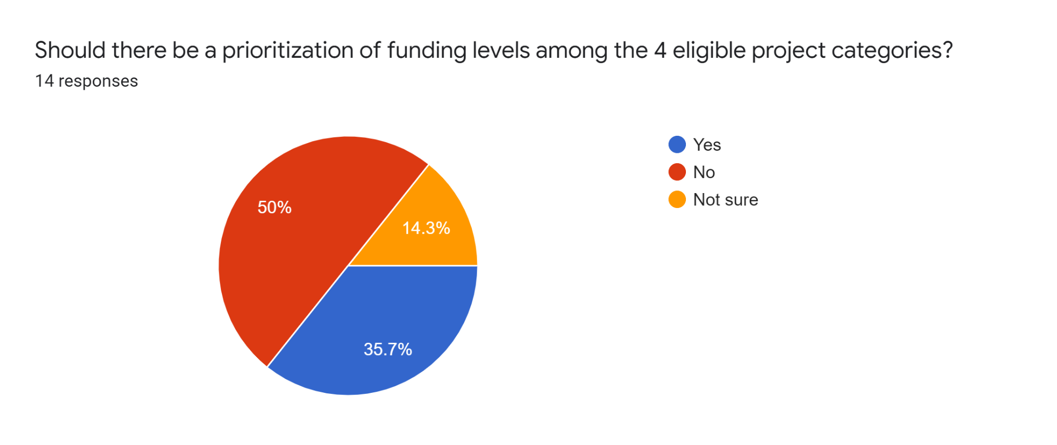
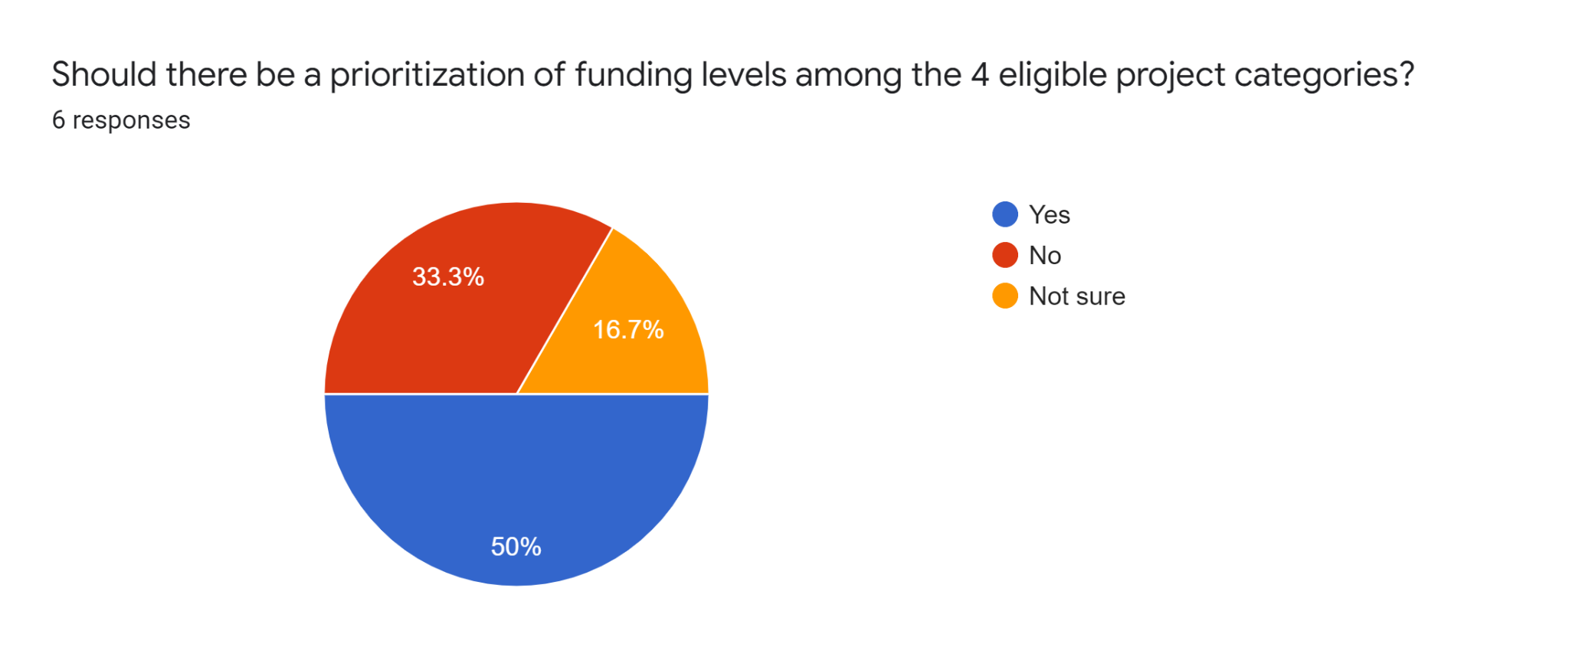
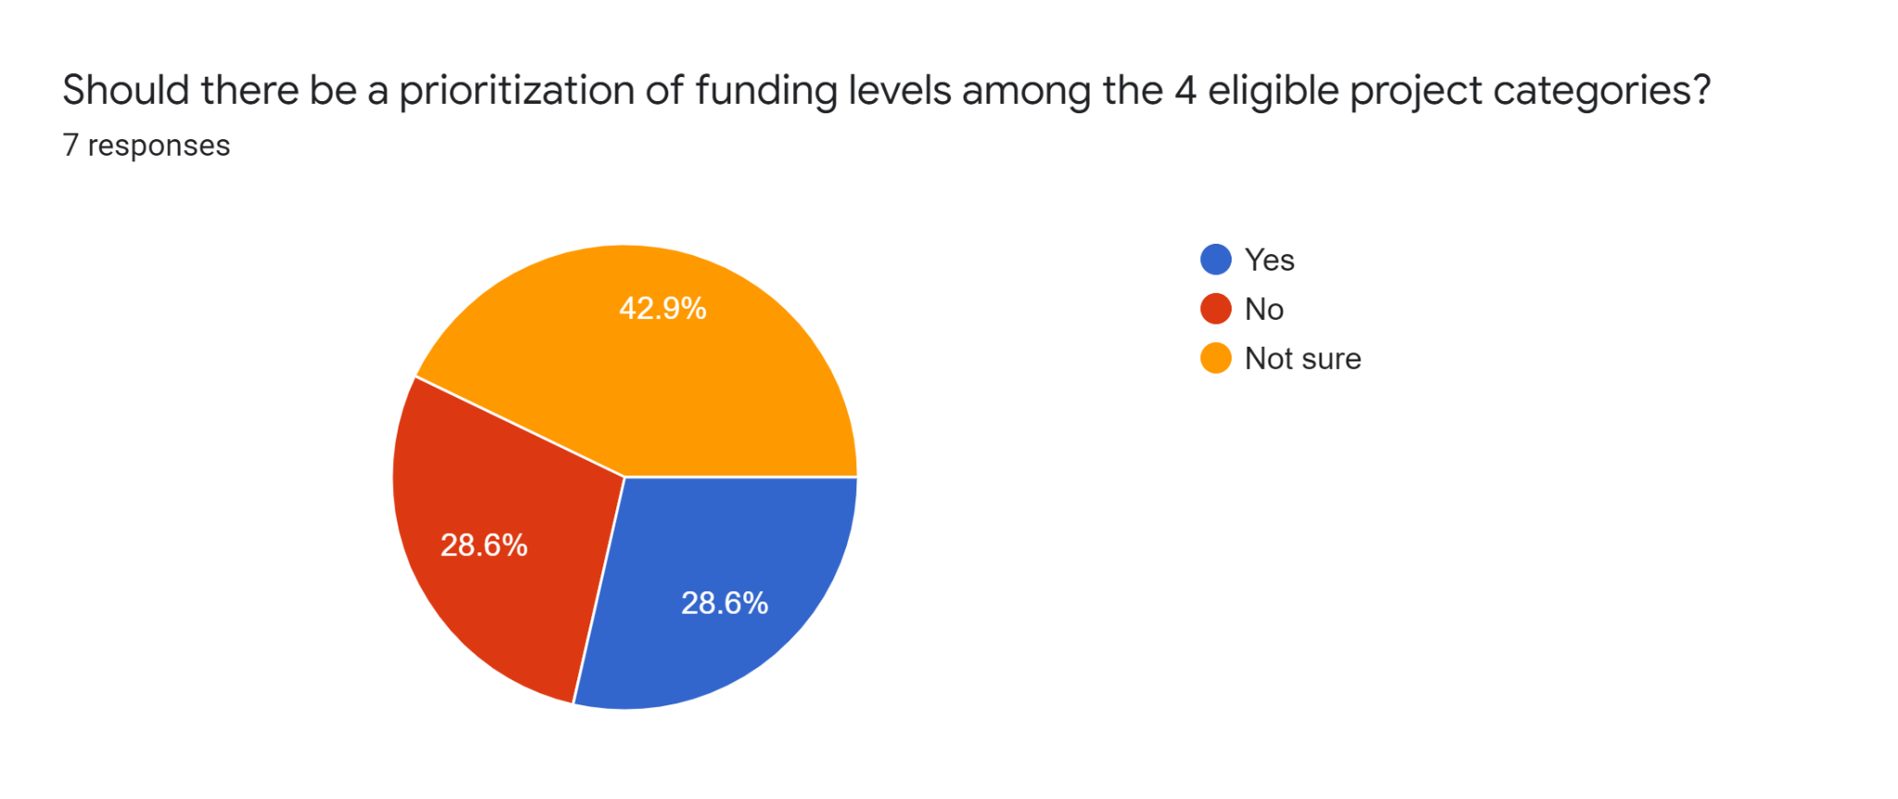
Funding Categories
The Clean Transit Enterprise is able to fund Vehicle Replacements, Charging Infrastructure, Facility Modifications, and Planning
Transit Monthly
CEVC Transit Subgroup
DTR Staff

Slide 9
Funding Categories
Key Questions
Should there be a prioritization of the 4 eligible funding categories over the course of the 10-Year Plan, or in individual subsections of that time period?
Should there by funding percentage caps for any or all of the 4 categories over the course of the 10-Year Plan, or in individual subsections of that time period?
Stakeholder Feedback Summary
Don’t establish specific funding caps by category, but some prioritization of Planning and Facility Modifications in the early years is appropriate to bring more agencies up to the implementation phase. In latter years, Charging Infrastructure and Vehicle Replacements would likely see a greater emphasis.

Slide 10
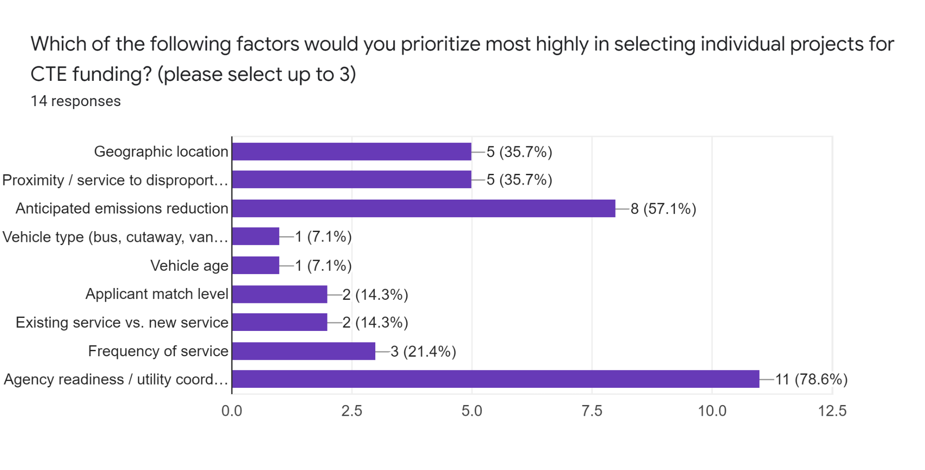
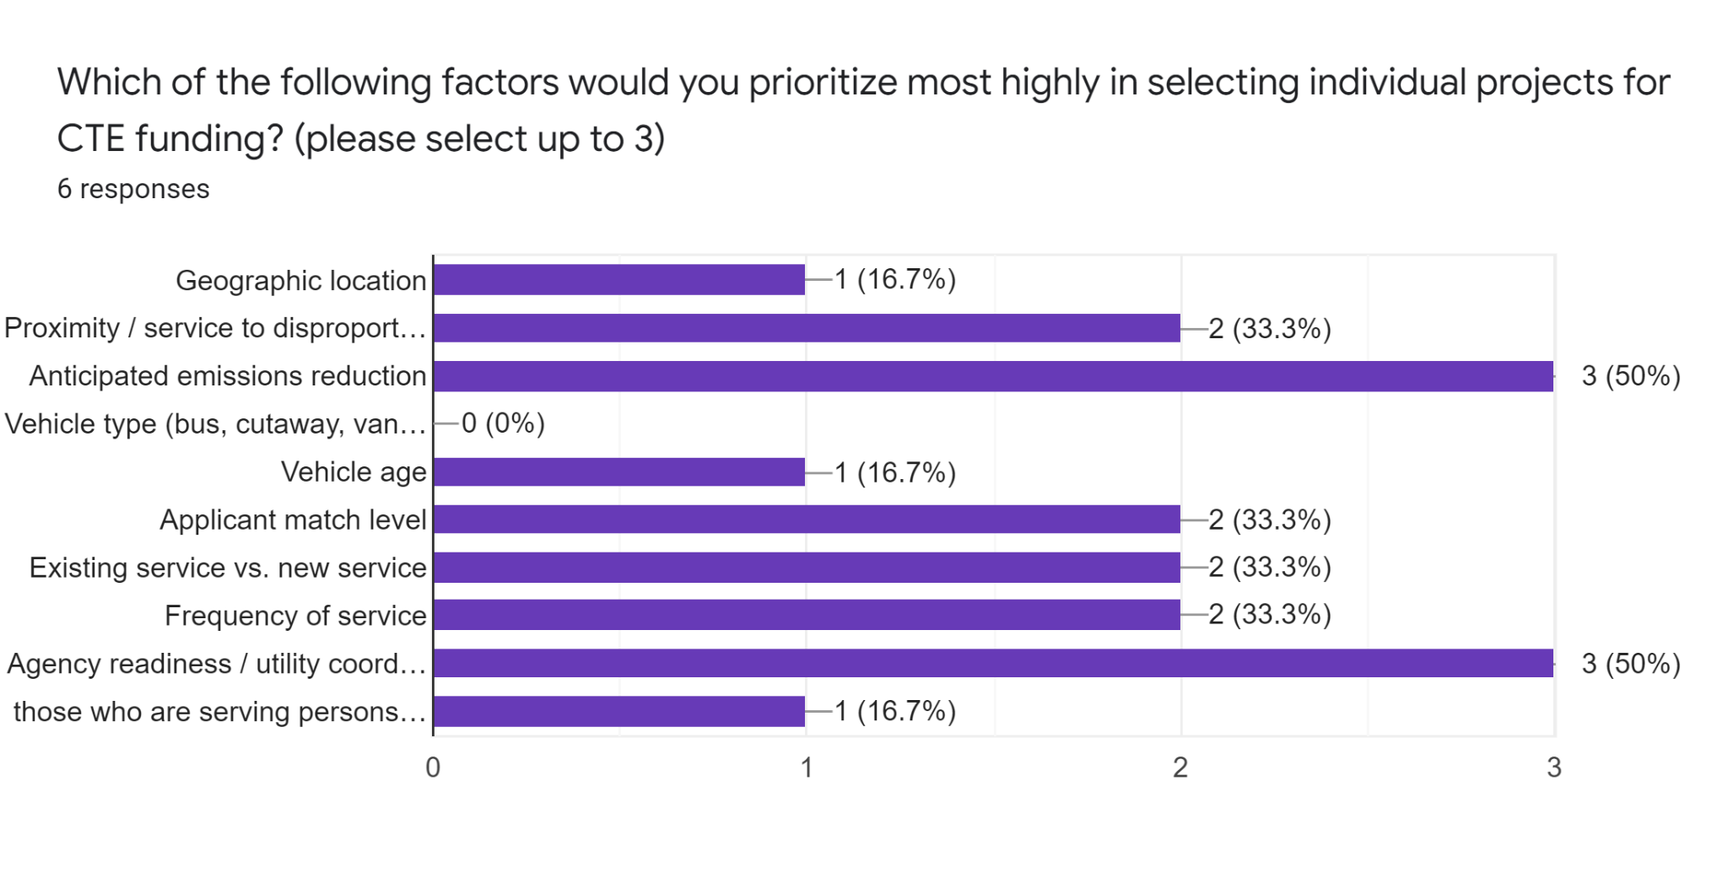
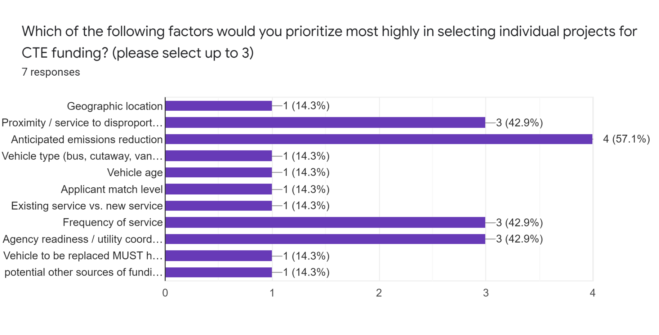
Project Prioritization
Among the 4 eligible project types, individual applications may need to be prioritized in the context of limited funding.
Transit Monthly
CEVC Transit Subgroup
DTR Staff

Slide 11
Project Prioritization
Key Questions
Which factors should be considered in project prioritization?
Should these factors be weighted in a specific manner?
Would project prioritization be similar across each of the 4 eligible categories, or differ for each?
  For instance, vehicle type vs. charger type
Stakeholder Feedback Summary
Use a weighted multifactor formula to score projects with an emphasis on Estimated Emissions Reduction, Service to Disproportionately Impacted Communities, and Agency Readiness. Also factor in Match Level, Frequency of Service, and Geographic Diversity.

Slide 12
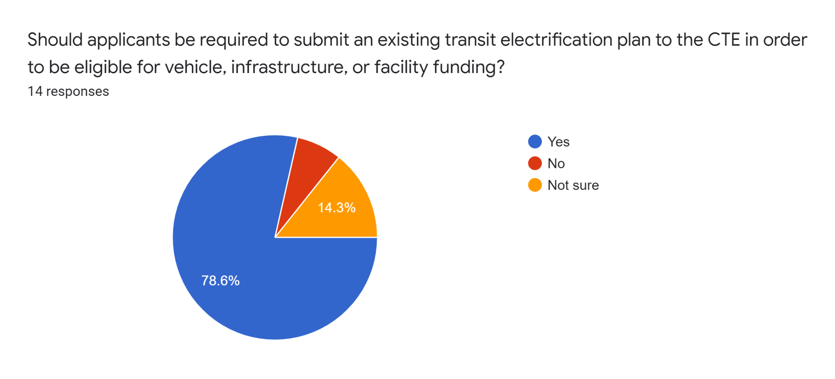
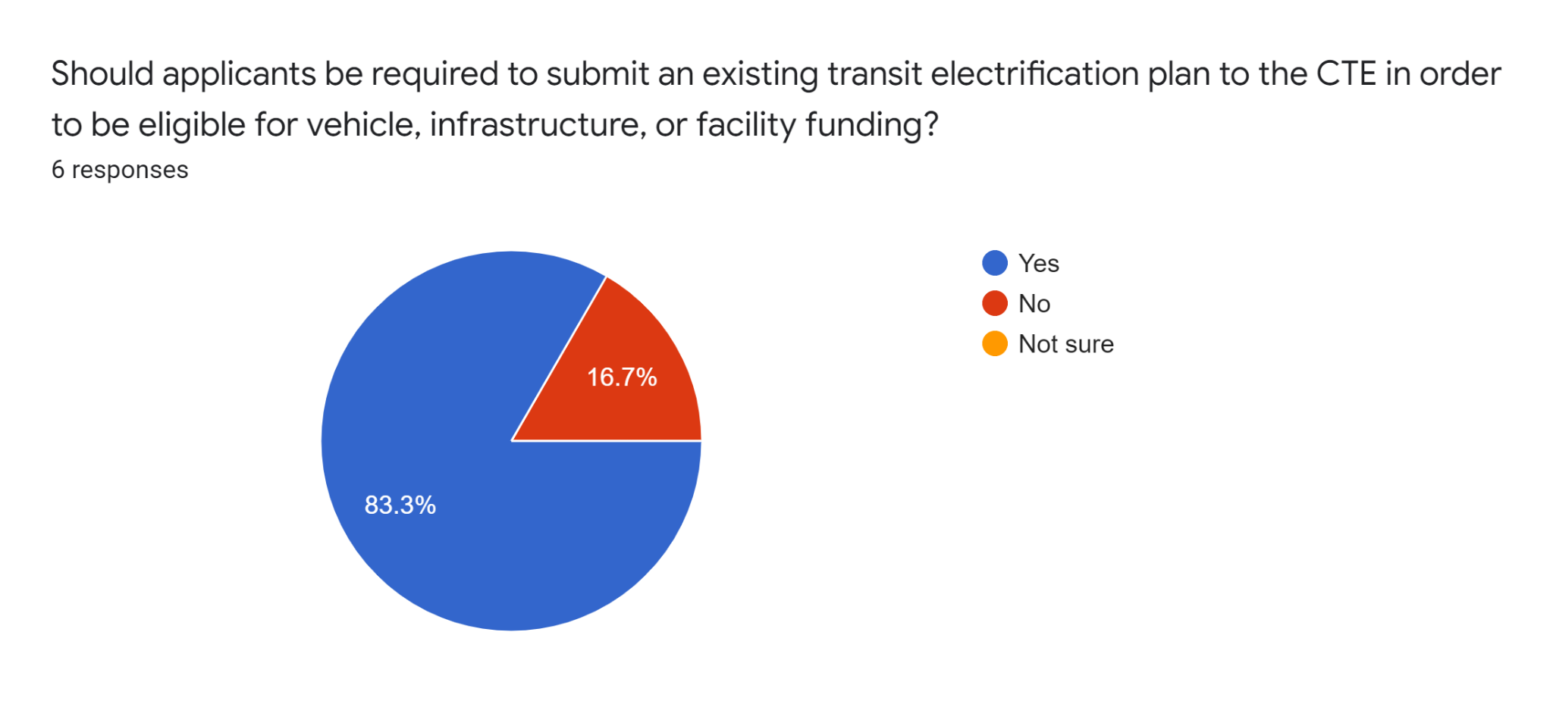
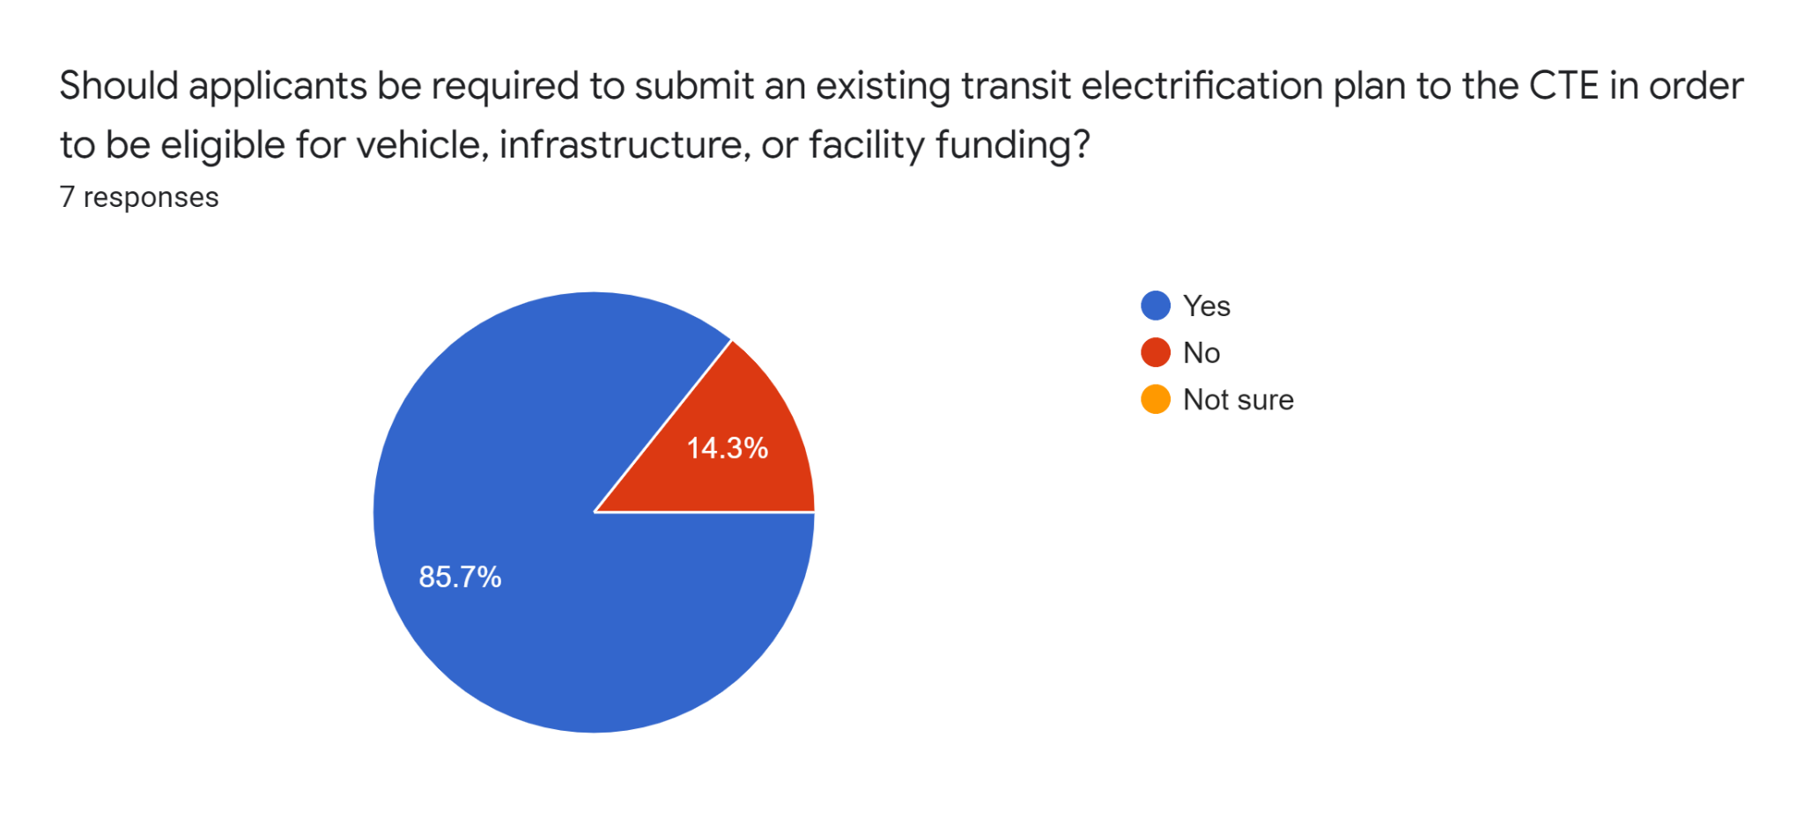
Applicant Planning Requirements
It is considered a best practice to ensure that grantee agencies are positioned for successful implementation before funding vehicles or infrastructure.
Transit Monthly
CEVC Transit Subgroup
DTR Staff

Slide 13
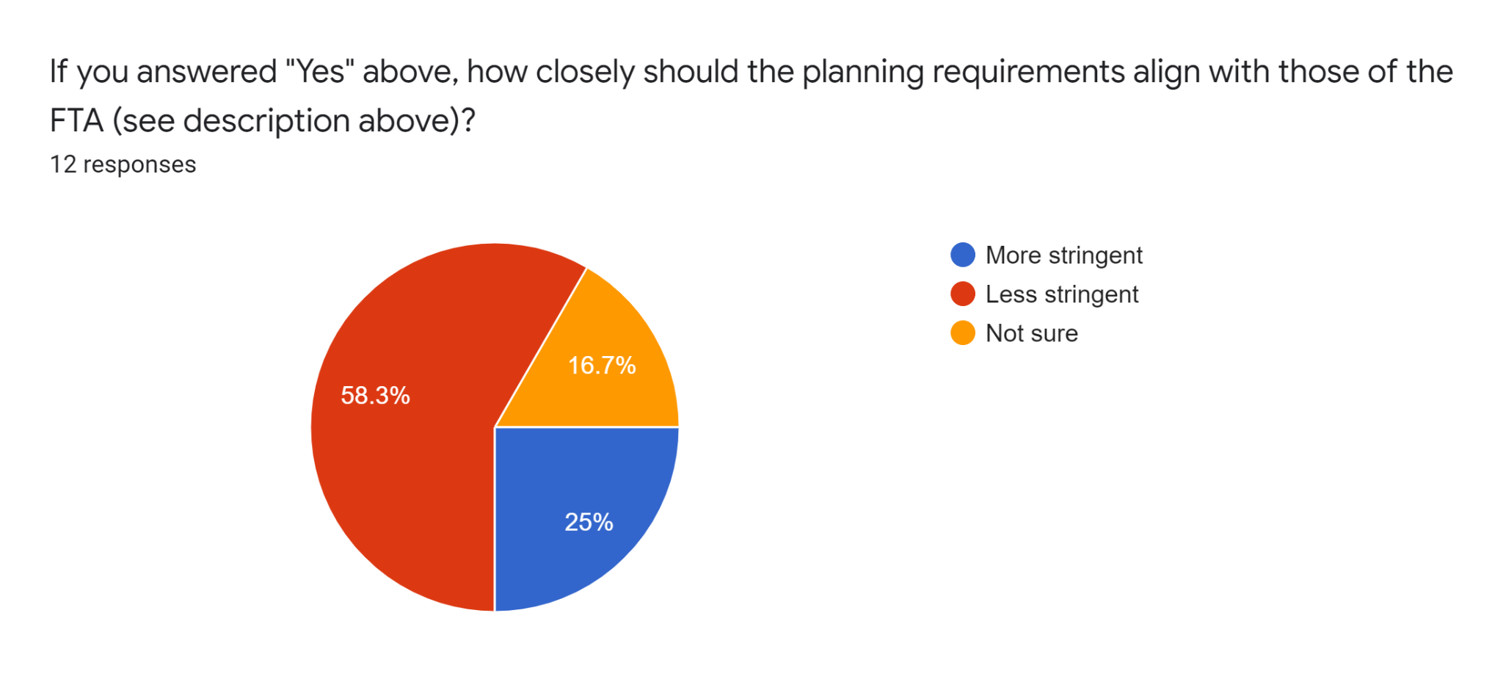
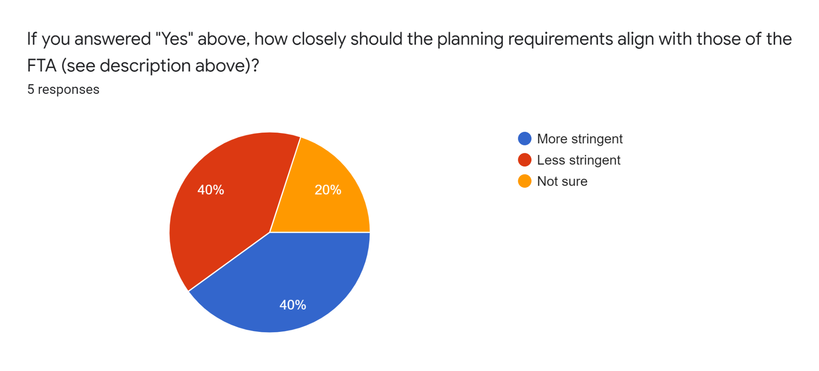
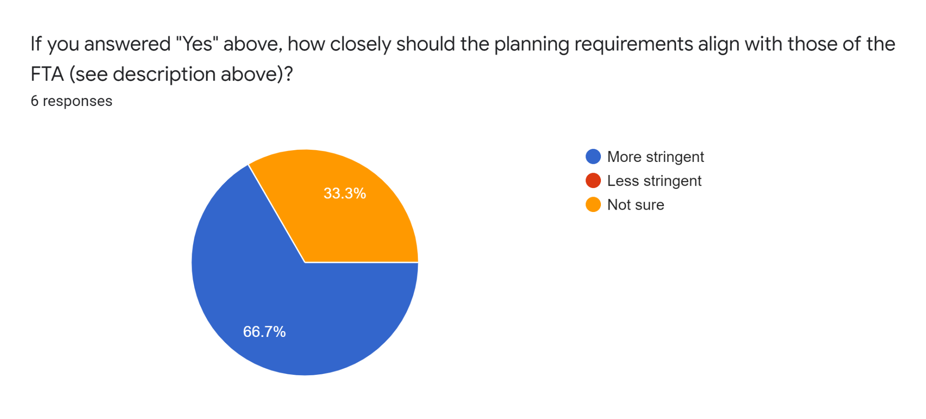
Applicant Planning Requirements
FTA recently released updated transition planning guidance for ZEV transit grant applicants.
Transit Monthly
CEVC Transit Subgroup
DTR Staff

Slide 14
Applicant Planning Requirements
Key Questions
Which level of existing planning should be expected from applicants (of non-planning projects)?
What is the right balance between planning requirements supporting successful implementation vs. presenting a barrier to entry?
How closely should potential planning requirements be aligned with those of the FTA?
Stakeholder Feedback Summary
Require documentation of planning by applicant agencies, but in a way that does not present a barrier to entry to those beginning the process. Develop CTE planning requirements that are at least as stringent as FTA’s to ensure that applicant agencies are eligible for both funding sources.

Slide 15
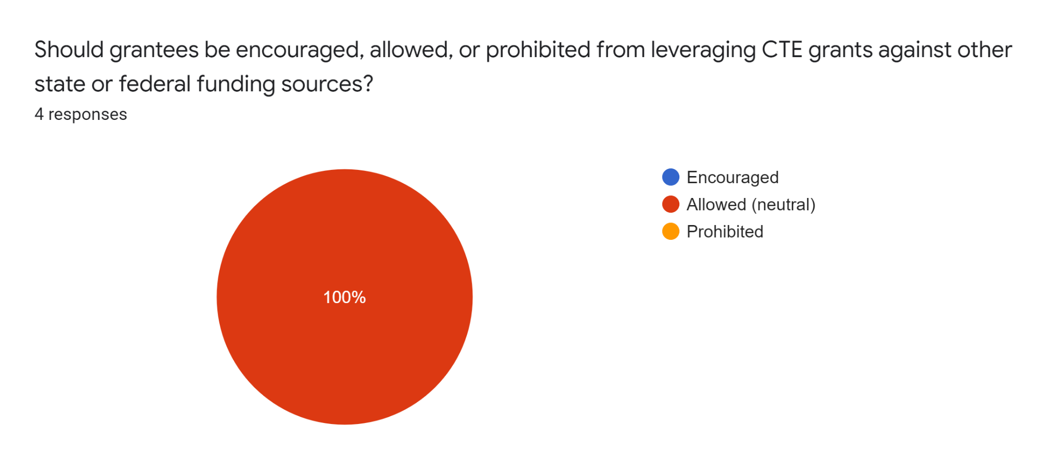
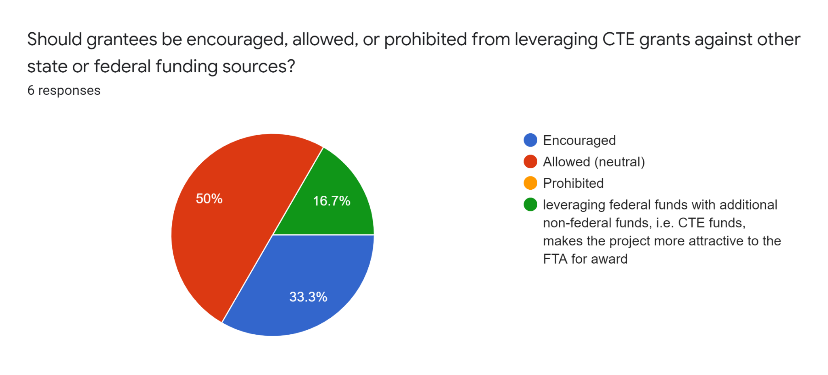
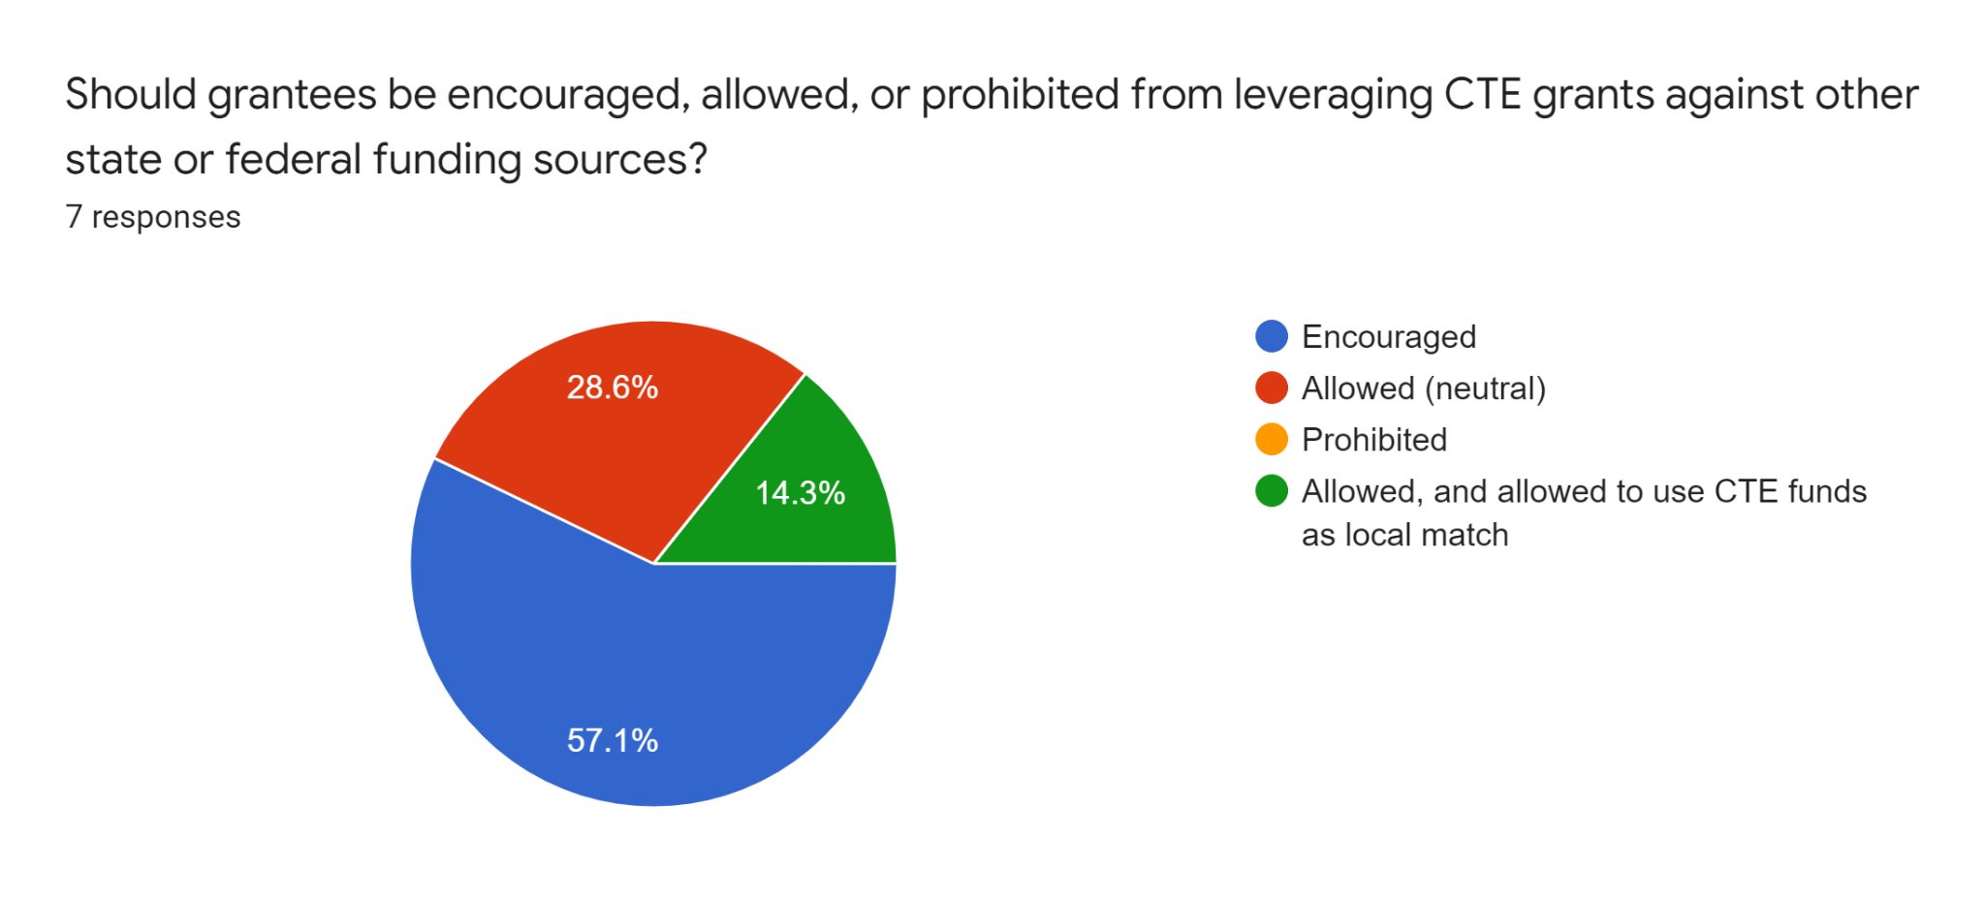
Match Levels
Many state and federal grant programs require a minimum 20% match by grantees.
Transit Monthly
CEVC Transit Subgroup
DTR Staff

Slide 16
Match Levels
Key Questions
Should the 10-Year Plan establish specific match levels or defer to staff in the program design stage of the process?
If match relief or tiered match levels are included, what factors should be used to define them? Should match levels be lower for some project types (i.e. planning) than others?
Should applicants be encouraged to use CTE funding as match for other state/federal grant programs, or would state/federal grant programs be acceptable as match for CTE funding?
Stakeholder Feedback Summary
Applicant match should either be tiered by grantee need or include a built-in match relief option to be assessed on a case-by-case basis by review committees. There may also be match tiering by project category. Agencies should be allowed and encouraged to leverage CTE funding as match for other federal and state grant opportunities, where allowable.

Slide 17
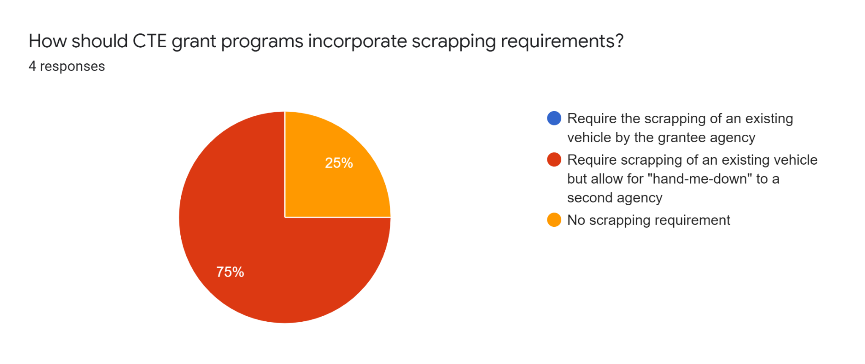
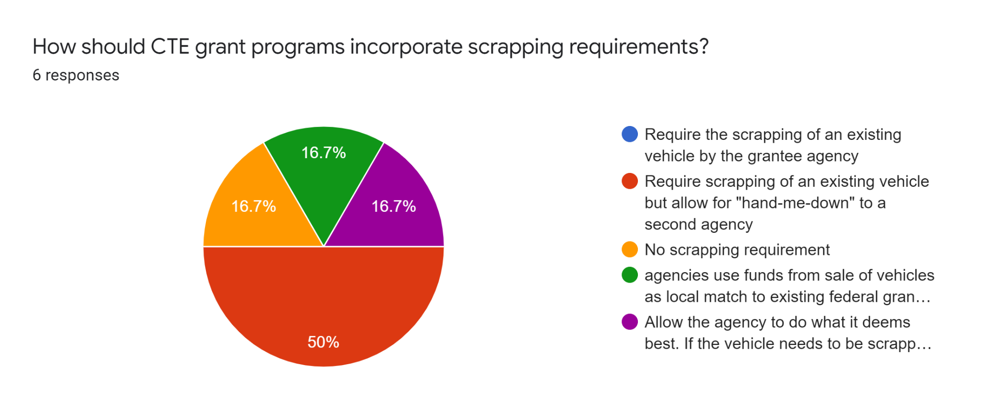
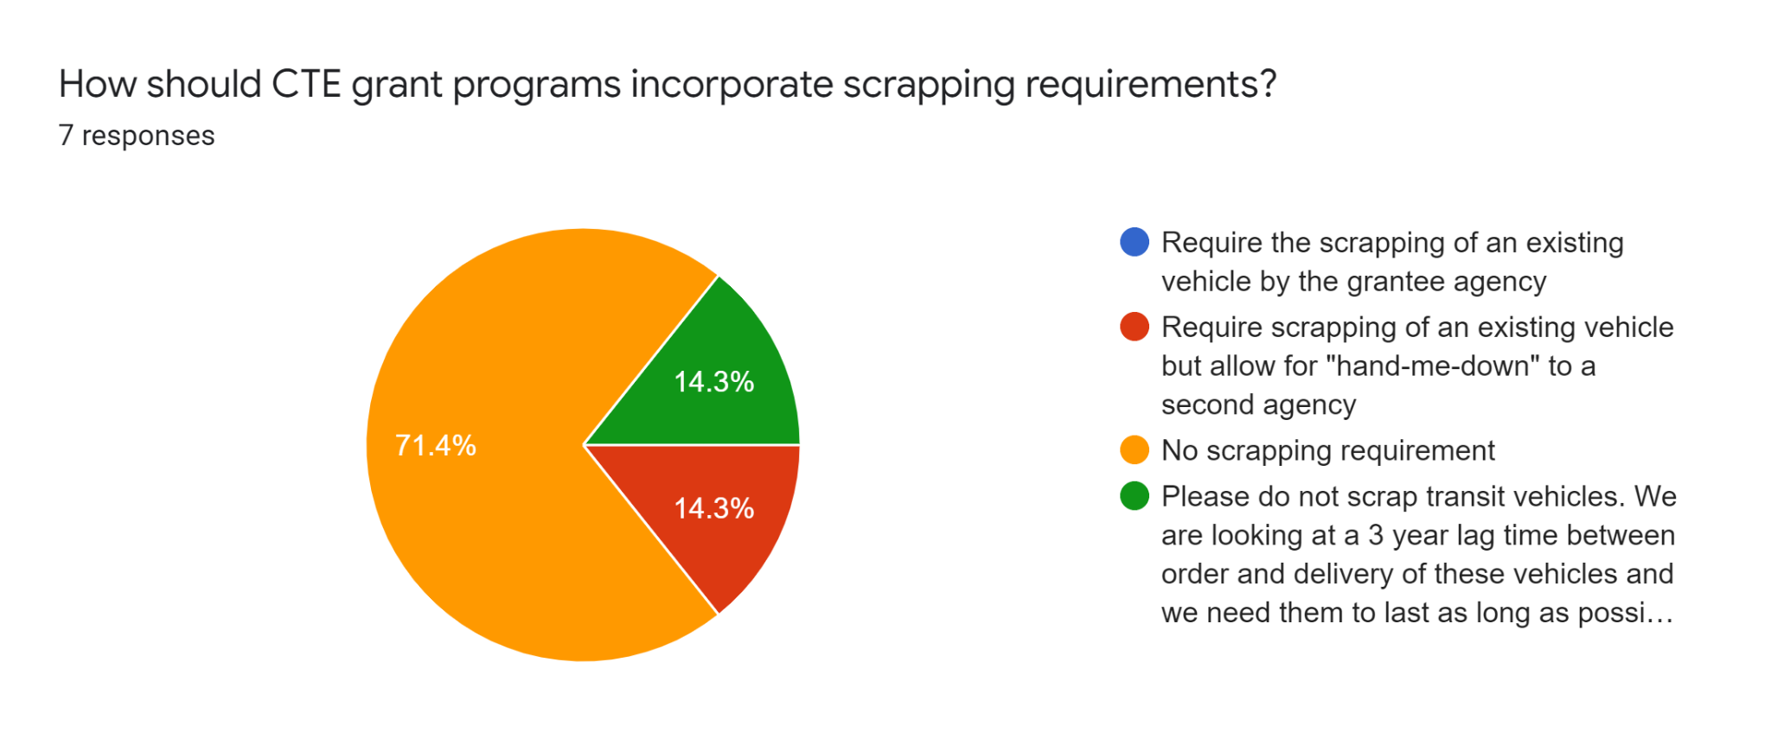
Scrapping Requirements
In the past, some zero-emission vehicle grant programs have required grantees to scrap vehicles in exchange for new vehicle funding
Transit Monthly
CEVC Transit Subgroup
DTR Staff

Slide 18
Scrapping Requirements
Key Questions
Should CTE-funded grant programs require or encourage scrapping of existing gasoline or diesel vehicles?
Should there be a “hand-me-down” option that still results in a scrapped vehicle but avoids the destruction of a still usable diesel or gasoline vehicle by a different agency?
Should greater flexibility in scrapping requirements be given to transit agencies to allow for fleet expansion during the transition process?
Stakeholder Feedback Summary
Do not require scrapping of existing vehicles, but consider creation of a hand-me-down system that would allow agencies in need of cleaner used vehicles to receive them from agencies receiving CTE-funded new vehicles.

Slide 19
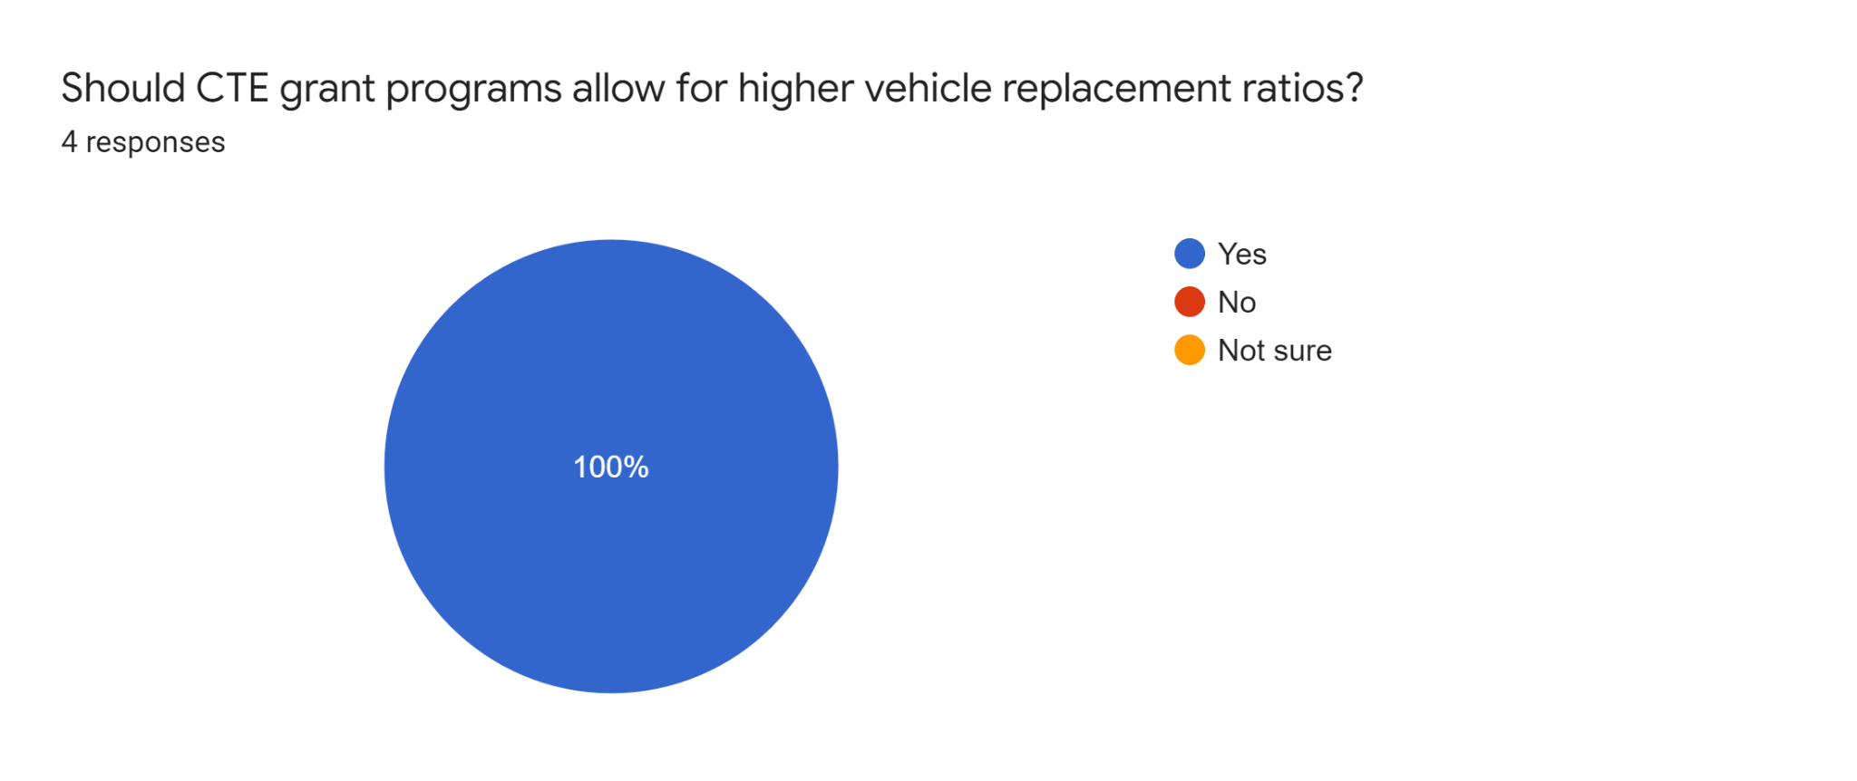
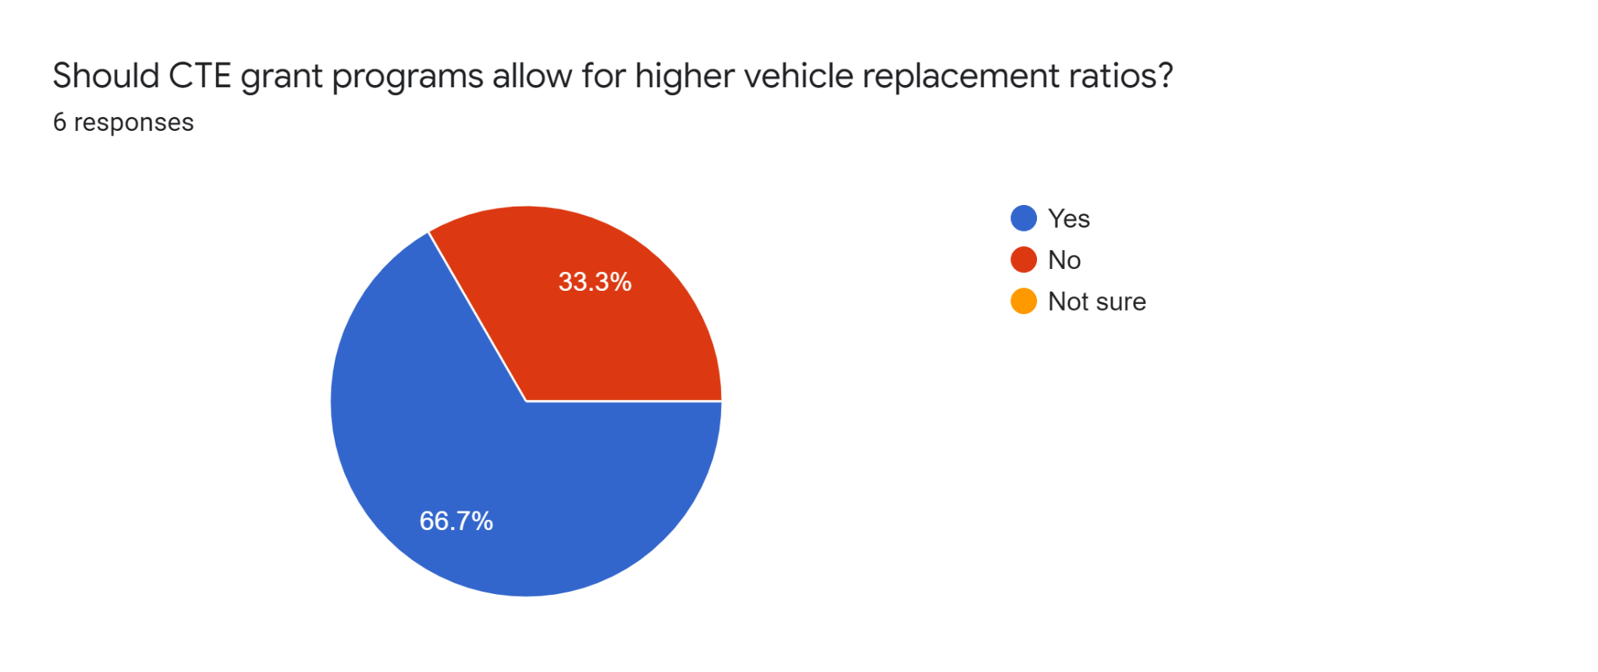
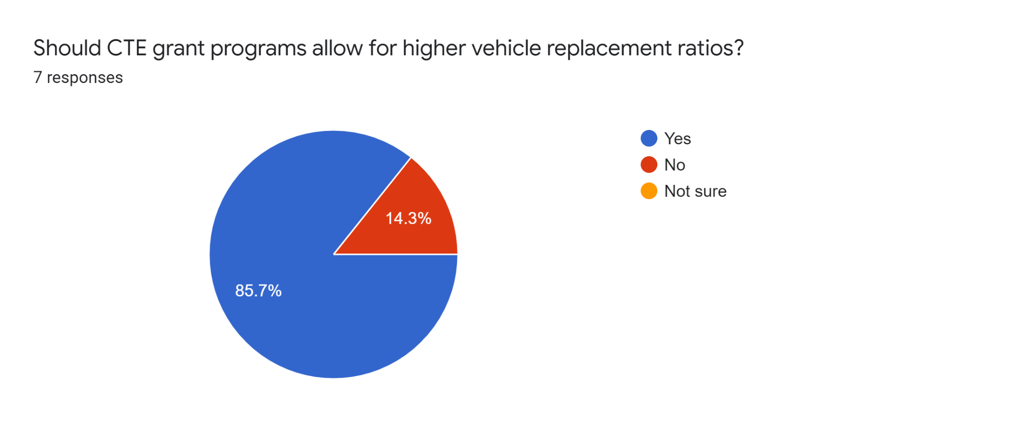
Replacement Ratios
Other state and federal grant programs often require a 1:1 ratio between new vehicles being funded and old vehicles being replaced.
Transit Monthly
CEVC Transit Subgroup
DTR Staff

Slide 20
Replacement Ratios
Key Questions
Should CTE-funded programs require a 1:1 vehicle replacement ratio or allow flexibility?
What factors should be considered in deciding whether a higher replacement ratio is justified for a given project proposal?
In terms of charging infrastructure, should a 1:1 charger-to-vehicle ratio be assumed or would a higher or lower ratio be an option?
Stakeholder Feedback Summary
Provide maximum flexibility to transit agencies to make the determination of the right vehicle replacement and vehicle-to-charger ratio for their operations, but avoid funding for chargers far in advance of bus procurement given variable standards. Encourage future-proofing of facilities to scale up charging over time as needed, and reassess appropriate replacement ratios moving forward as vehicle ranges improve.

Slide 21
Data Reporting Requirements
CDOT’s Division of Transit & Rail typically requires transit agencies to report usage data for vehicles funded with state or federal grants.
Mileage
Average Range
Passenger Trips
Charging Times
Emissions Reductions (cost per pound)
kWh per Mile
Cost per Mile
Maintenance Costs
Battery Capacity Over Time

Slide 22
Data Reporting Requirements
Key Questions
Should CTE-funded projects be required to report more detailed usage data for the state to compile, analyze, and share with other transit agencies and stakeholders?
If so, what data points should be included (or excluded) from the requirements?
Stakeholder Feedback Summary
Work with agencies to align existing NTD reporting with any CTE data reporting requirements to ensure it is not burdensome. Collect data that will be used to inform program design, and establish a linkage between this data and the CDOT Transit Emissions Dashboard to consistently quantify GHG reductions and other air quality benefits. Explore how to quantify equity implications and benefits for disproportionately impacted communities through the CTE and its funding programs.

Slide 23
Additional Topics
Key Questions
Should the 10 Year Plan include approximate yearly dollar or percentage ranges for each project category?
What is an appropriate reserve level for the CTE to maintain in order to manage year-to-year fluctuations in fee revenues and other unanticipated challenges?
Should the CTE establish a process or funding pool to react quickly to project cost increases without requiring a full re-application?
Should the CTE consider funding a statewide on-call planning support offering in addition to funding individual agency-specific Planning proposals?
How does the Board want to respond to requests for endorsements or letters of support from local transit agencies pursuing competitive federal grants?

Slide 24
Upcoming Engagement Opportunities
Stakeholder Engagement
April 7, 2022 - Transit Monthly Meeting
April 12, 2022 - Clean Transit Enterprise Board Meeting
April 20, 2022 - CEVC Transit Subgroup Meeting
May 5, 2022 - Transit Monthly Meeting
May 11, 2022 - Clean Transit Enterprise 10 Year Plan Work Session
May 13, 2022 - Transit & Rail Advisory Committee (TRAC) Meeting
May 18, 2022 - CEVC Transit Subgroup Meeting
May 23-27, 2022 - CASTA Spring Conference
May 25, 2022 - Clean Transit Enterprise Board Meeting
June 1, 2022 - 10-Year Plan Completion Deadline
Expect to share a draft 10 year plan with the CTE Board by May 20th

Slide 25
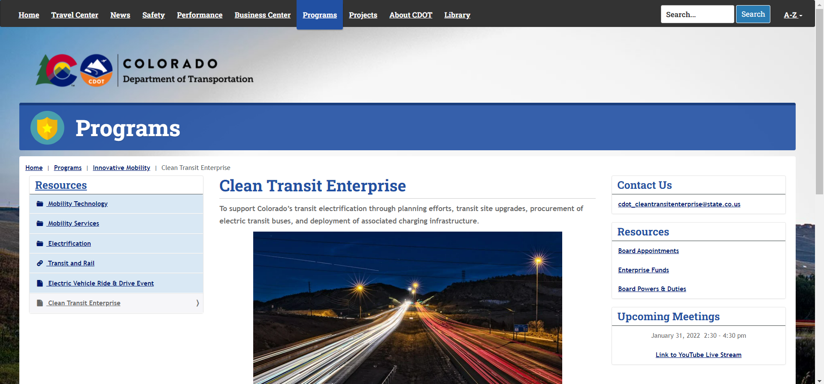
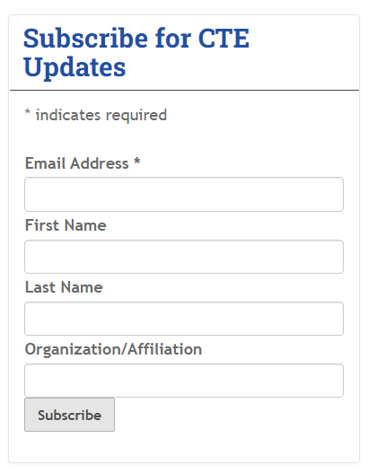
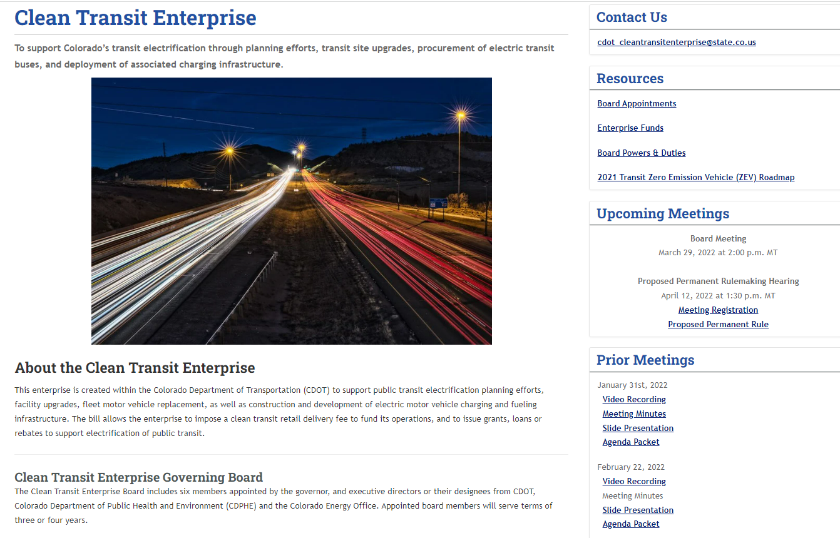
More Information
https://www.codot.gov/programs/innovativemobility/cte

Slide 26
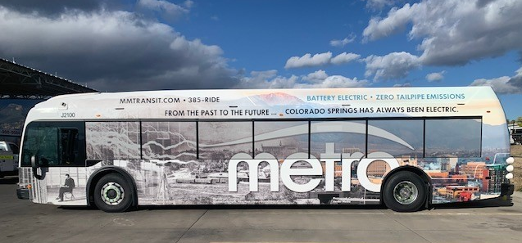
Questions & Discussion
‹#›

