Slide 1
Problem Statement Title
Author and Affiliation: [Jane Doe, CDOT Research Branch]
CDOT Champion: [Name of CDOT project champion, use TBD if none exists yet]
Cost and Duration: [$XX,000 for XX years]
Description: [What is the problem, and who/what does it affect? Keep this short]
Objective(s): [The desired outcome(s) and expected final product(s).]
Benefits to CDOT: [Concisely explain: Why solving this problem is important to CDOT. What are the anticipated cost/time savings or other benefits to CDOT?]
Implementation: [How will CDOT be able to implement the results?]
Supplements. [Add relevant photo(s), table(s), etc., but total slides must be under three.]

Slide 2
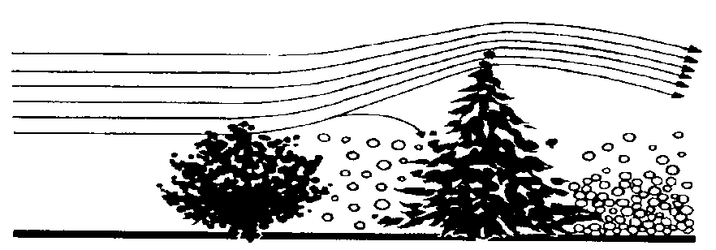
(Example) Living Snow Fences to Reduce Maintenance Costs and Improve Safety
Author and Affiliation:
  Mike Banovich, CDOT Landscape Architect
CDOT Champion:
  Mike Banovich
RIC Sponsor:
  Jane Hann CDOT EPB
Cost and Duration:
  $90,000 for 2 yrs (Colorado State Forest Service contributing additional $60,000)
Description:
  Living snow fences are highly sustainable engineering actions for highway corridors
  Designed plantings of trees, shrubs, native grasses create very effective vegetative buffers to trap and control blowing / drifting snow
  High longevity and cost-effective to maintain
  But require more space (up to 200’ setback) and time (5-7 yrs) to be effective
  See maintenance cost comparison below (USDA, 1994):
Cost to Maintain Living Snow Fence | Cost to Maintain Typical 4’ Slat Fence
$3/mile/yr | $185/mile/yr

Slide 3
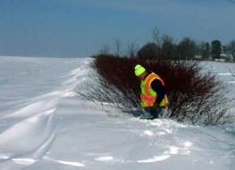
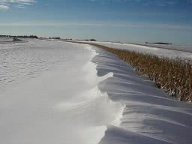
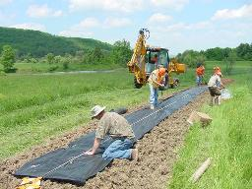
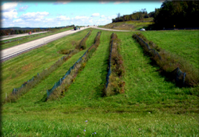
(Example) Living Snow Fences to Reduce Maintenance Costs and Improve Safety
Objective(s):
  Identify priority areas for strategic snow fence placement
  Produce site-specific ecologically appropriate species lists, planting guidelines and partnership opportunities
Benefits to CDOT:
  Reduced effort on snow management and fence maintenance
  Improve road visibility and driver safety
  Energy cost, sustainability, stewardship
  Visual screens
  Potential mitigation for tree removal
Implementation:
  New guidance and specs for living fence construction in highway design and landscape planning

Slide 4
Blank Two Column Template

