Slide 2
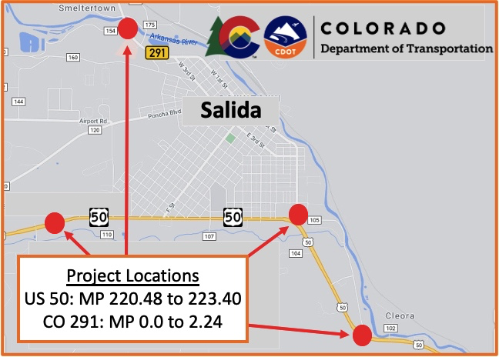

Slide 3
ADA Ramps & Streetscape Improvements:
US 50: MP 220.48 to 223.40, East 15 St.
CO 291: 0.0 to 2.24, Wood Ave, B St., D St., E St., G St., I St., L St., M St., N St., O St.

Slide 4
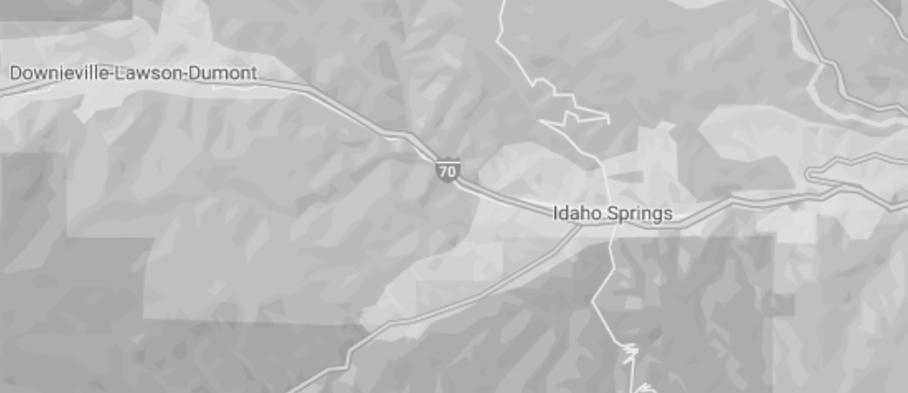
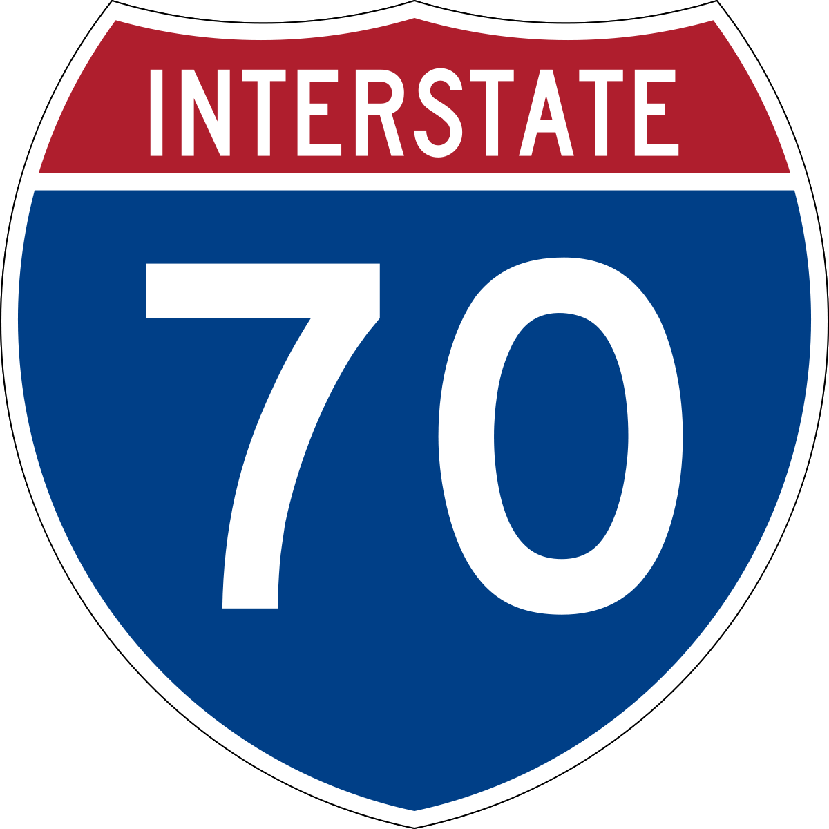
MP 235
MP 242
I-70 Clear Creek Greenway Path
Mileposts: 235 & 242

