Slide 1
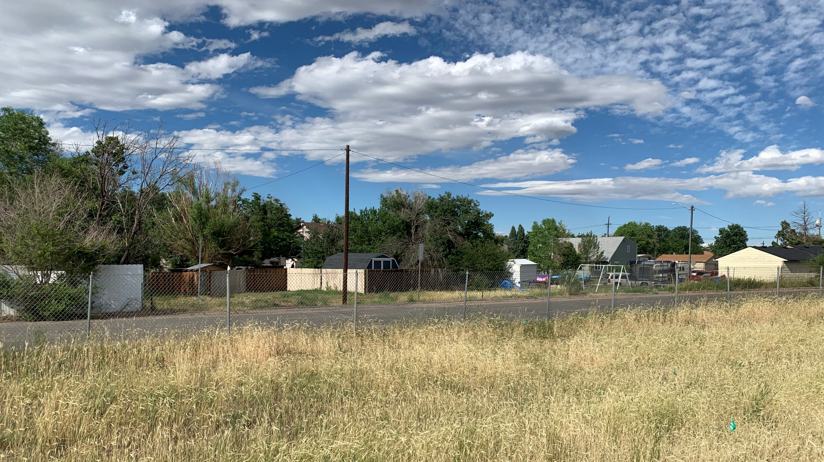
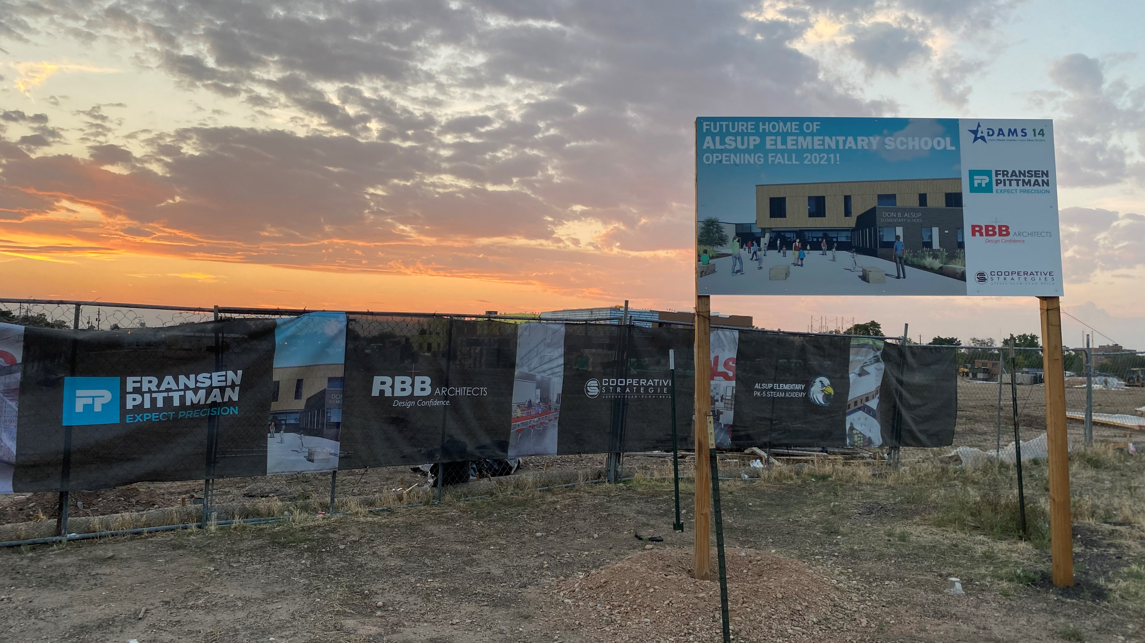
Community & Environmental Resource Evaluation

Slide 2
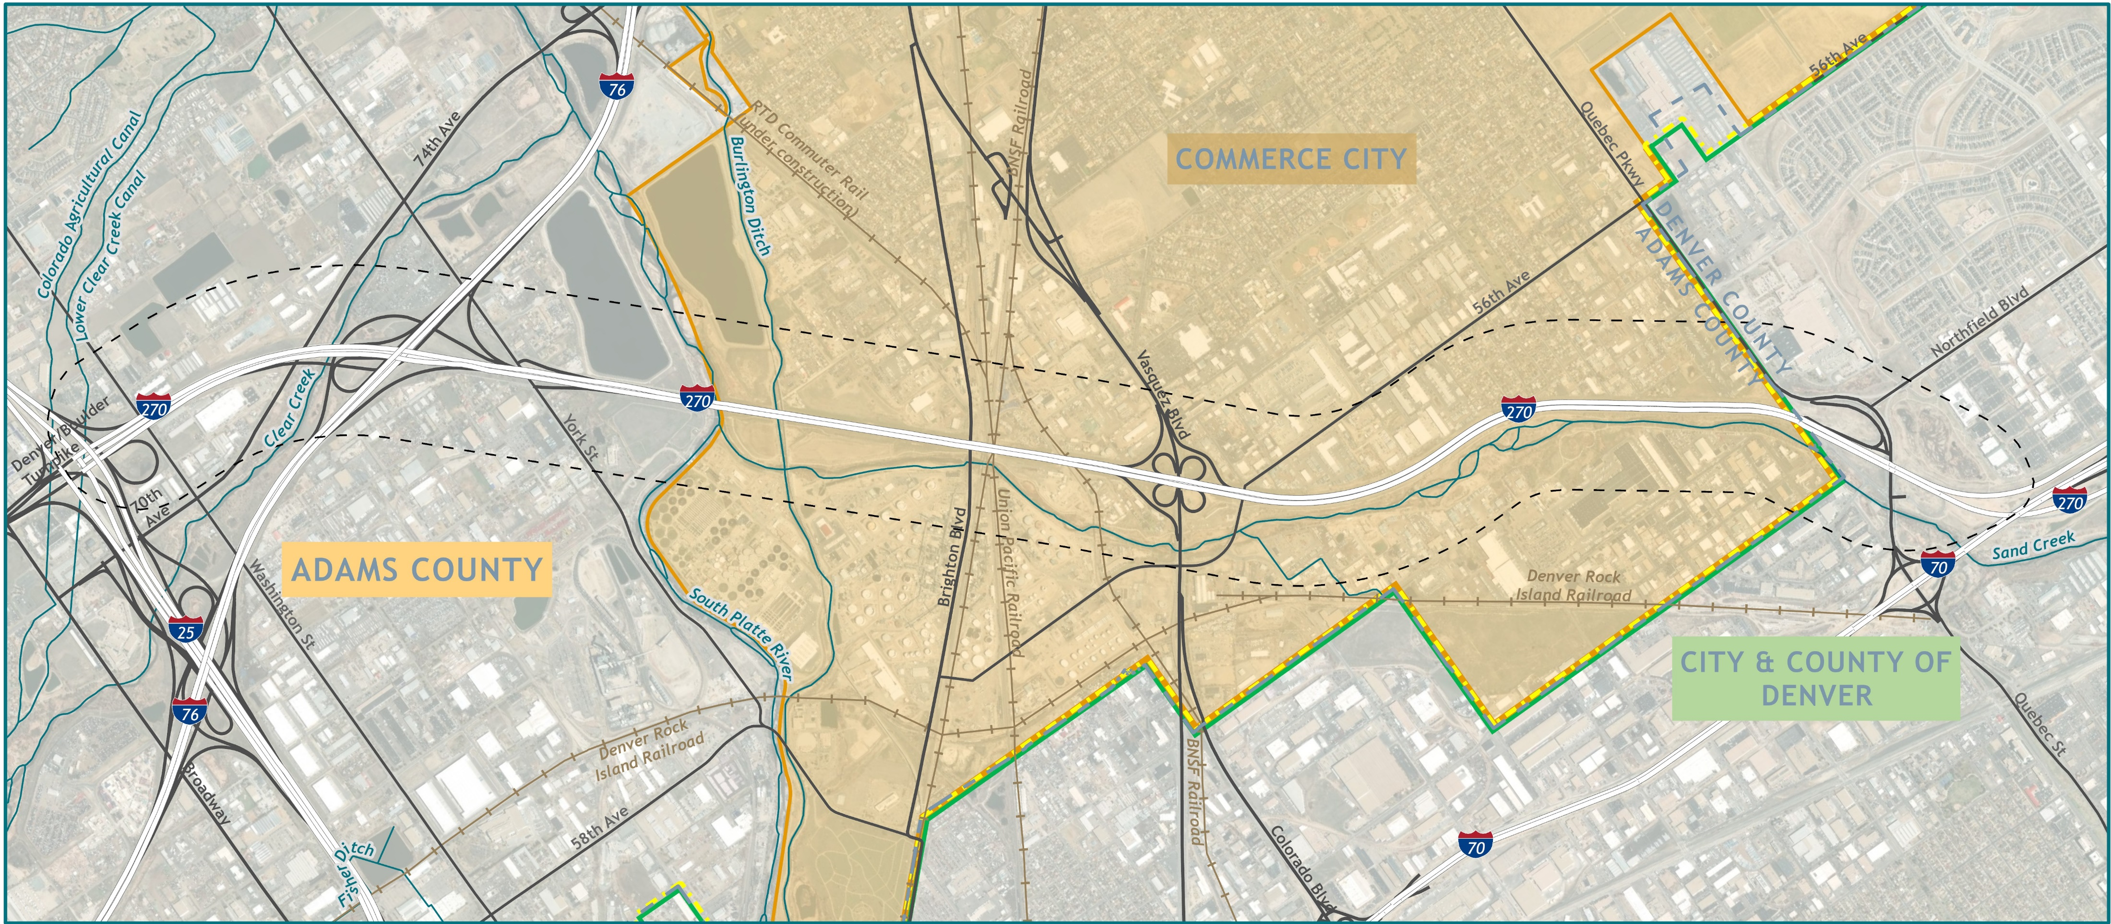
Community & Environmental Resources

Slide 3
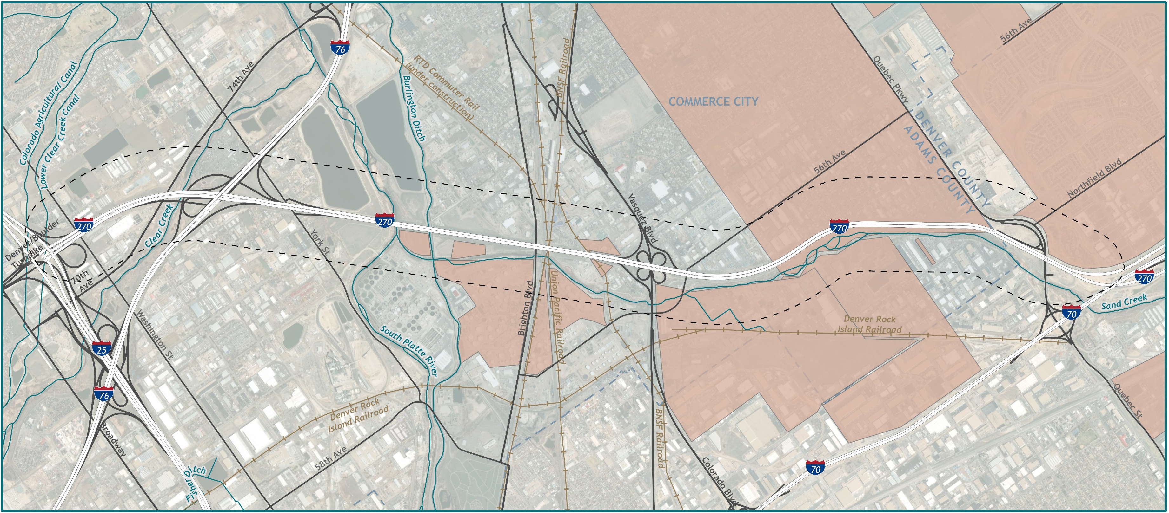
Community & Environmental Resources

Slide 4
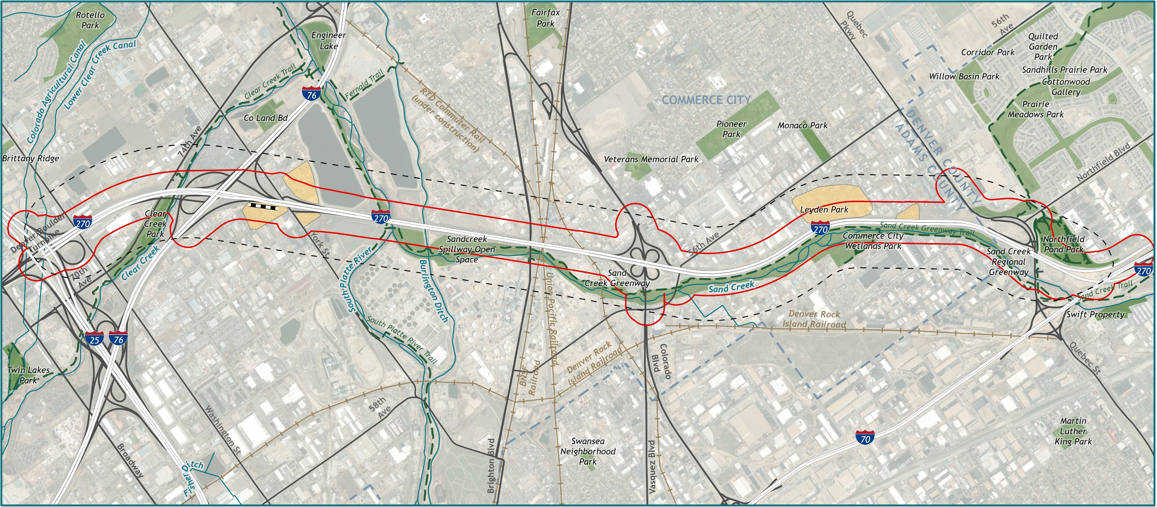
Community & Environmental Resources

Slide 5
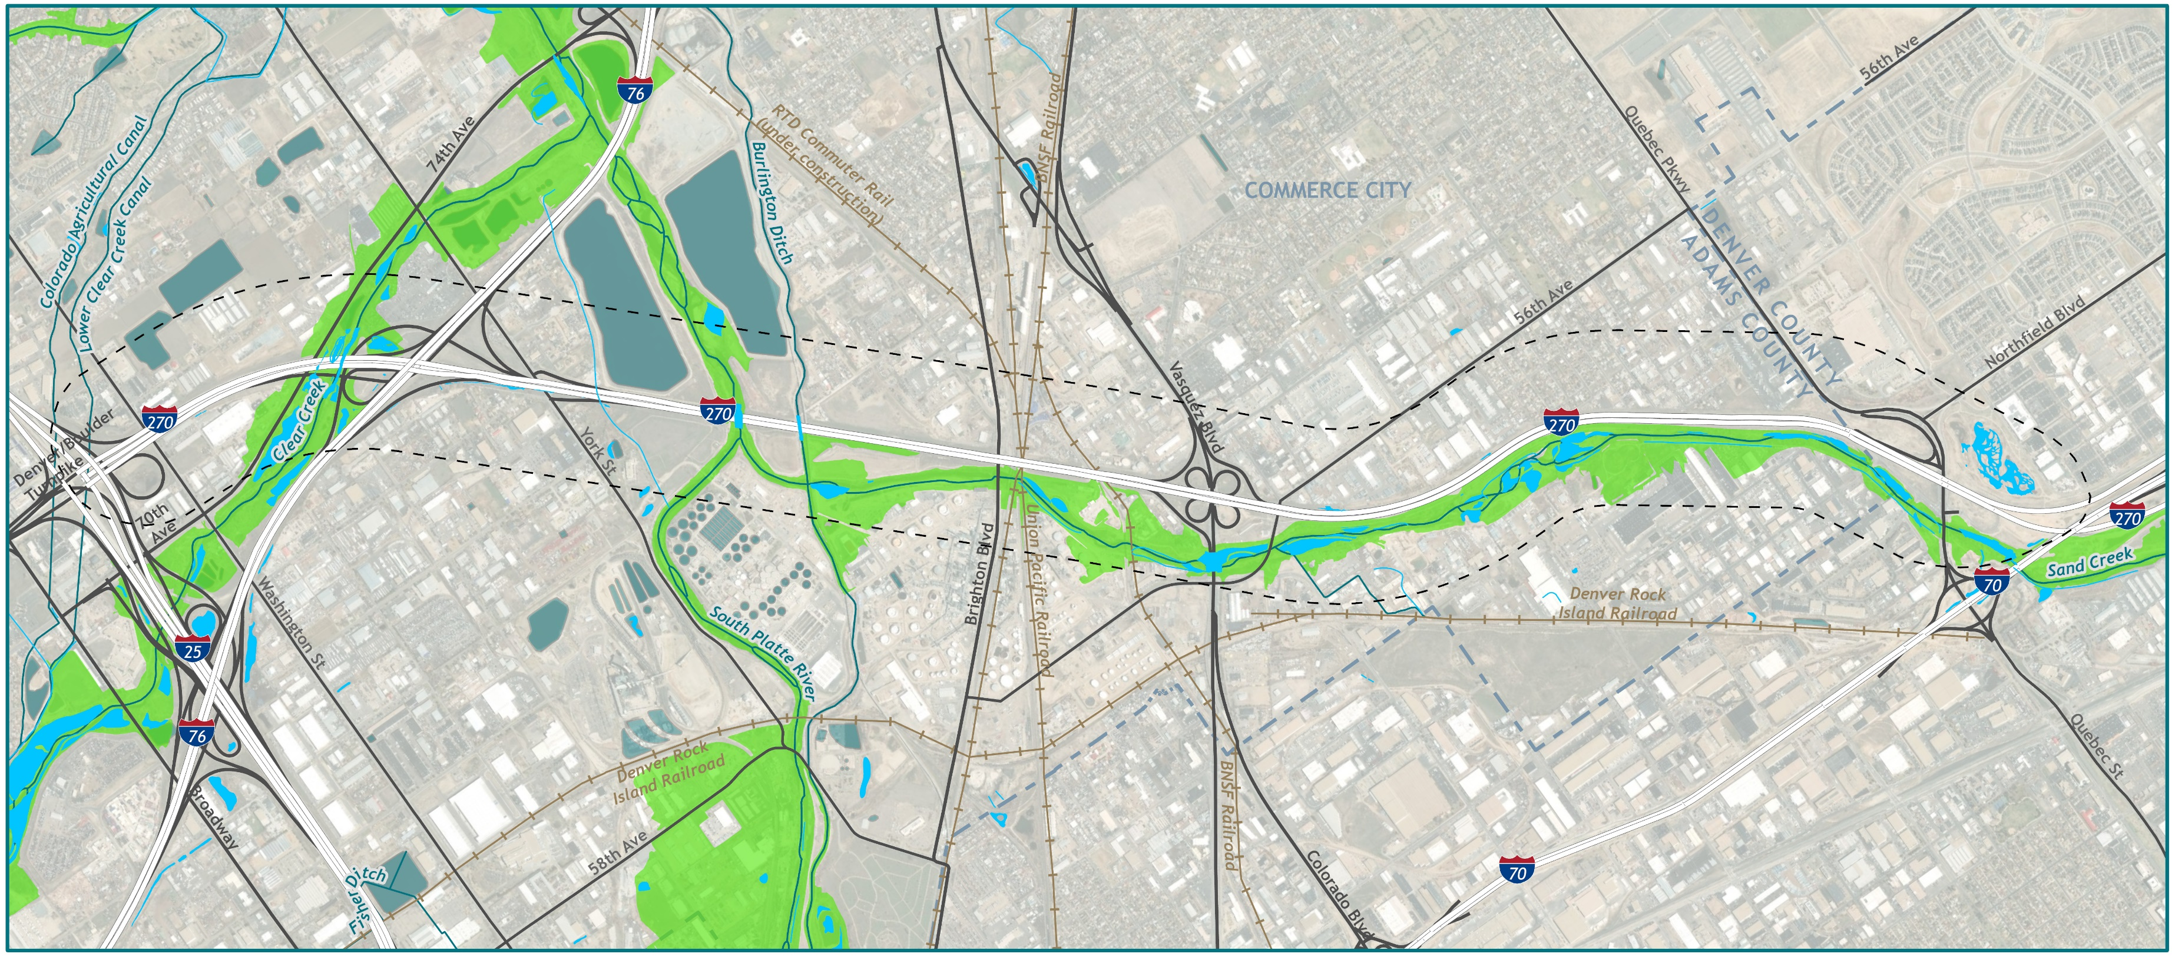
Community & Environmental Resources

Slide 6
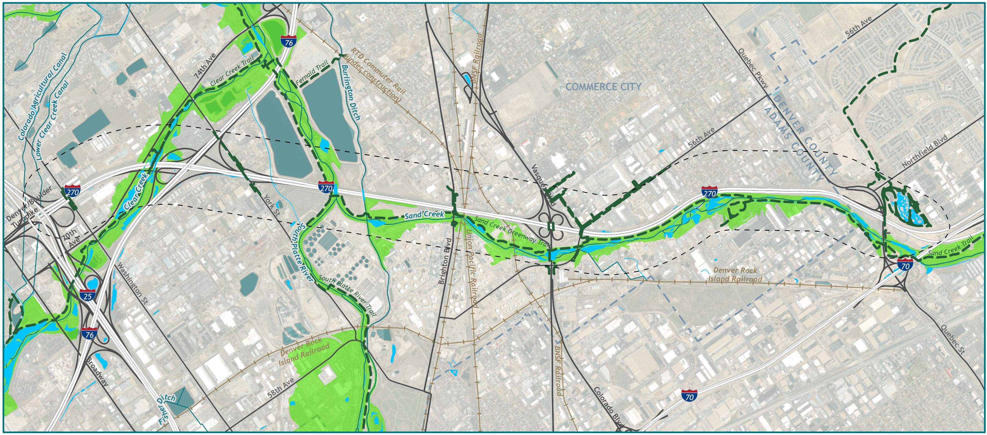
Community & Environmental Resources

Slide 7
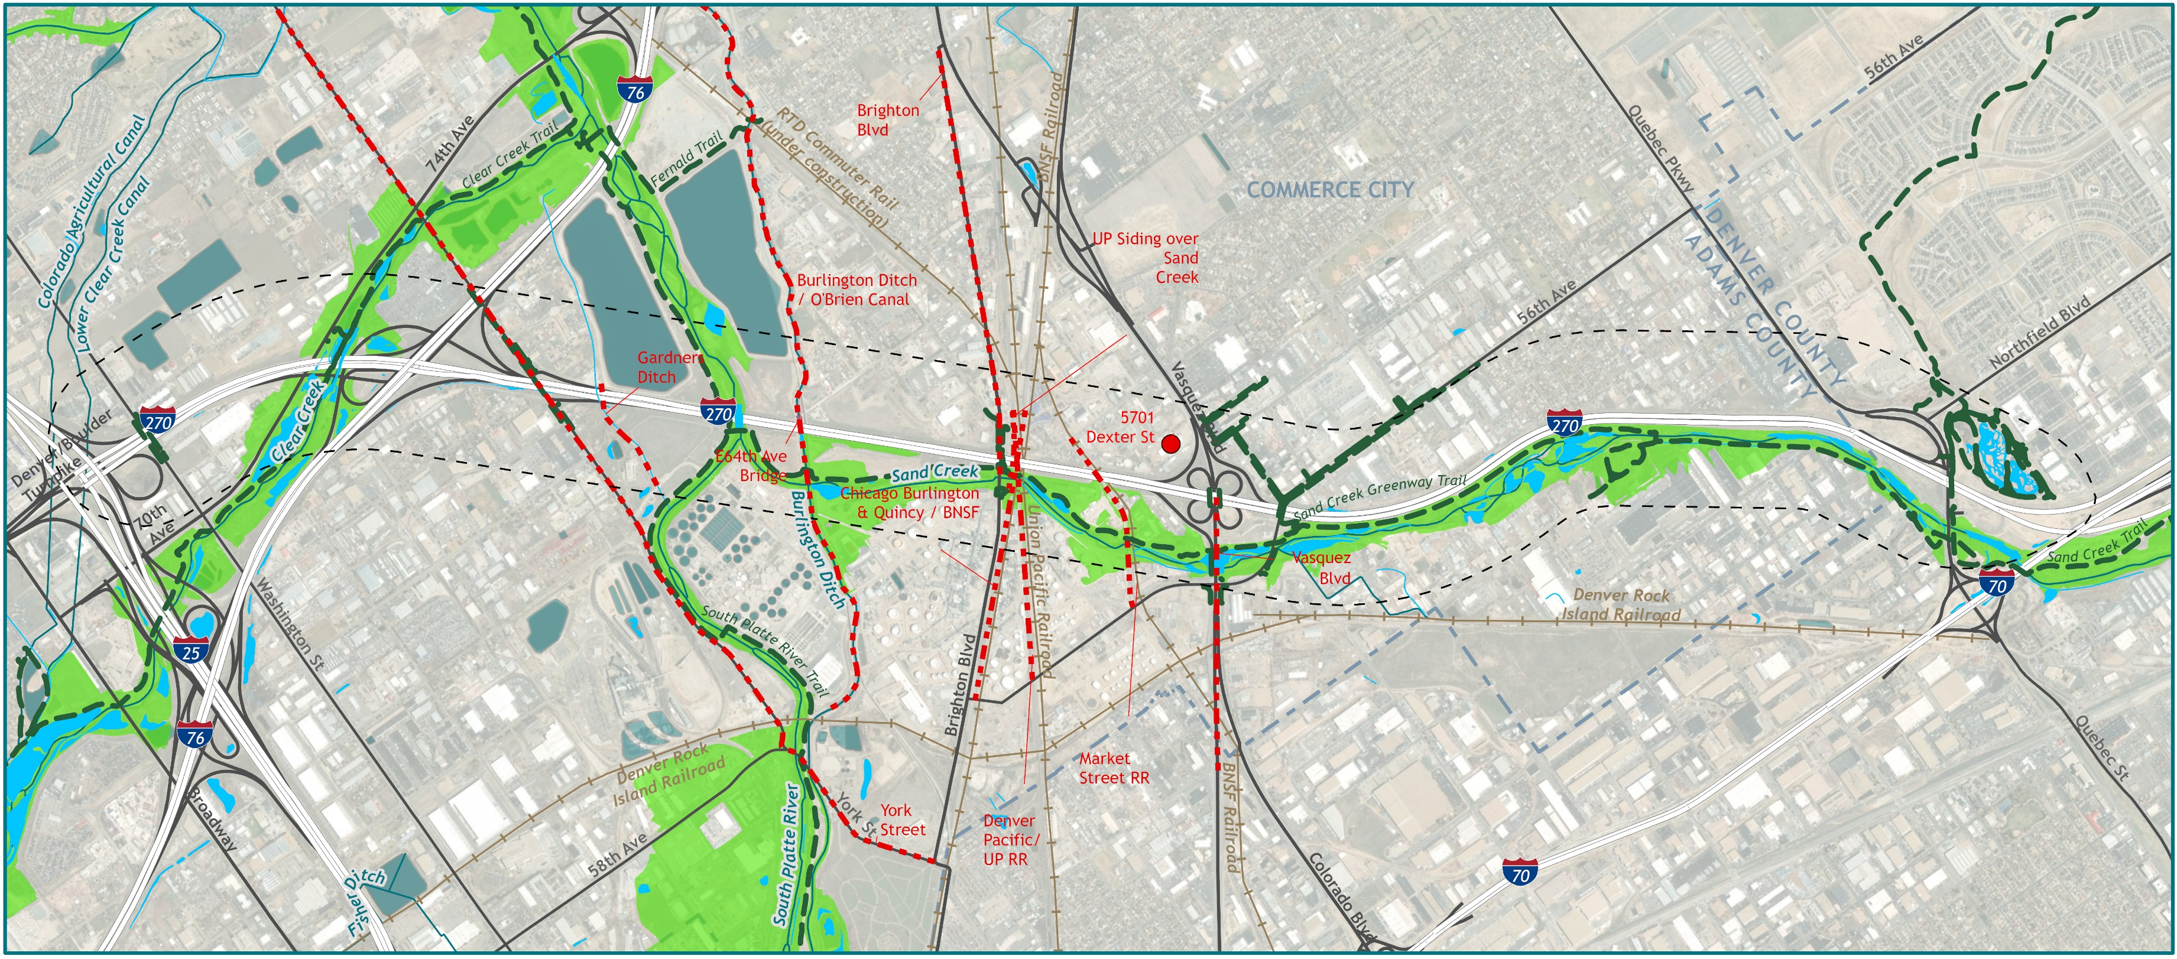
Community & Environmental Resources

Slide 8
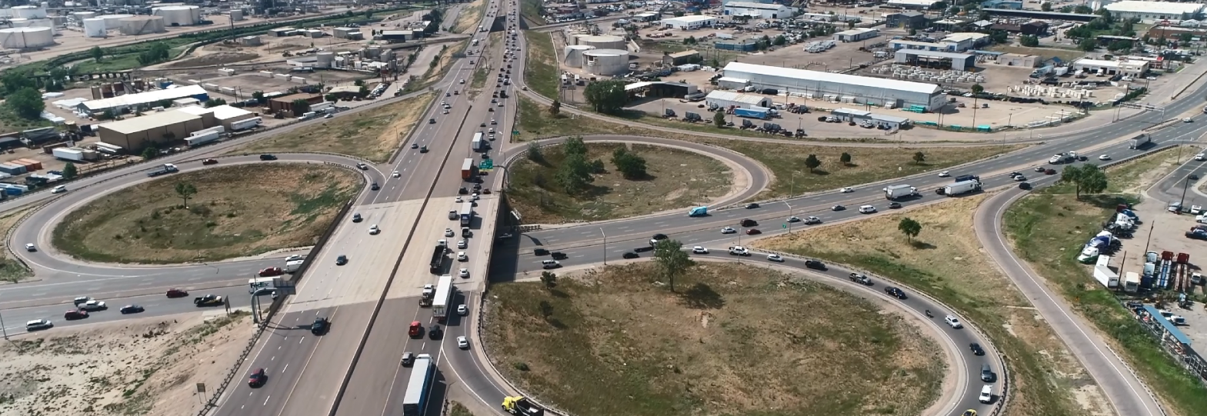
Community & Environmental Resources
Clean Air Act
Requires that the project achieve transportation conformity.
Project would not cause or contribute to any new localized violations
Project would not increase the frequency or severity of any existing violations
Project would not delay attainment of national ambient air quality standards or required emission reductions

Slide 9
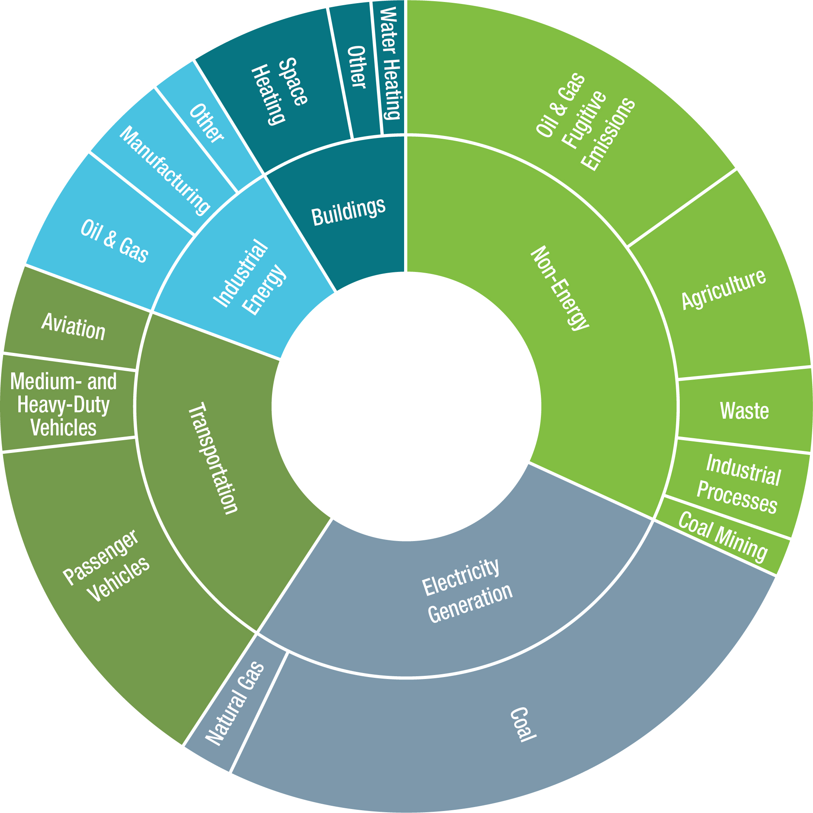
Community & Environmental Resources
Sources of greenhouse gases in Colorado
Transportation greenhouse gas emissions come primarily from internal combustion engines in our cars, trucks, trains, and planes.
Adapted from Colorado Greenhouse Gas Pollution Reduction Roadmap, CDOT 2020

Slide 10
“To enhance the quality of life and the environment of the citizens of Colorado by creating an integrated transportation system that focuses on safely moving people and goods by offering convenient linkages among modal choices.” CDOT Vision Statement

