Slide 1

Child Passenger Safety for Law Enforcement

Slide 2

WHY ARE WE HERE?
To Create an Awareness of the importance of Child Passenger Safety Education & ENFORCEMENT.
To work to integrate Child Passenger Safety into our traffic stops.

Slide 3
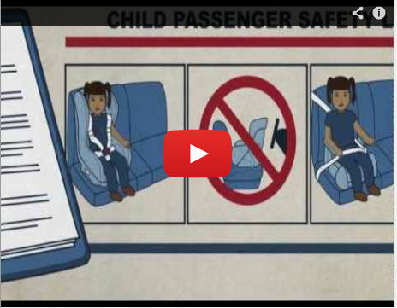
VIDEO
http://www.youtube.com/watch?v=2jGKKzxmZds&feature=player_embedded

Slide 4
CPS – Child Passenger Safety Laws can be confusing as there are numerous elements written into the law.
These laws are
ALL PRIMARY ENFORCEMENT
Notes:
Enforcement of the Law is a counter measure that works (as define by NHTSA).

Slide 5
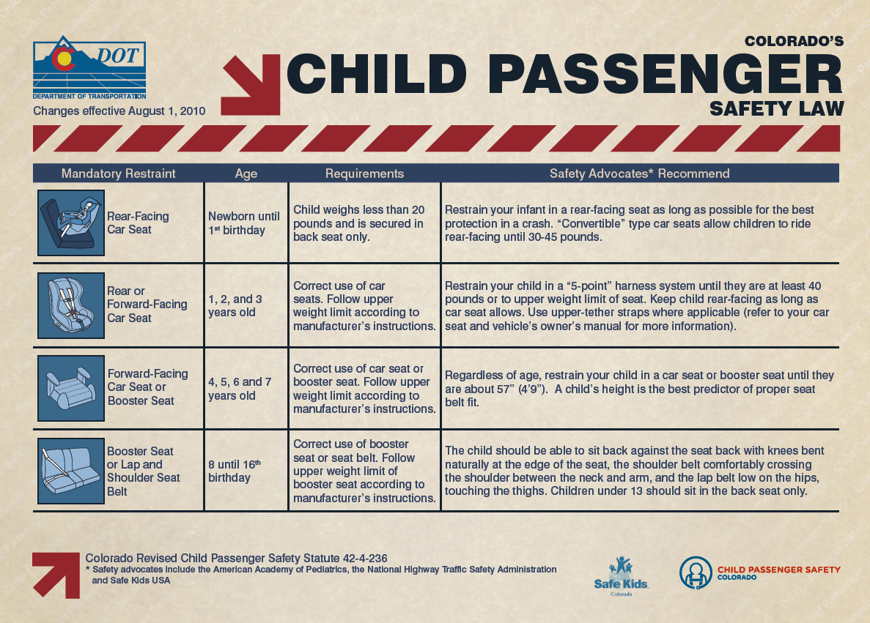
Colorado Law vs. Best Practice
Notes:
The CPS Law can be confusing so there is a guide for Law Enforcement as well as parents.

Slide 6
COLORADO LAW 42-4-236
“Unless exempted pursuant to subsection (3) of this section and except as otherwise provided in subparagraphs (II) and (III) of this paragraph (a), every child who is under eight years of age and who is being transported in this state in a motor vehicle or in a vehicle operated by a child care center, shall be properly restrained in a child restraint system, according to the manufacturer’s instructions”
“Unless excepted pursuant to subsection (3) of this section, every child who is at least eight years of age but less than sixteen year of age who is being transported in this state in a motor vehicle or in a vehicle operated by a child care center, shall be properly restrained in a safety belt or child restraint system according to the manufacturer’s instructions.”

Slide 7
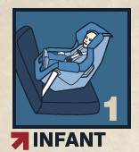
Children (Newborn – 1 year)
Statute 42-4-236 (2)(a)(II)
Less than 20 lbs.
    Rear-facing safety seat in a rear seat of the vehicle.
  20-40 lbs.
    Rear-facing safety seat in a rear seat of the vehicle.
1 year AND 20 lbs.
    Must meet both requirements for turning the child forward-facing.
  Must be installed according to Manufacture’ s instructions. NEVER place a rear facing child restraint in front of an active airbag.

Slide 8
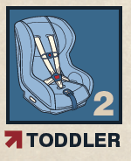
Children (1 - 3 years)
Statute 42-4-236 (2)(a)(III)
Less than 20 lbs.
    Rear-facing safety seat in a rear seat of the vehicle.
20-40 lbs.
    The child shall be properly restrained in a rear-facing or forward-facing child restraint system.
1 year to their 4th Birthday.

Slide 9
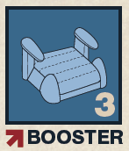
Children (4 – 7 years)
Statute 42-4-236*
Forward facing 5 point harness or a belt positioning booster seat.
If the child exceeds the weight limit of the safety seat then a vehicle seat belt must be used.
Never use a lap-only belt with a booster seat.
4 years to their 8th Birthday

Slide 10
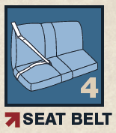
Children (8 – 16 Years)
Statute 42-4-236 (2)(a)
Booster seat or vehicle seat belt.
Children may remain in a car seat or booster seat beyond stated age as long as they fall within the car seat manufacturer’s instructions and weight requirements, for safety.

Slide 11
BEST PRACTICES
THIS MEANS TRANSPORTING A CHILD IN THE SAFEST WAY POSSIBLE WHILE USING CHILD SAFETY SEATS CORRECTLY AND WITHIN THE GUIDELINES OF THE COLORADO LAW.
Children should ride rear facing until at least age 2 or until children have reached the maximum ht & wt limit of the convertible car seat.
Forward Facing -use a harnessed seat up to the maximum ht & wt limit for the car seat.
Use a booster seat until child fits correctly in a vehicle lap and shoulder belt – 5 step test (about 4”9”)
All children under the age of 13 should ride in the back seat. (not a teenager – back seat)

Slide 12
MORE INFO ABOUT CPS LAW
ENFORCEMENT ACTION
EXEMPTIONS
If the parent is in vehicle, the parent gets the ticket.
Violation of this law shall not constitute negligence per se or contributory negligence per se.
Minor Driver
    Enforcement action should be GDL, not CPS.
Medical Emergencies
Taxi’s, Busses, Shuttle Vans, Etc.
RV’s.
Commercial Vehicle Operated by a Day Care Facility.
    Does not constitute CMV until 16+ passengers. Look for License Endorsement.

Slide 13
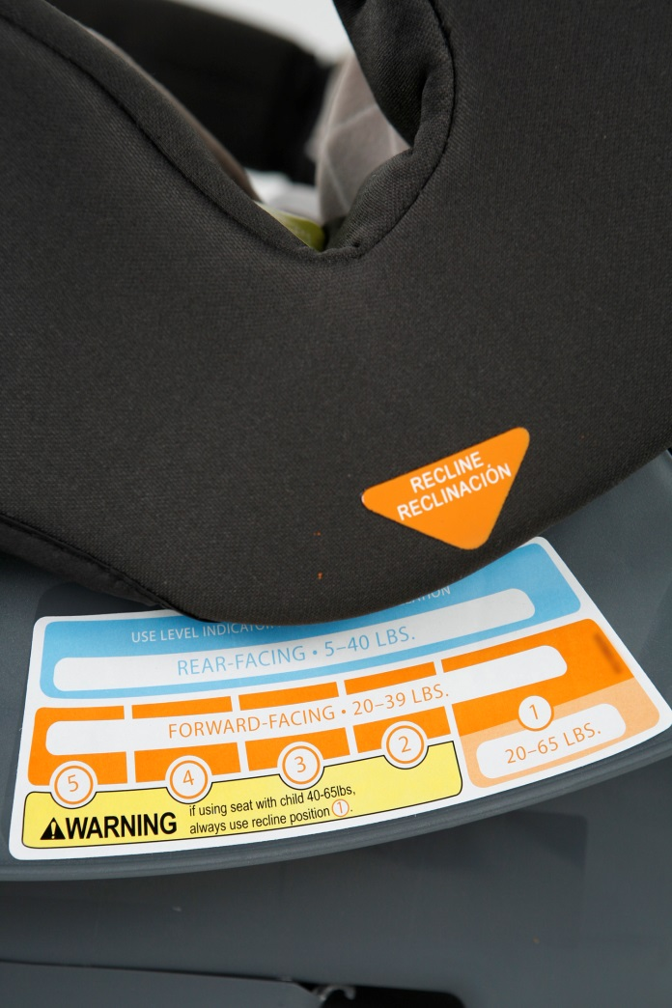
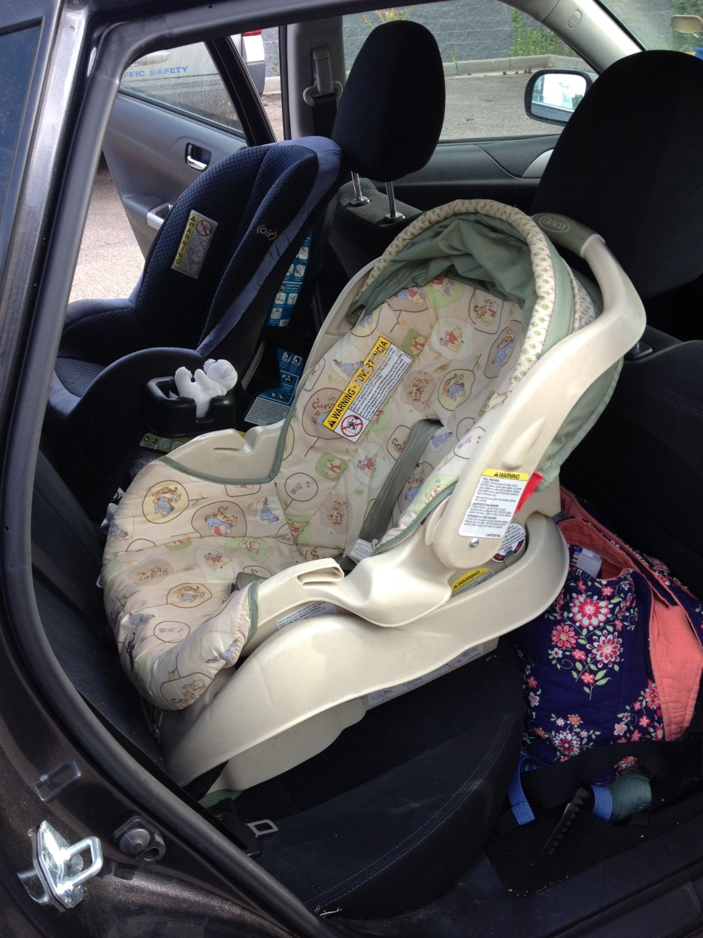
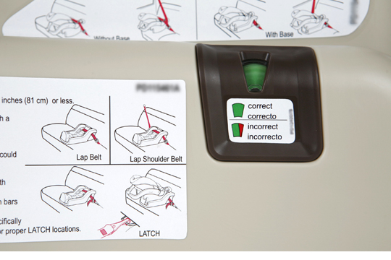
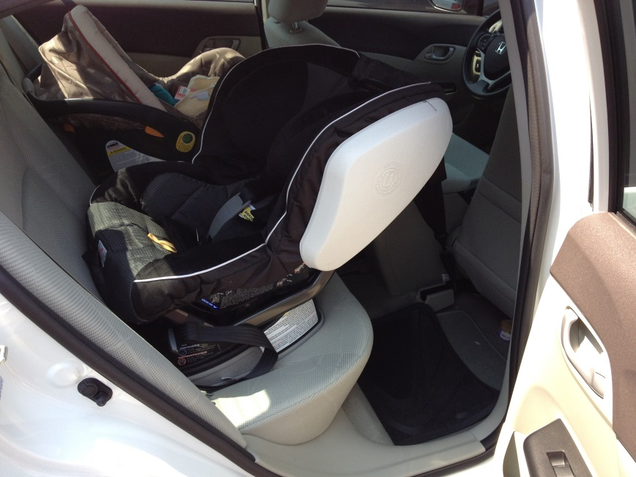
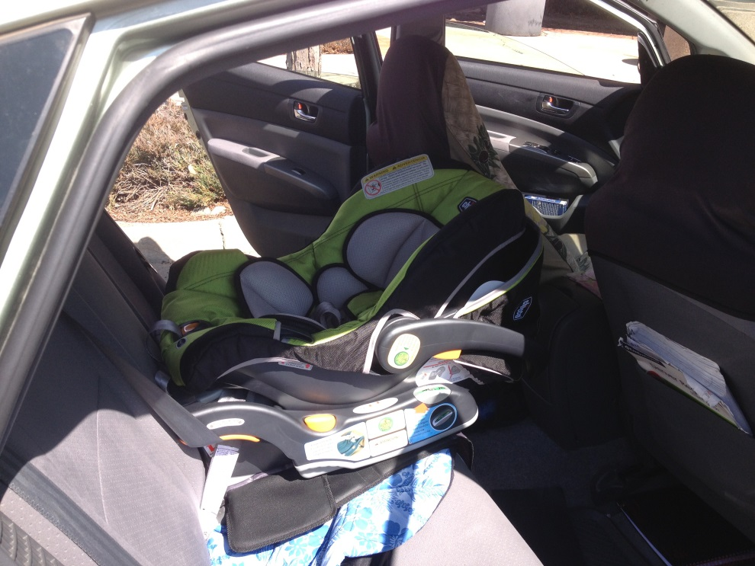
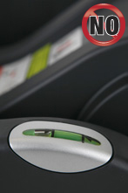
IS it installed according to the manufacturer’s instructions?
Angle for Rear Facing Seats
Notes:
Should be 35-45 degree angle. Look for the indicator on the side of the seat. Infants that do not have head control are especially vulnerable to airway blockage if angle is not correct.

Slide 14
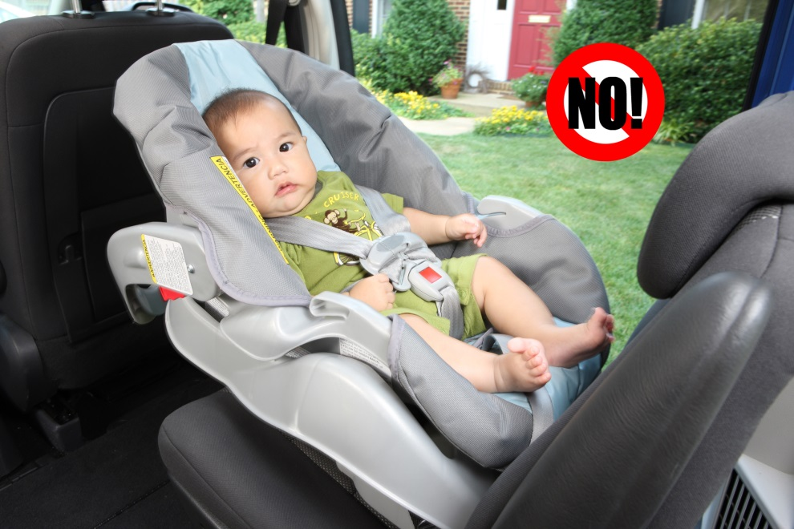
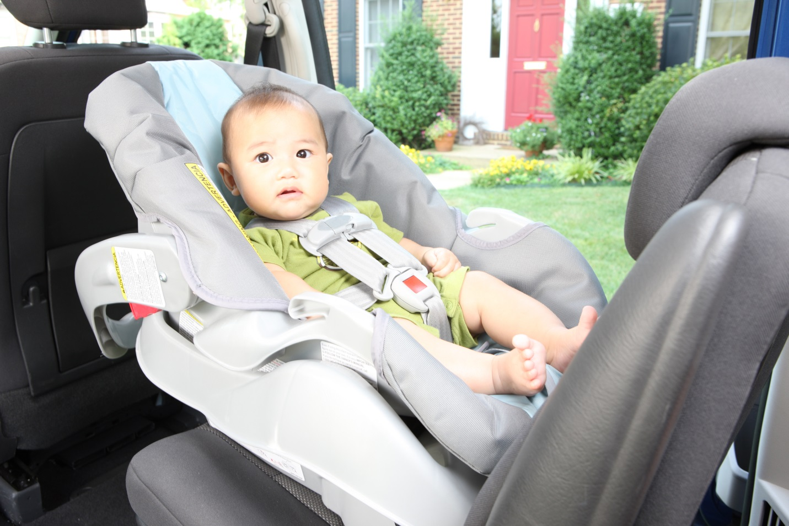
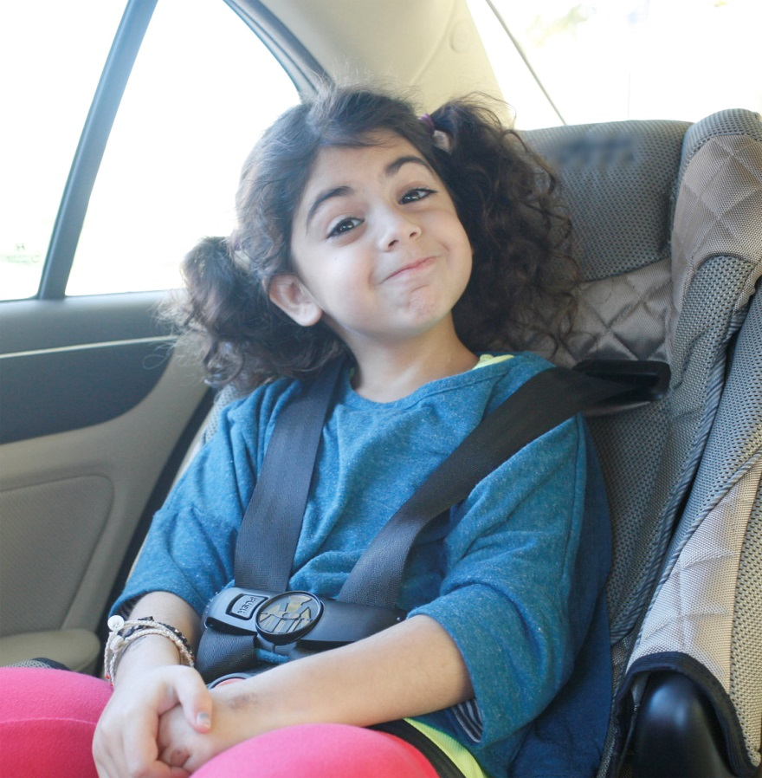
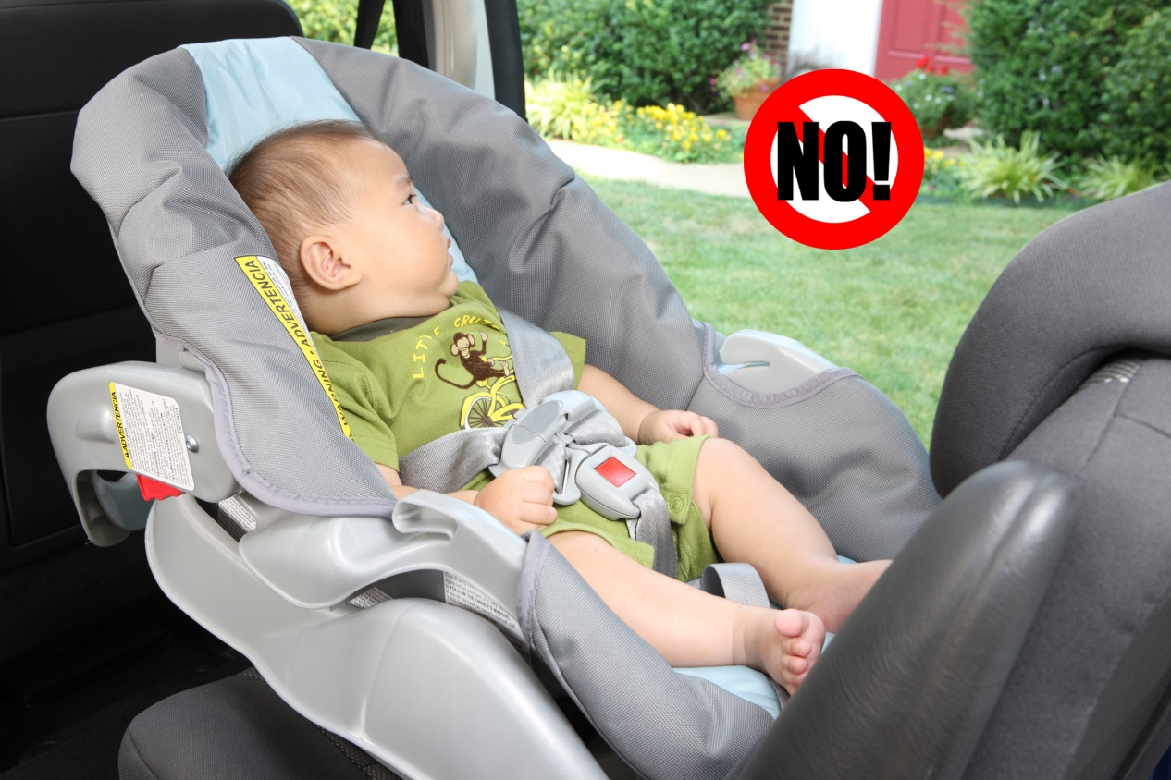
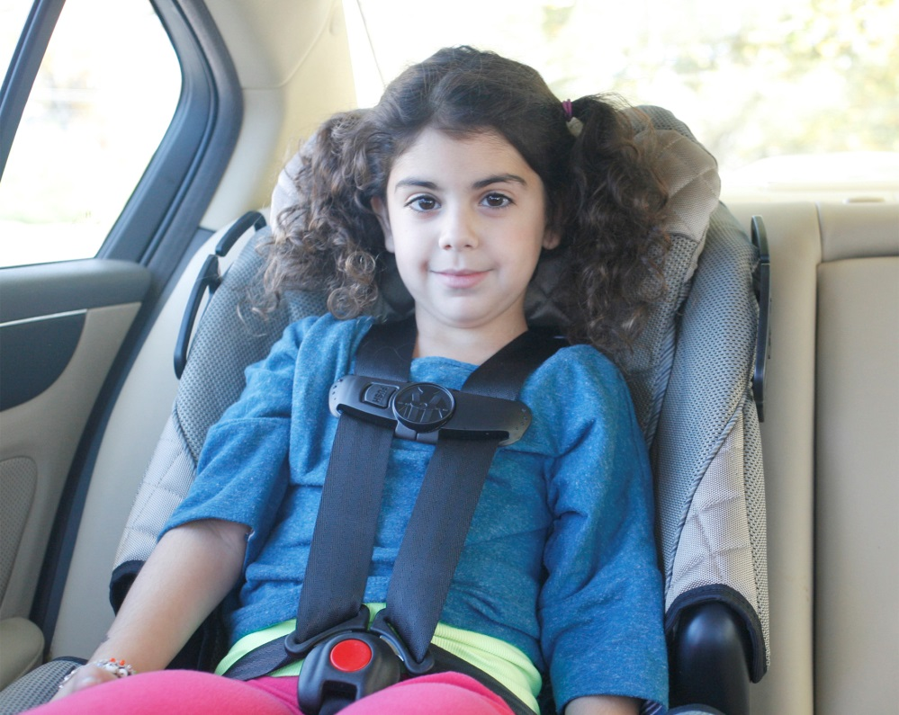
IS it installed according to the manufacturer’s instructions?
2. Harness
No!
YES
YES
Notes:
Are the harness straps snug? Do they look too loose? The harness clip should be at armpit level.

Slide 15
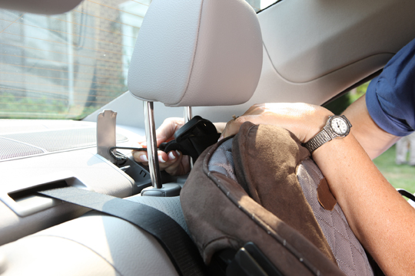
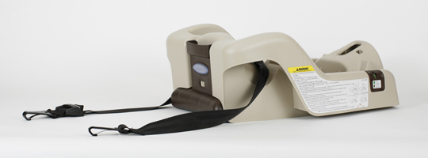
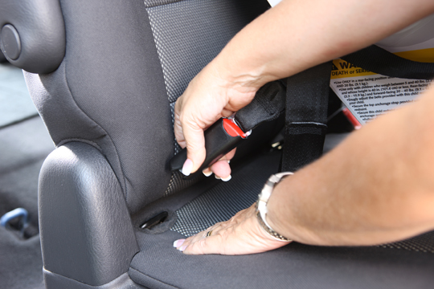
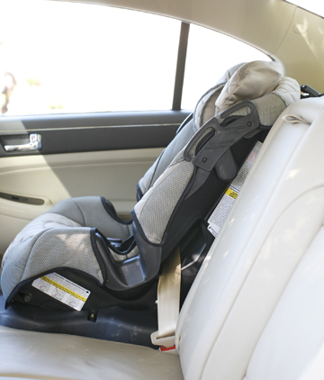
IS it installed according to the manufacturer’s instructions?
3. Attaching the seat to the vehicle
Notes:
Use either LATCH or seatbelt. Not both. Is the seat belt locked? The seat cannot move more than 1” side to side for a correct installation.

Slide 16
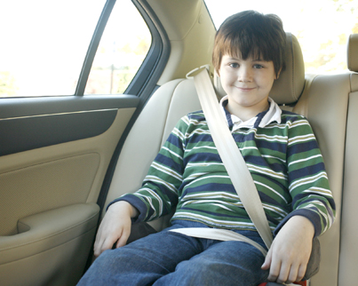
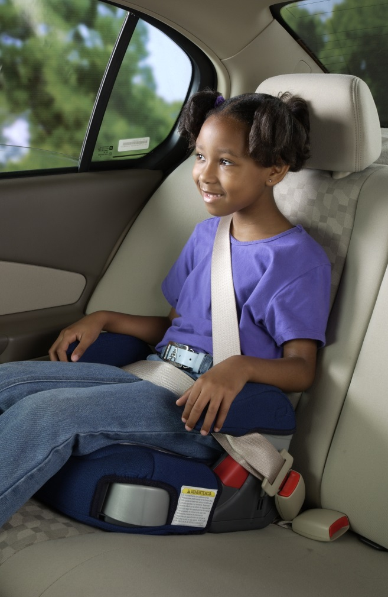
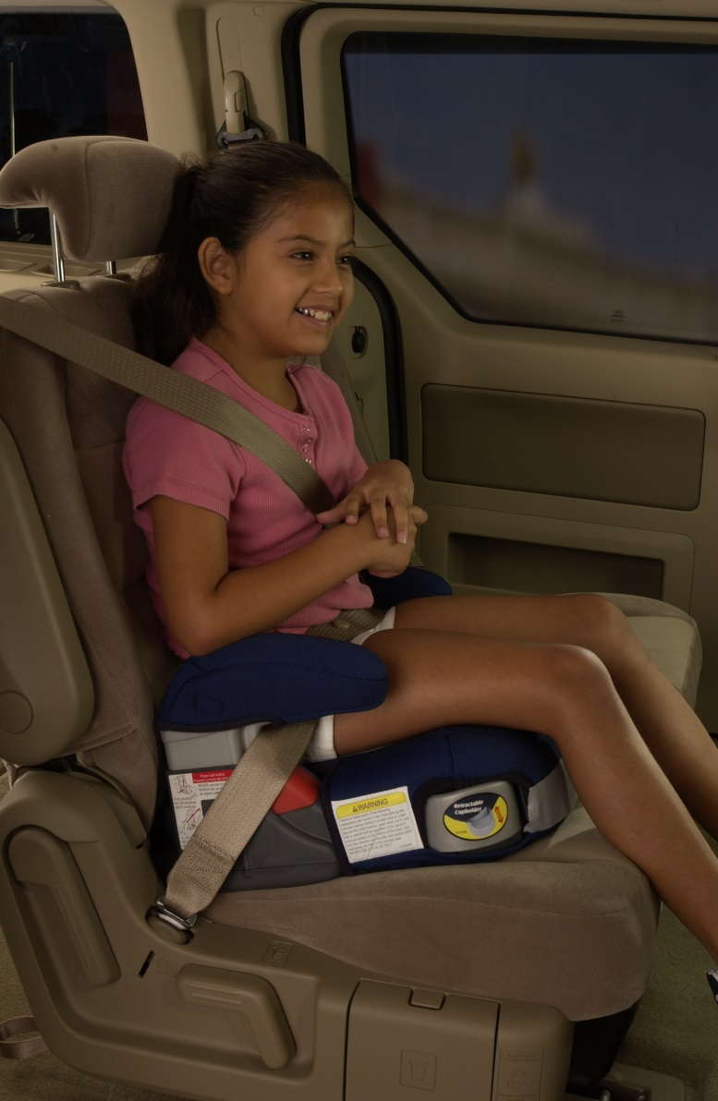
IS it installed according to the manufacturer’s instructions?
4. Booster Seat
Notes:
Cannot put seatbelt behind back. Must be used correctly with both lap and shoulder belt. Never lap-only.
Pay attention to placement of lap belt, is it touching the thighs and NOT in the abdomen!

Slide 17
What Do You THINK?
The Seat Looks unusual:
Look for the FMVSS label.
    All child restraint systems certified to FMVSS standards (as required by law) must have an FMVSS label attached to the seat.
The Child looks uncomfortable in the seat:
If the seat looks too big or too small make sure the child fits the height/weight requirements as listed on the seat labels.
Refer to a certified CPS technician for assistance with proper installation and education this could make all the difference in a crash!
Notes:
Special needs seats – car beds – vests

Slide 18
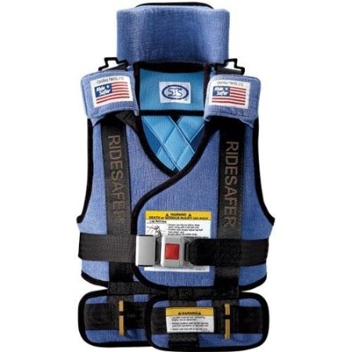
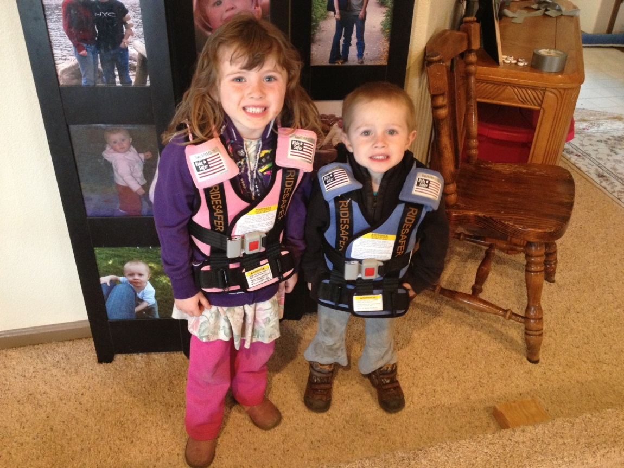
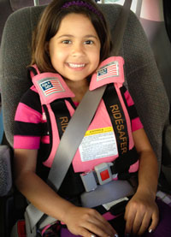
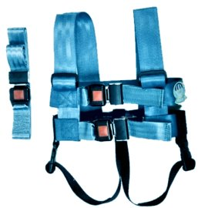
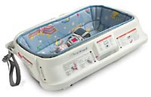
Not Your Typical Car Seat!
Notes:
Ridesafer vest meets FMVSS 213 car bed EZ on modified vest

Slide 19
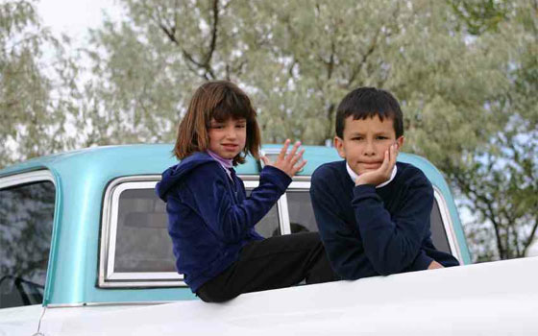
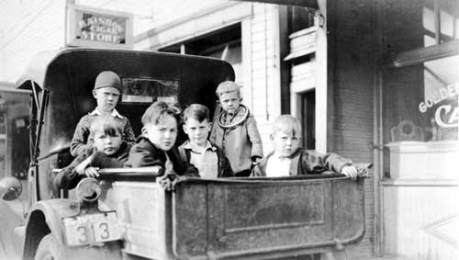

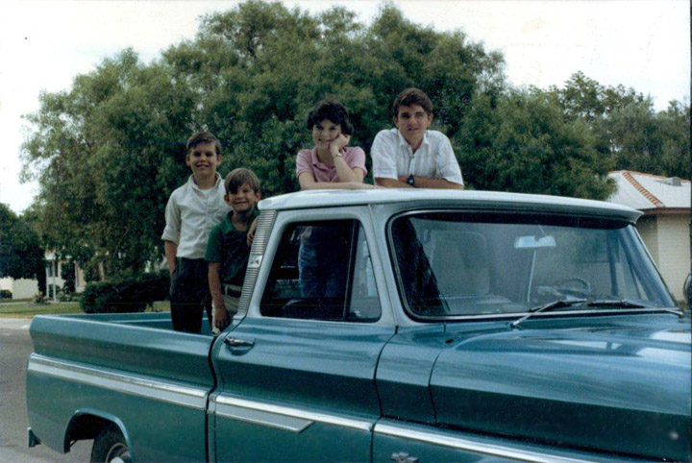
Kid’s aren’t cargo!
No Exemptions – All kids until their 16th Birthday are required to be in a seatbelt or car seat.

Slide 20
Ticket or warning?
It’s up to you!
If you decide to issue a warning
Please refer them to CPS Team Colorado (A network of over 1,000 certified Child Passenger Technicians across the state). www.CarSeatsColorado.com
Express the importance of the child’s safety, every child deserves the right to be transported safely!
If you decide to issue a ticket
You can still refer them to a local CPS Technician.
Be aware that state statute also says “the fine may be waived if the defendant presents the court with satisfactory evidence of proof of the acquisition, purchase, or rental of a child restraint system by the time of the court appearance.”

Slide 21
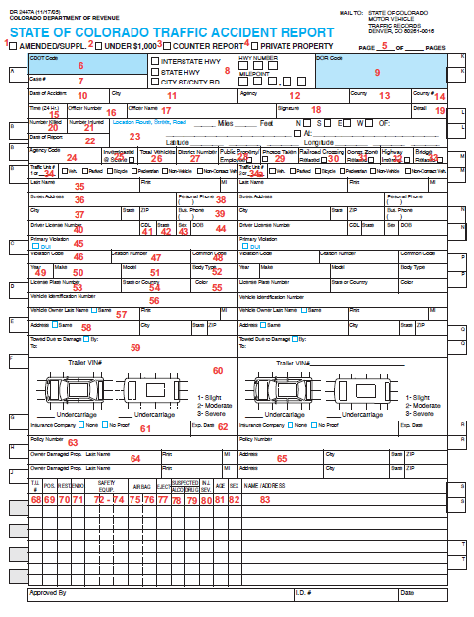
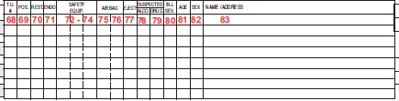
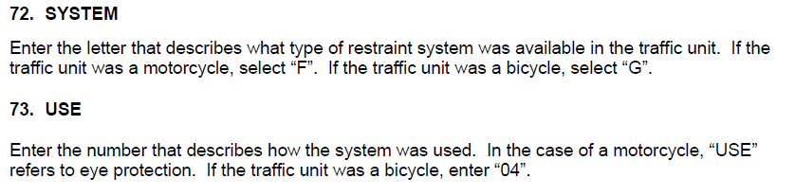
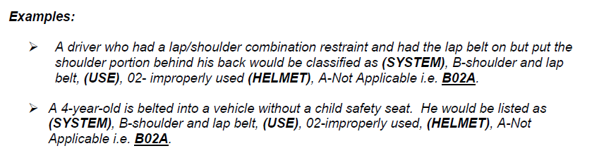
Crash reporting

Slide 22
In an emergency!
Notes:
Emergency ID stickers were designed for First Responders – If adults are unresponsive, who are these children?

Slide 23
CPS In your patrol vehicle
-Ever had to transport someone to a safe location?
Most police vehicles provide challenges that make it unsafe to transport children in police vehicles because:
  Excursion limits in vehicles with screens or cages.
  Hard plastic seats don’t allow use.
  Non-factory anchor points.
  Additional equipment such as data terminals, long guns and other fastened or loose equipment make using the front seat unsafe as well.
Agencies often need to look at alternative forms of transportation, such as unmarked vehicles that are free of police hardware, or other agencies such as social services for transportation of children.

Slide 24
Enforcement and Education
TIPS:
What do I see?
    Children in the car… Are they correctly installed? Facing the right direction? Is the car seat attached to the vehicle? Major issues? Minor Issues?
What does that mean?
    Incorrect use means the child is not safe.
What should I do?
    Warning/ticket. Education or referral, depending on your knowledge.
Why is this important?
    The goal of traffic enforcement is to improve compliance. We can accomplish this is education and/or enforcement at the same time.

Slide 25
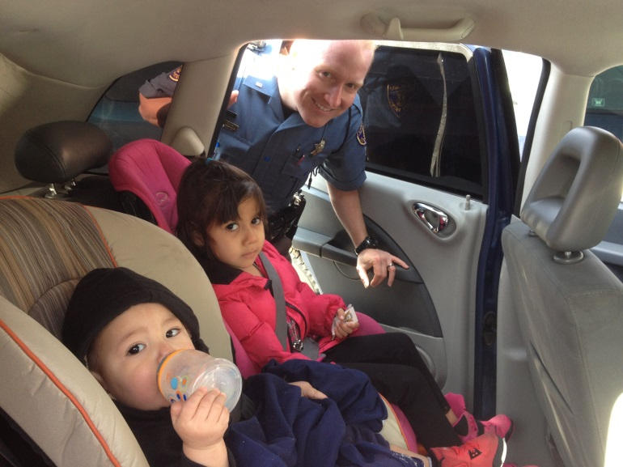
ENFORCEMENT WORKS
-CPS Team Colorado provides education and support to parents and caregivers across Colorado.
-The National Highway Traffic Safety Administration outlines in its prevention strategy that Proper and Continued Enforcement of CPS Laws works to decrease injury rates and increase seatbelt use!
Questions?
email@email.com
Phone: (123) 345-6789

