Slide 1
Child Passenger Safety for New and Expecting Parents

Slide 2
Objectives
Understand Colorado’s child passenger safety law and “best practice recommendations.”
How to choose the appropriate restraint system
How to use the restraint system correctly
Learn about traveling in other vehicles

Slide 3
Statistics
Three out of four parents think their child is in the right car seat, but they are not.
Child safety seats reduce the risk of fatal injury by 71% for infants and by 54% for toddlers in passenger cars. (Source: NHTSA, 2010 data).
Placing children in age- and size-appropriate car seats reduces serious and fatal injuries by more than half.
Notes:
In 2010 there were 291 passenger vehicle occupant fatalities among children age 4 and younger. Of those, 77 (28%) were totally unrestrained.
Over the period 1975 – 2010, an estimated 9,611 lives were saved by child restraints for children under the age of 5 in passenger vehicles.

Slide 4
Learning The LAW

Slide 5
Notes:
Emphasize that the law is a MINIMUM standard. It is not necessarily what is best for your child, it is just what legislators could get passed.
The fine is $82/child for not restraining children properly. This is a primary offense.
All 50 States and the District of Columbia have primary child restraint laws - if you are travelling to another state you should Google the CPS law(s) for the state(s) you will be travelling through/to.

Slide 6
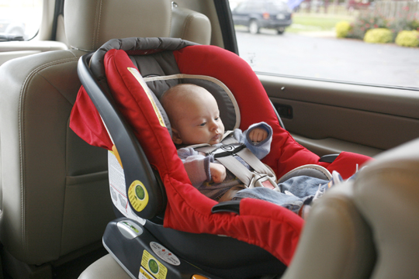
Colorado’s Child Passenger Safety Law
Birth to age one.
Less than 20 pounds.
Properly restrained in a rear facing child restraint system in the back seat.
Notes:
Explain the difference between the law and best practice. The best practice is to keep your child RF until the uppermost weight limit of the CR or 2 years old.
Photos are from the NHTSA image library.

Slide 7
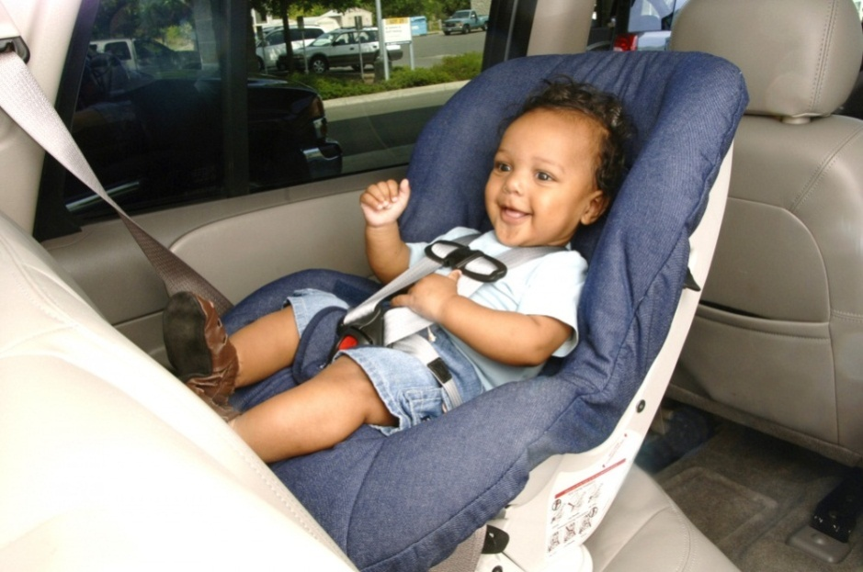
American Academy of Pediatrics Recommends:
Keep all children in an appropriate rear facing Child Safety Seat until the uppermost weight limit of the child safety seat.
*Rear-facing is 5 times safer than forward-facing*
Notes:
AAP recommends at least 2 years old or the upper weight limit of the car seat. You have to read the labels and/or owner’s manual to know what the limits are for your specific seat.
Here’s a good website with Q and A about rear facing for older children.
http://www.parenting.com/article/rear-facing-car-seat-guidelines?page=0,0
Study Confirms: Rear Facing is Best for Children up to Age 2
“Children are five times safer riding rear facing than forward facing into the second year of life.” Dr. Marilyn Bull and Dr. Dennis Durbin
There is new, unequivocal, real-world evidence that children under age 2 are best protected riding in a rear-facing (RF) car seat (CR). Injuries to rear- and forward-facing children under age 2 were studied in crashes from 1998 to 2003. Rear-facing CRs were given an effectiveness rating of 93 percent, while forward-facing (FF) CRs were rated at only 78 percent, 15 points lower. This appears to confirm Swedish research that has shown the benefits of the RF position over many years.
An unexpected finding was the degree to which the RF position benefited children. The study looked at various vehicle types, crash types, and where the child was seated in the vehicle. While the most basic benefit in terms of how the body moves in a crash occurs in a frontal crash, there was considerable benefit found in side impacts. The researchers suggest that this may be because most side impacts also involve some frontal-impact forces. The researchers described the benefit to the RF child in a side-impact as a “cocoon” effect, because the frontal forces hold the child’s head confined in the headrest area and the side-wings of the CR shell, despite the sideward forces. For a FF child, the frontal forces thrust the child’s head out of the area where side-wings would be of any use to resist the sideward forces.
The benefit of the RF position was also found when the different ages (0–12 and 13–24 months) were each looked at separately. Thus RF CRs for children from 13 to 24 months continued to have a marked benefit despite the children’s physical development beyond the more fragile infant stage.
Photo from NHTSA Library.

Slide 8
SELECTING THE RIGHT SEAT

Slide 9
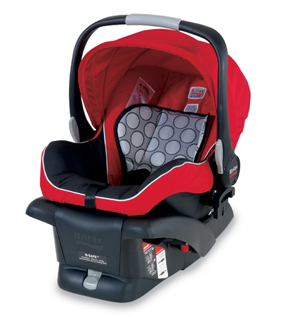
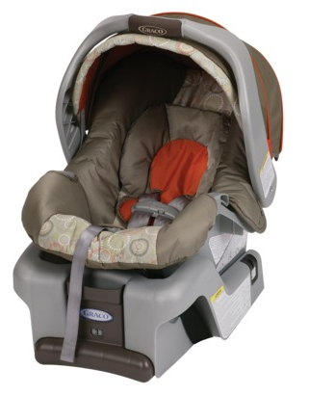
Infant Car Seats
From birth (or 4-5 lbs) up to 17-40+pounds
Very small infants need seats that fit their weight
Premature infants may have special transportation needs (check with health care provider)
Infant seats use a base that stays in the vehicle
Most infant seats can be installed without the base
19
Notes:
You have to read the labels on car seats to know the actual limitations. Weights described here are approximate. AAP recommends that children stay in a RF seat until at least 2 years old or the upper weight limit of the seat.
Study Confirms: Rear Facing is Best for Children up to Age 2
“Children are five times safer riding rear facing than forward facing into the second year of life.” Dr. Marilyn Bull and Dr. Dennis Durbin
There is new, unequivocal, real-world evidence that children under age 2 are best protected riding in a rear-facing (RF) car seat (CR). Injuries to rear- and forward-facing children under age 2 were studied in crashes from 1998 to 2003. Rear-facing CRs were given an effectiveness rating of 93 percent, while forward-facing (FF) CRs were rated at only 78 percent, 15 points lower. This appears to confirm Swedish research that has shown the benefits of the RF position over many years.
An unexpected finding was the degree to which the RF position benefited children. The study looked at various vehicle types, crash types, and where the child was seated in the vehicle. While the most basic benefit in terms of how the body moves in a crash occurs in a frontal crash, there was considerable benefit found in side impacts. The researchers suggest that this may be because most side impacts also involve some frontal-impact forces. The researchers described the benefit to the RF child in a side-impact as a “cocoon” effect, because the frontal forces hold the child’s head confined in the headrest area and the side-wings of the CR shell, despite the sideward forces. For a FF child, the frontal forces thrust the child’s head out of the area where side-wings would be of any use to resist the sideward forces.
The benefit of the RF position was also found when the different ages (0–12 and 13–24 months) were each looked at separately. Thus RF CRs for children from 13 to 24 months continued to have a marked benefit despite the children’s physical development beyond the more fragile infant stage.

Slide 10
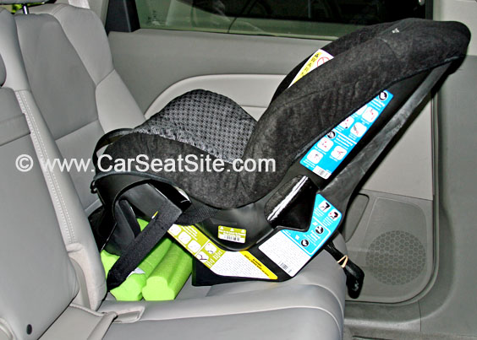
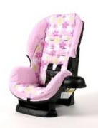
Convertible Car Seats
Usually have a higher maximum weight (up to 40+ lbs)
Rear-facing must be in the reclined position
Change to forward-facing when child exceeds the rear-facing height and weight limits of the car seat
Converts from rear-facing to forward-facing
Notes:
Both car-seats are a Cosco Scenera seat. You have to read the labels on the car seat for height and weight limits.
Best practice is to keep children rear-facing until they reach the upper weight limits of the seat and minimum 2 years old.
RF seats need to be reclined – even if they are using the convertible seat.

Slide 11
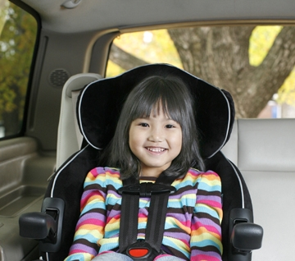
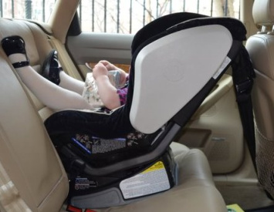
Convertible Car Seats
Forward Facing: when child exceeds the rear-facing height and weight limits of the car seat
Rear Facing: for children until at least 1 yr AND 20 pounds.
**The American Academy of Pediatrics advises rear-facing car seats until age two, or until they exceed the height or weight limit for the car seat.
Notes:
Weights are approximate – you have to read the labels on the seat to know what your particular seat is rated for.
It is ok for a child’s legs/feet to touch the vehicle seat, even on long trips. This does not hurt the child and there are no reports of significant injury from children having legs touching the vehicle seat.

Slide 12
Installing your Car Seat

Slide 13
Correct Installation
Read child cafety seat manual
Read vehicle owner’s manual
Choose a seating position
Seat Belts or LATCH (lower anchors & tethers for children)
Secure car seat so there is no more than 1” movement
Notes:
1” of movement with 15 pounds of force. A little bit of movement is ok – remember you can over-tighten carseats.

Slide 14
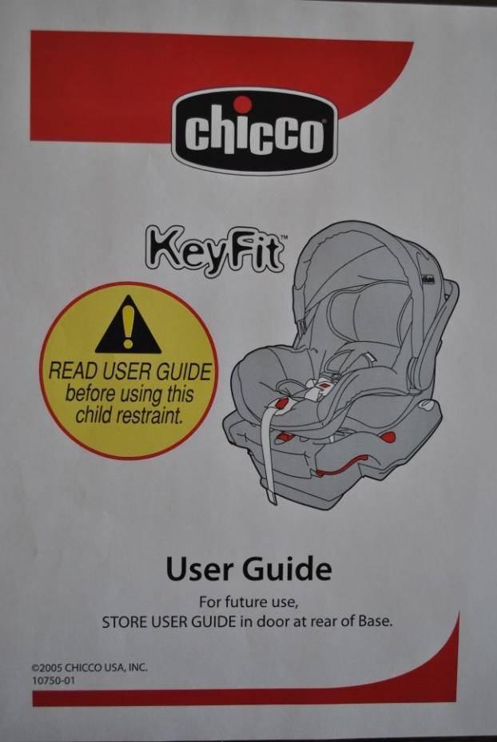
Owner’s Manuals
Vehicle Manual
Car Seat Manual
Notes:
Owner’s manuals can be confusing. Typically you will look for “child safety restraint” in the vehicle’s owner’s manual, seatbelt and LATCH instructions are generally in this section. Can also look up “seatbelts”
Go through the carseat owner’s manuals for pertinent info (eg. LATCH and seatbelt installations, harnessing instructions, carry handle positions, etc.)

Slide 15
Which is better…
the middle or outboard seats?
Notes:
The reality is that anywhere in the back seat is the best. Talk to the parents about different considerations: do they have other people (e.g. children) or pets who travel in the back seat. The carseat doesn’t always fit in the middle position – is there a hump (e.g. Subaru’s)? Is the driver really tall? If parallel parked, the passenger seat allows you to take the baby out on the side-walk side of the car – as opposed to into traffic. What works best in their garage…

Slide 16
Tightening The car seat:
Push and pull the seat to tighten
Seat should not move more than 1 inch
NHTSA Infant Seat w/seatbelt Installation: http://www.youtube.com/watch?feature=player_embedded&v=Bxy_Tf5VKTc
NHTSA Convertible Seat w/LATCH Installation: http://www.youtube.com/watch?feature=player_detailpage&v=LhgJ30Q9qjk
Graco Infant Seat Installation: http://youtu.be/a84BxdNpDgU
Chicco Infant Seat Installation: http://youtu.be/TfEjp9iNRqc
Notes:
Videos are approximately 2 minutes each. [Choose the one(s) that you like best.]
First two videos are courtesy of the National Highway Traffic Safety Administration (NHTSA). The best way to protect children on the road is to put them in the right seat for their age, weight, and height, and to use the seat correctly. Learn more at The Right Seat on NHTSA's child safety site, Parents Central.

Slide 17
LATCH
Lower anchors and tethers for children

Slide 18
Seat Belt or LATCH ?
(lower anchors and tethers for children)
Read vehicle instruction manual first!

Slide 19
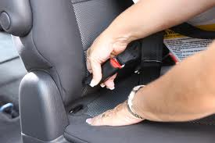
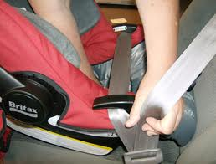
Seat Belt or LATCH ? (lower anchors & tethers for children)
Try both!
Which ever is easier for you to get a correct installation is the one you should use!
Notes:
With regard to safety, seat belts and LATCH are the same – both are tested to the same standards.
The one that is easiest for you to use correctly every time is the safest.

Slide 20
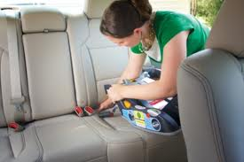
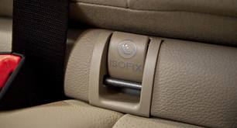
LATCH Summary
Lower anchors can be found in vehicles 2002 and newer in at least two rear seating positions
Attach only to LATCH
Notes:
There should be a symbol in the vehicle to indicate where the anchors are located.
Some lower anchors are buried in the seat byte and some are very obvious. Tethers can be located in the back dash of the window, on the roof of the car, or at the bottom/back of the vehicle seat. You have to check the owner’s manual for locations and proper belt routing. DO NOT ATTACH LATCH CONNECTORS TO CARGO CONNECTORS.

Slide 21
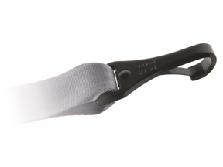
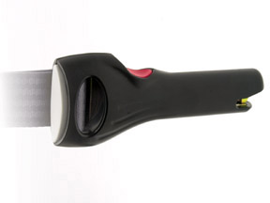
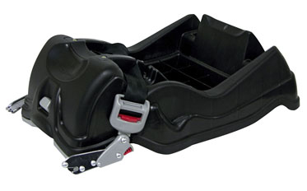
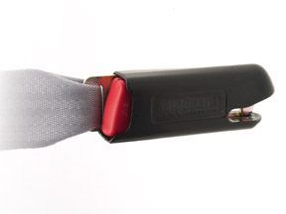
LATCH (lower anchors & tethers for children)
Connector Designs
There are different connector designs
Installation is similar
Install right side up
Notes:
Connectors have a right and wrong way to be installed - don’t install them upside down. Again, check the owner’s manual.

Slide 22
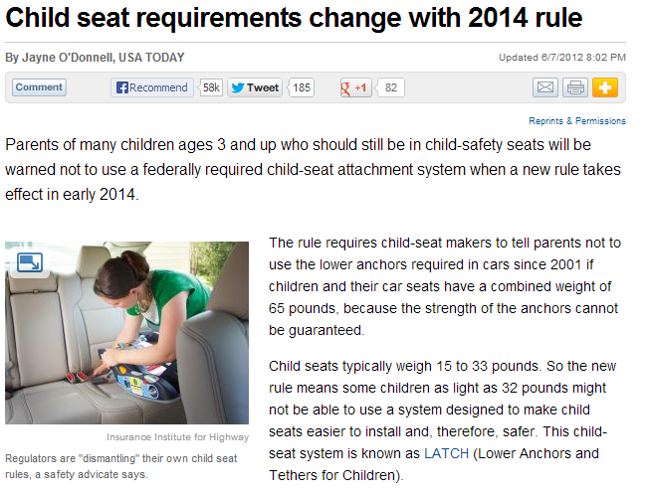
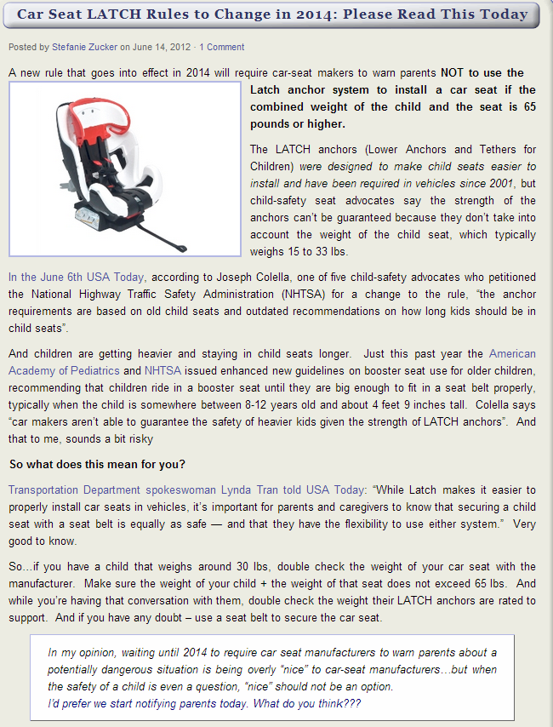
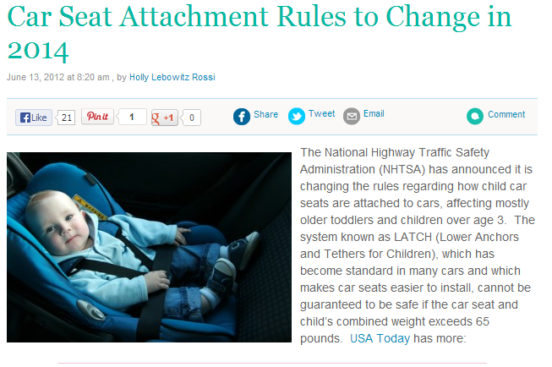
Notes:
Starting in 2014 new requirements must be met by car seat manufacturers advising parents that the Lower anchor system cannot be used if the weight of the car seat plus the weight of the child is 65 pounds or higher.
Always check your vehicle manual for Lower anchor information as well as your car seat manual.
This is a good rule of thumb to follow!
This does not apply to the upper tether. (See next slide)

Slide 23
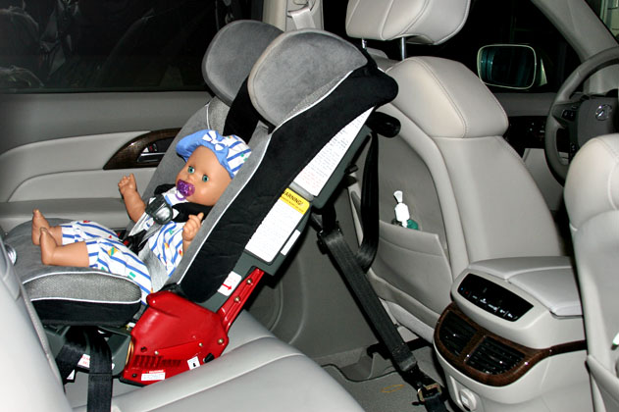
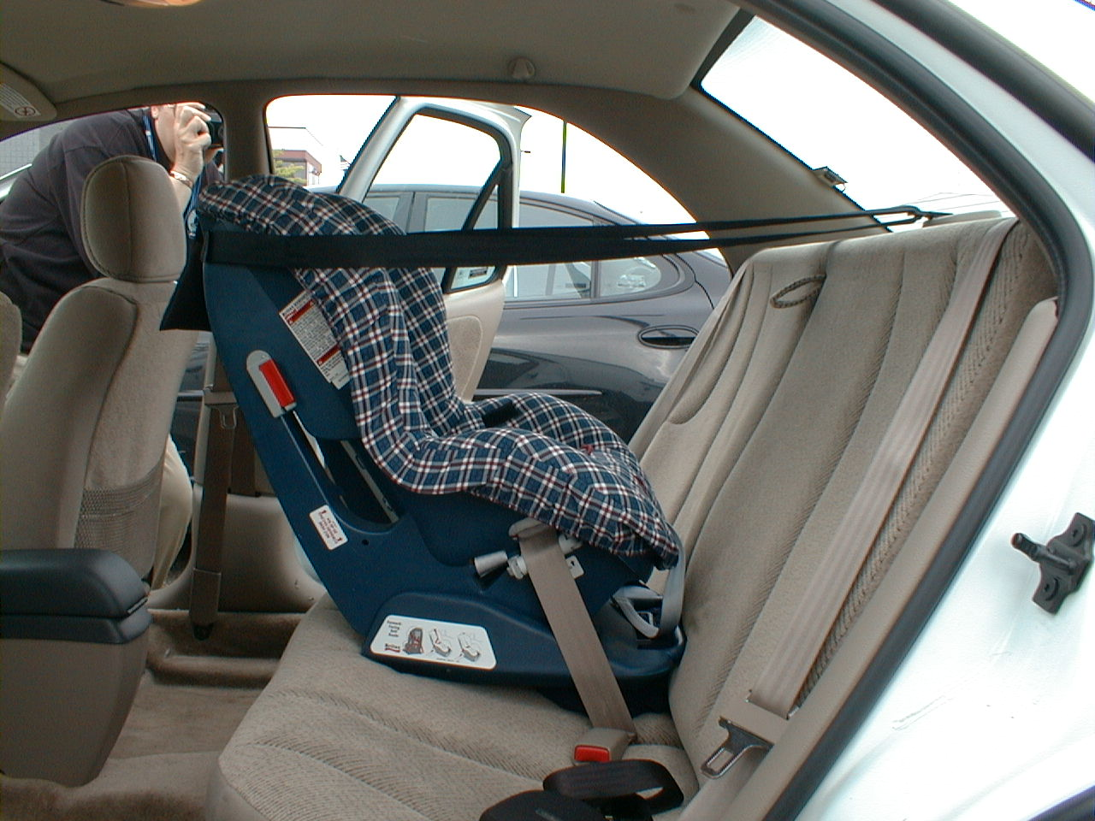
Rear-Facing Tethering
Some restraints provide a rear facing tether.
Read the Instructions!!!
Notes:
Britax, Clek, Combi, Diono (formerly Sunshine Kids), Snug Seat, and Triple Play all provide some models that can be tethered RF (Source: 2013 LATCH Manual Page 75).
Tethers offer rebound control. Australian Method or Swedish Method just different technology—one is not necessarily better than the other. (See 2013 LATCH Manual Page 69)
Tethers add additional stability in side impact and rollover crashes.

Slide 24
Getting the proper fit

Slide 25
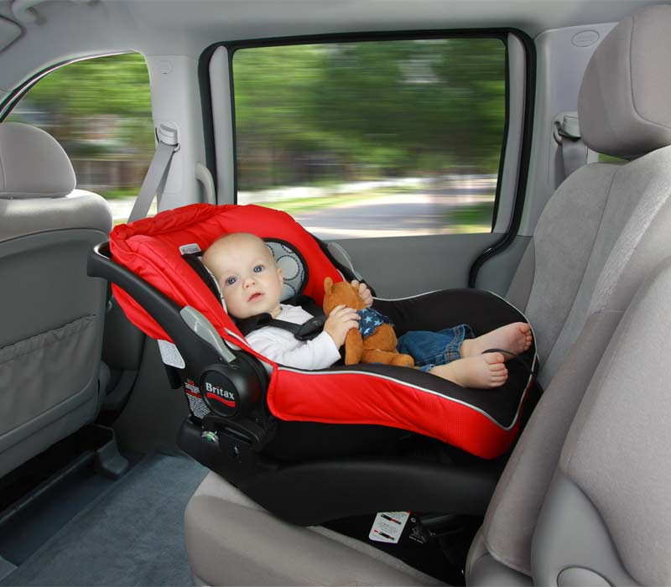
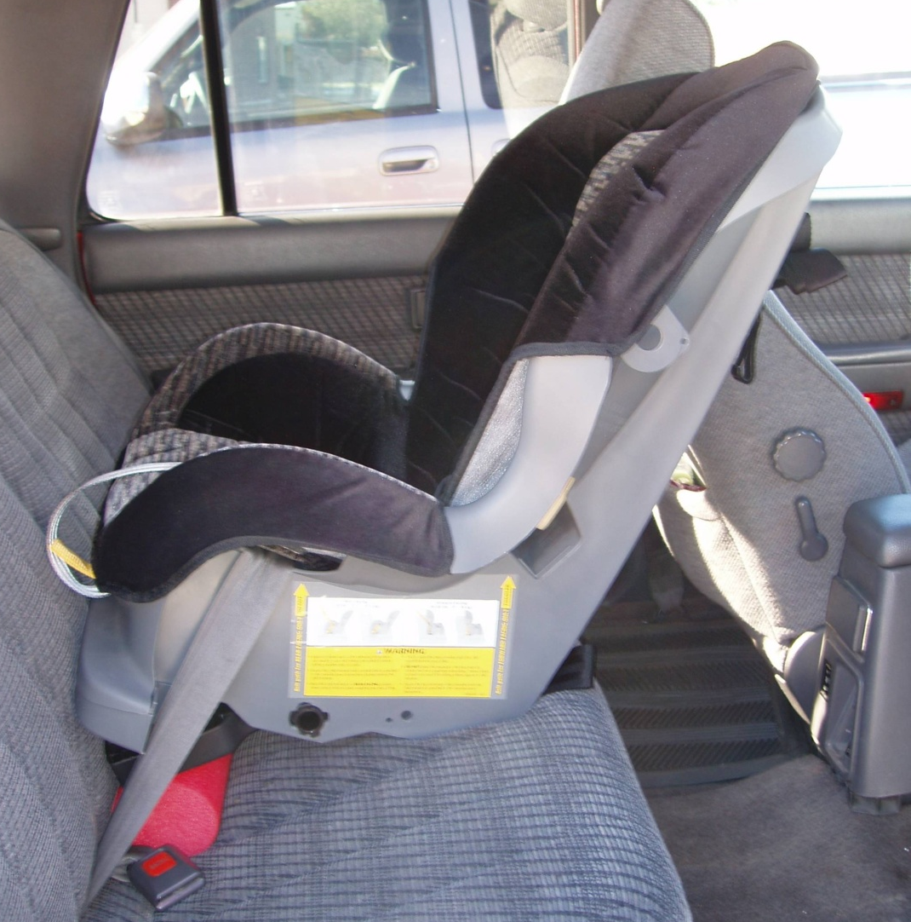
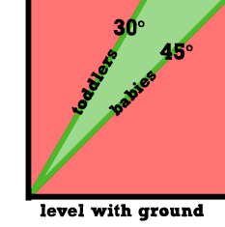
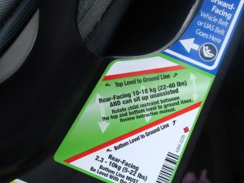
Recline angle is VERY important
Follow car seat recline angle instructions!
Notes:
Convertible seats usually have one or two lines that need to be parallel to the ground.
Why is recline important?
Not just baby’s head control and proper breathing but also positioning during a crash.
Also can discuss putting the seat in on a hill…. Parallel is parallel. You don’t have to adjust because you are on a hill.

Slide 26
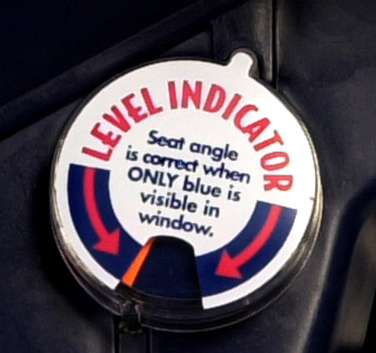
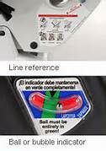
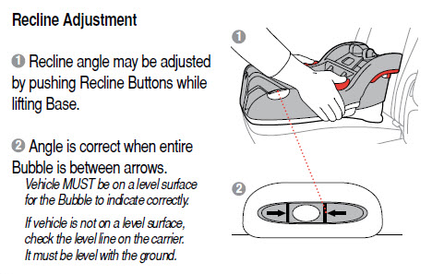
Recline Indicators
Notes:
Sometimes it is located on the carrier and sometimes it is on the base. Does the ball or bubble have to be centered? Check the owner’s manual.
Why is the recline is important? Baby’s heads are heavy and big compared to the rest of their body. If the car seat is too straight up and down, the baby’s head may fall forward (could cause airway problems). If the car seat is reclined too much, the car seat can over-rotate in a crash.

Slide 27
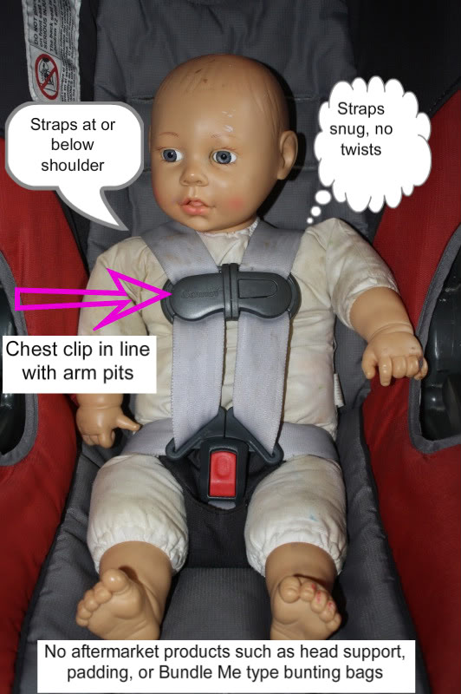
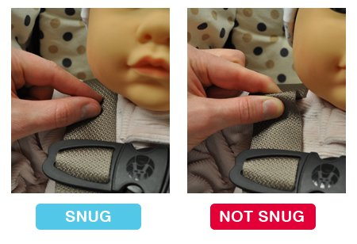
Harness Rules: Rear Facing
Get a good fit:
Use rolled receiving blanket(s) next to the baby’s head
Use rolled receiving blanket between baby and crotch strap
Use pinch test to determine if harness is tight enough
Pinch Test:
Notes:
On convertible seats, there may be specific slots that can be used for rear facing only and for forward facing only. Check the owner’s manual.

Slide 28
How to put baby in the car seat
The Car Seat Lady video clip:
http://youtu.be/MvzPZfba4ys
www.thecarseatlady.com
Notes:
OPTIONAL: this video is about 8 minutes. She does not mention that the baby’s shoulders need to be at or below the harness slots. She talks about the pinch test and using one finger to check the harness for tightness. Stress the pinch test – we do not teach the one finger rule anymore.

Slide 29
Rear Facing is best. Here’s why…
A true story about car seat safety
http://youtu.be/Q8gU9zzCGA8
Here’s another story (pictures, not video)
http://myangelsaliandpeanut.tripod.com/id5.html
Notes:
OPTIONAL - this video is 6 minutes. Could be scary for some parents – not everyone will be able to handle it.
The second weblink is to a successful story (in pictures, not video). There are no pictures of injured children.

Slide 30
Air Bags are bad for babies

Slide 31
NEVER place a Rear Facing Child Seat in front of an airbag.
http://www.youtube.com/watch?feature=player_detailpage&v=CY6WuGg-Fhc
Notes:
NEVER EVER PLACE A RF SEAT IN FRONT OF AN AIRBAG BECAUSE: The airbag is moving at 200-300 mph.
Baby cannot sustain that much force.
Insurance Institute of Highway Safety Video (12 seconds) May want to show more than once.

Slide 32
More Tips

Slide 33
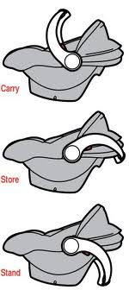
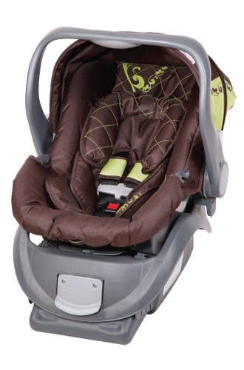
Carry Handle position
Check the car seat manual for instructions!
Notes:
There is no general rule of thumb anymore. Always check the owner’s manual. Some carseats require the handle to be down, some require it to be up for rebound control, some require it to be in any locked position, and some have specific locked positions that it can be in.

Slide 34
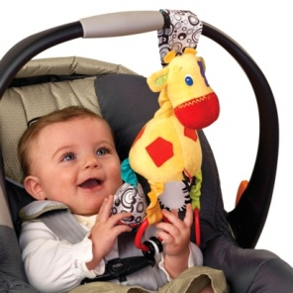
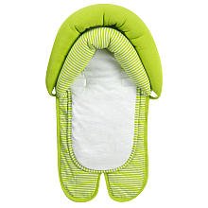
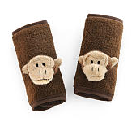
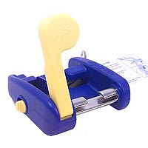
Know your car seat
Car seats have expiration date.
Second hand car seats are risky.
Car seats are not cribs – they are for travel only!
Only use products that come with the car seat.
Notes:
Car seats have expirations – if there is no expiration date on the seat, contact the manufacturer to find out how long it is safe to use.
Second hand seats: you must have the instructions and labels, check for recalls, check expiration date and date of manufacture (6 years max for most seats), is there visible damage or missing parts, what is the crash history, do you trust the person you got it from...
IF YOU DON’T KNOW THE HISTORY, DON’T USE IT!
Best Practice: if it comes with the carseat, then it is ok to use it. There are no federal standards for these products. Carefully read all manuals and instructions, including vehicle and child restraint instructions. Many warn against using “extras” with their products. Parents make the final decision regarding use of these products.

Slide 35
Common Mistakes

Slide 36
Common Mistakes
Seat is not tightly installed
Improper use of LATCH and/or seatbelt
Child is not tightly harnessed
Rear-facing car seat in front of airbag
Incorrect angle
Handle is not in correct position for driving
Harness retainer clip too low or not buckled
Second-hand seat with:
*No crash history *Signs of stress
*Recalled or too old *Missing parts & labels

Slide 37
Other Transportation
Planes, Buses, and Vans…. Oh My!

Slide 38
Other Transportation
Airplane Travel Car seat must have a label stating it is certified for aircraft use http://www.faa.gov/passengers/ﬂy_children
Taxi Cabs: Exempted from car seat laws by PUC Best Practice Recommendation: Restrain children as in passenger vehicles
Public Transportation Buses: Not equipped with seat belts
Motorcycles: Very unsafe for children!
Notes:
Advise parents to contact the airline directly to find out their rules and regulations.

Slide 39
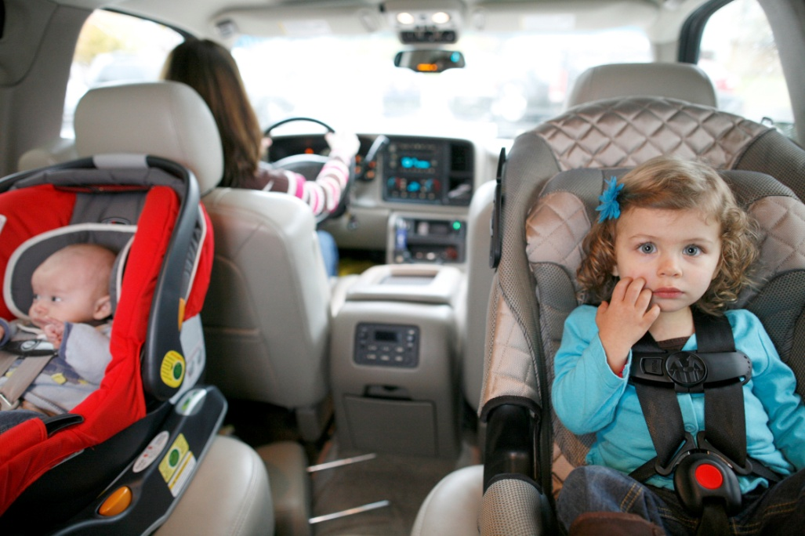
Other Transportation:
Day Care
Make it YOUR responsibility to assure that appropriate restraints are used correctly.
Car seats are required in 15 passenger vans.
Notes:
15 passenger vans are NOT exempt from the law for using car seats.
Licensed Day Care facilities are charged with making sure every child is in a proper restraint system. They may or may not know this regulation!

Slide 40
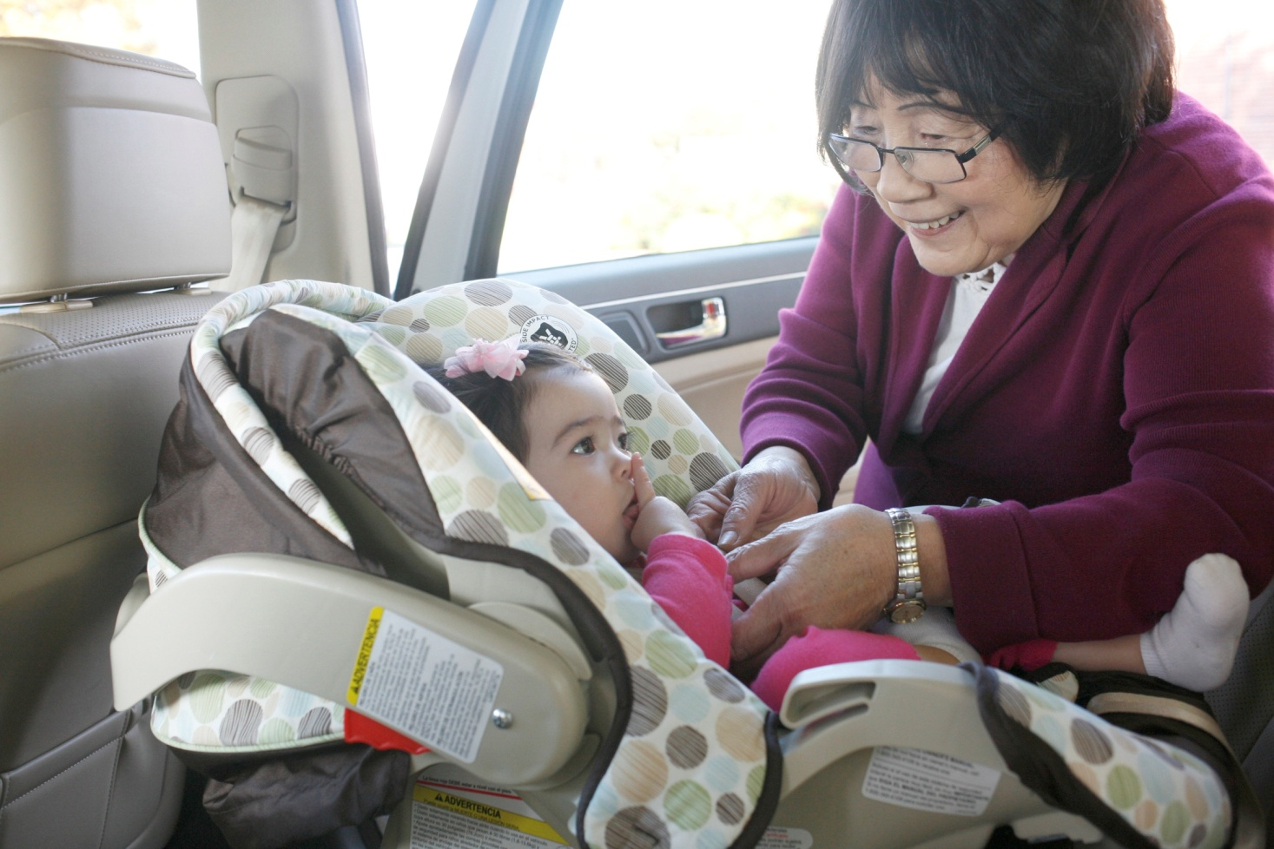
Traveling in Other Vehicles
Grandparents and other caregivers:
Educate family members
Buy more than one base
Ensure the right car seat and fit for EVERY ride
Notes:
Grand parents can come to fit stations too.

Slide 41
LAST QUICK REVIEW
Video Review:
http://www.youtube.com/watch?v=87wknW5t2Zk

Slide 42
Questions

Slide 43
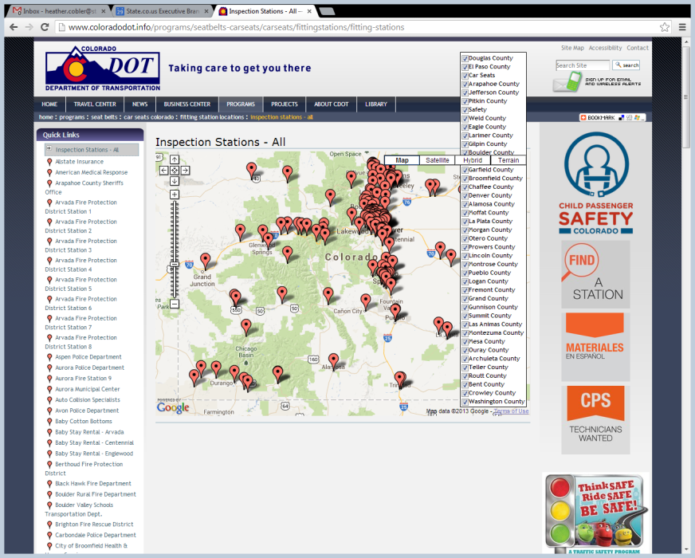
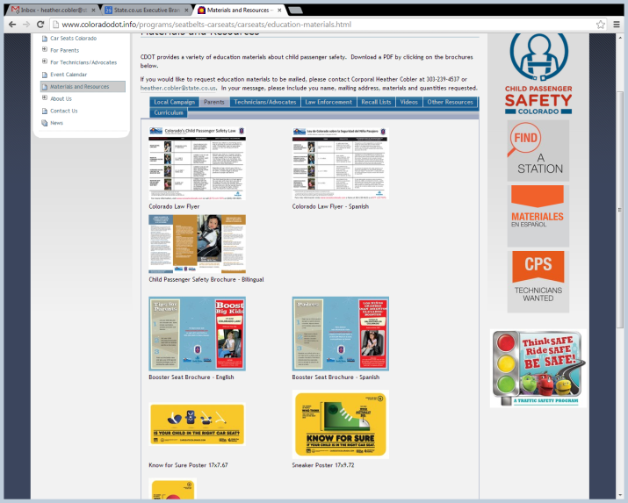
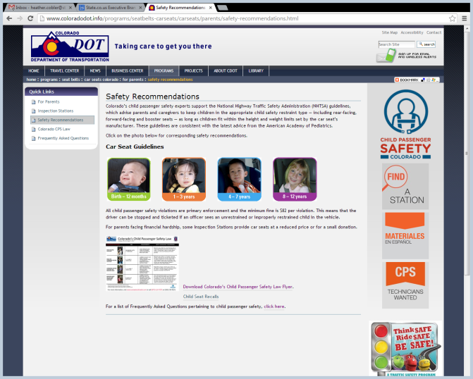
Colorado Child Passenger Safety Team Colorado
1,000+ certified technicians
150+ inspection stations
Hundreds of local partners
Great resources are available for you!
www.carseatscolorado.com

