Slide 1
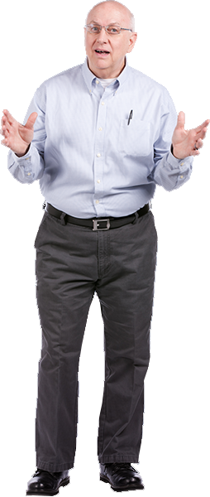
Thank you for helping us identify the best solutions for I-270!
We need to have safe places for people to walk along the streets that cross under I-270 and we need to improve the appearance of the corridor.
Traffic is usually so backed up on I-270, I use back roads whenever possible to avoid getting onto the interstate.
What can be done to separate truck traffic from passenger vehicle traffic?
Vasquez Boulevard interchange is really dangerous because of the weaving movements resulting from the loop ramps onto I-270.
Are you going to put Express Lanes or HOV lanes on I-270?

Slide 2
Summary of Outreach Efforts
Established project website, hotline, and email
More than 20 agencies and organizations participated in project meetings and interviews
Mailed meeting notices to more than 7000 addresses
Brief you on discussions with Stakeholders and feedback
474 people participated in the virtual public event held August 17th through August 30th

Slide 3
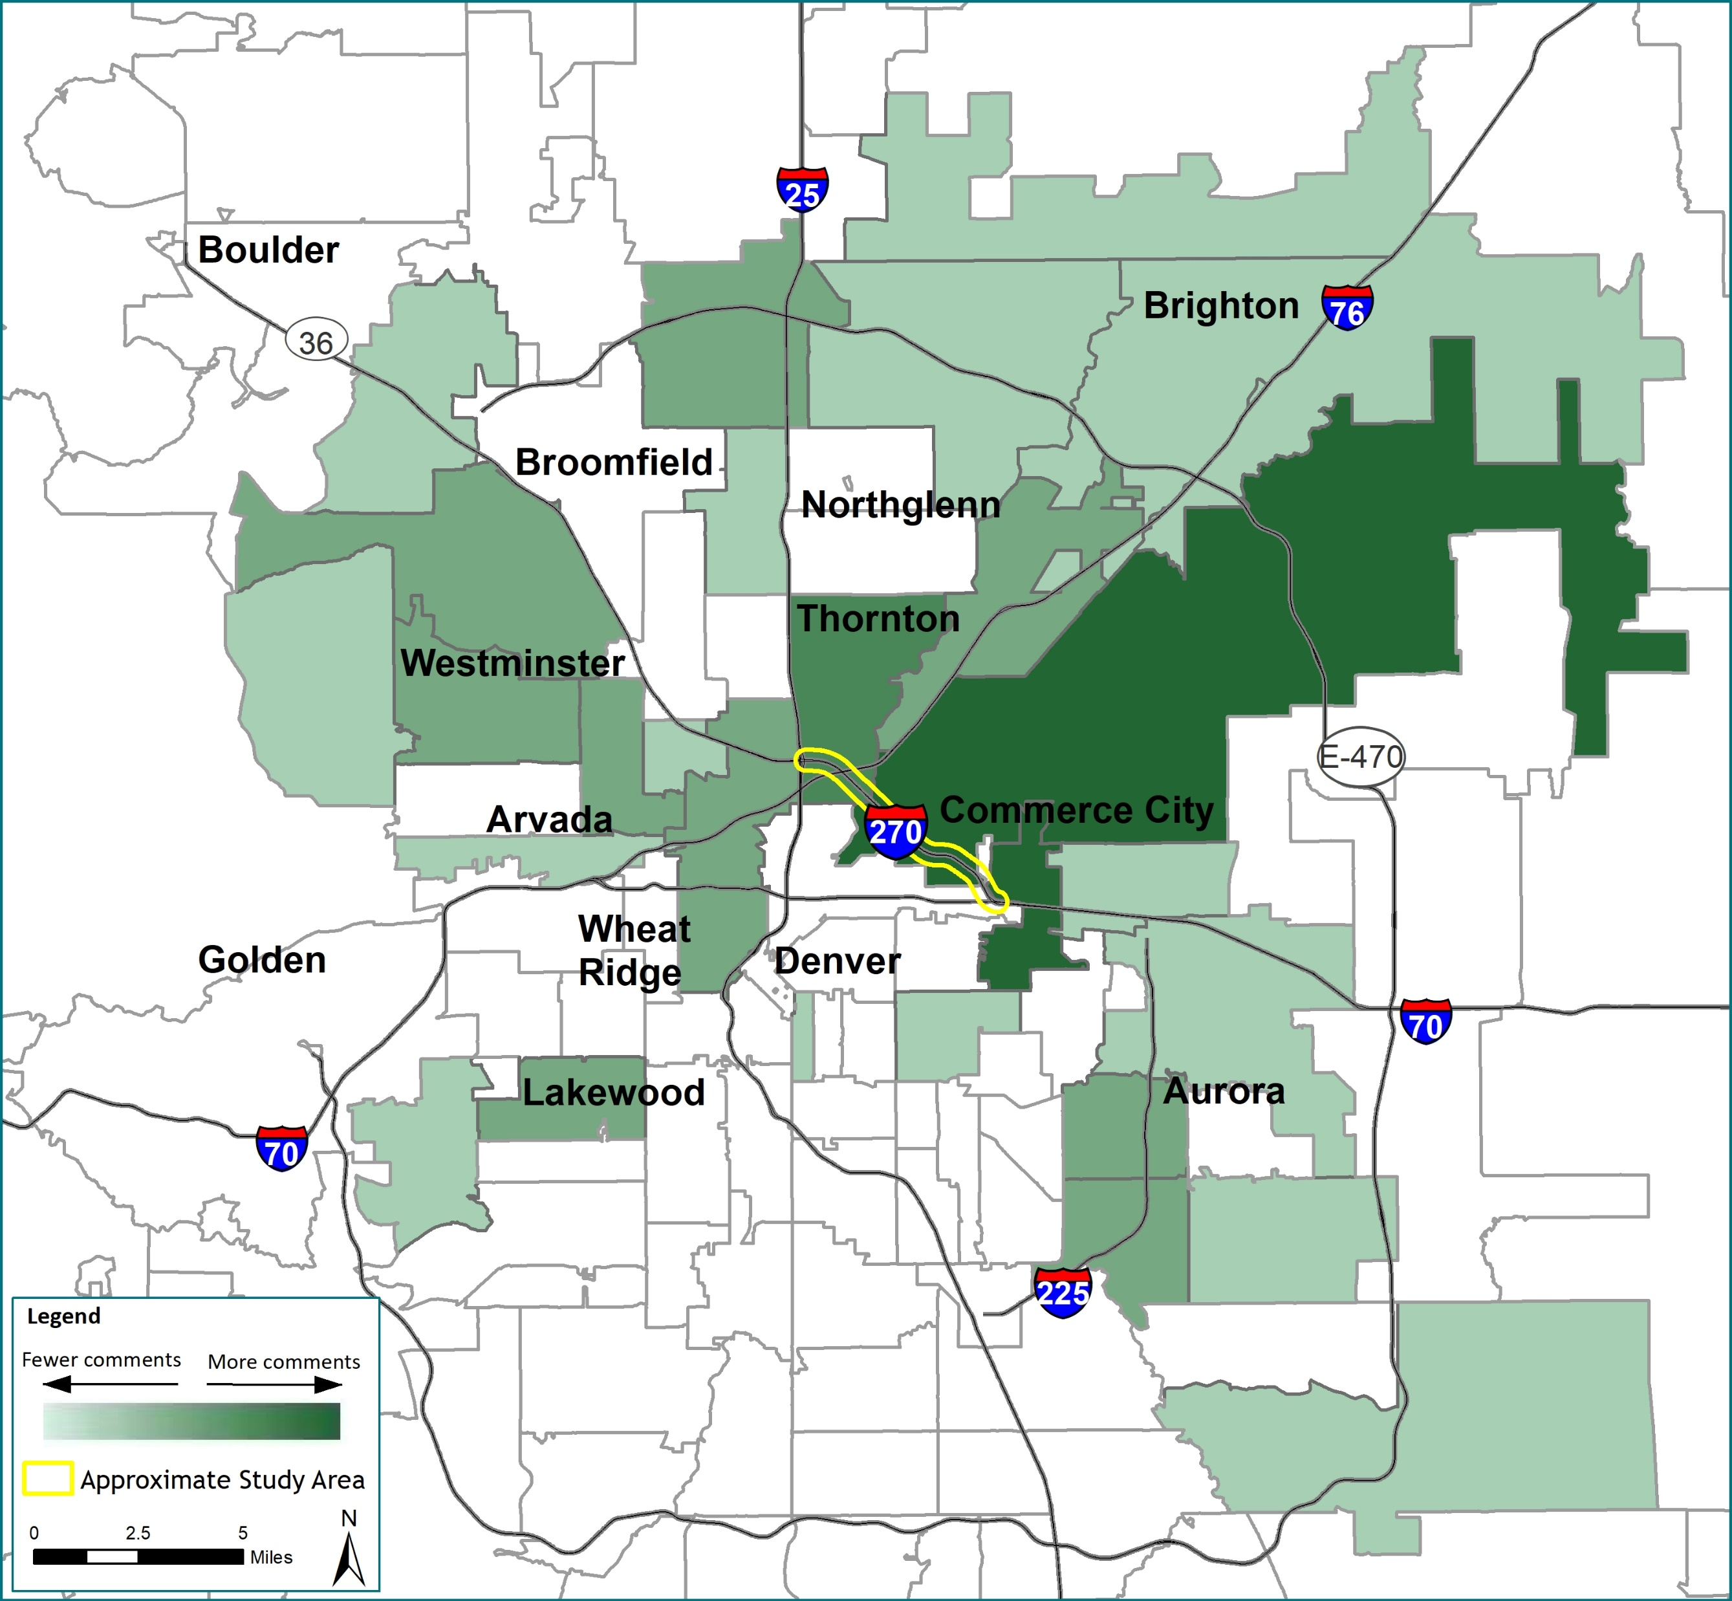
We received over 260 comments from agencies, organizations, and individuals across the metro area.

Slide 4
Distribution of Public Comments by Topic

Slide 5
CDOT is working with more than 20 agencies and organizations to understand and address corridor issues.

